Slide 1
BIG SING 2018 28-30 September
Come and sing with us under the direction of renowned choral conductor, Emma Dean.
Brolga Theatre
Maryborough

Slide 2
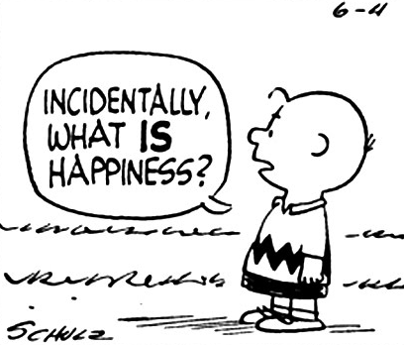
What’s Involved
The Program
Who can Attend
Cost
Musical Preparations
Catering for Individual Needs
Where to Stay
The Main Concert
ANCA Support

Slide 3
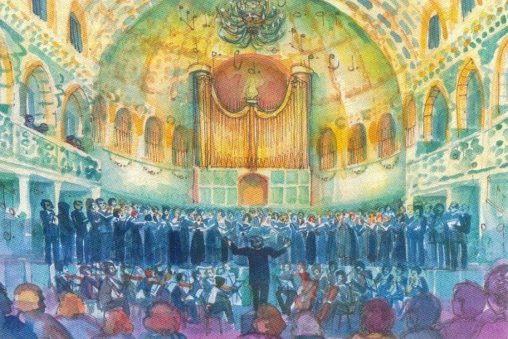
Program of Events
Friday | Registration, followed by an introductory workshop
Saturday | Workshops, followed by a combined evening dinner
Sunday | Workshops, followed by a public concert

Slide 4
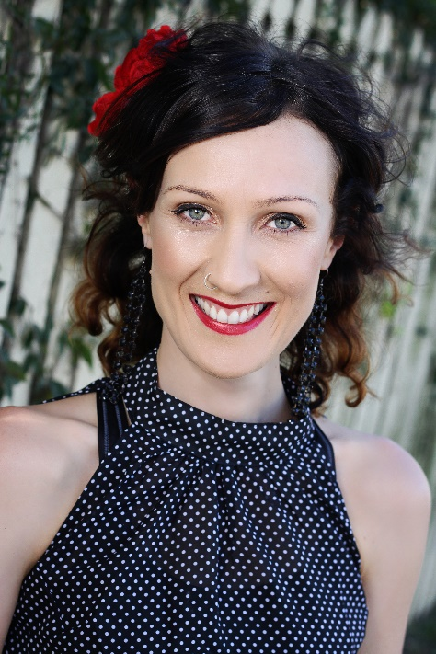
Meet the Conductor
Emma Dean is an imperfect, romantic and passionate human-being who loves to write theatrical pop songs about love and the human spirit. She has performed in North America, Germany, Costa Rica and all over Australia, and has released over ten independent original albums.
"....It's just right. Move over Rufus and Tori. You have company." - Noel Mengel, Courier Mail
When Emma is not on stage, she can be found writing choral arrangements for choirs and musicians, including John Farnham, Kate Ceberano and Katie Noonan. She is a passionate advocate of the magical healing qualities of group singing and proudly leads a colourful community choir called Cheep Trill who she considers to be her extended family.

Slide 5
Meet the Conductor
Emma has performed with Kate Miller-Heidke, Katie Noonan, Placebo, Macy Gray, Jinkx Monsoon, Amanda Palmer and The Dresden Dolls, as well as playing lead roles in theatre shows such as Cabaret and The Tempest. Her original show ‘Imaginarium’ was performed on Off-Broadway and she has been listed as ‘one of ten artists to watch’ by The New York Post after featuring on the US specialty radio charts alongside PJ Harvey and REM. She is also a recipient of the prestigious ‘Under Our Wing’ cabaret award alongside musical comedy superstars, Tim Minchin and Sammy J.
"....Just sample her monster Broadway single “Sincerely Fearful,” which is 50% “Wicked” and 50% Tori Amos and 100% addictive, and you will find an unavoidable sound worthy of the repeat button." – The New York Post
Emma’s new show, Broken Romantics: A Unicorn’s Quest For Love will be performed around Australia and in Edinburgh Fringe in 2018.
For more information go to Emma’s website - http://www.emmadean.com/index.htm

Slide 6
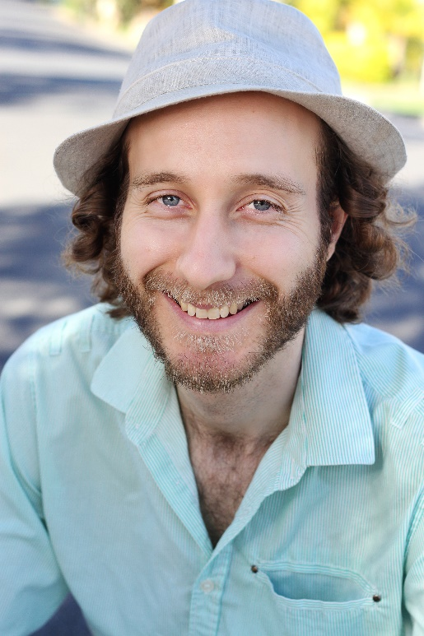
Meet the Accompanist
Tony Dean graduated from the Queensland Conservatorium of Music, with a Bachelor of Music specialising in jazz drums, in 2006. Since then, Tony has played drums in numerous bands, touring all over Australia and America. When Tony's not drumming he's also a multi-instrumentalist and vocalist. He has written and independently released his debut EP Whole Day, on which he played all instruments – guitar, piano, bass, drums and vocals. Currently Tony performs around Brisbane as an in-demand covers singer, solo singer songwriter, and as a jazz drummer and crooner. He's also the accompanist and assistant musical director of community choir Cheep Trill.
Visit www.tonydean.net to view his performing career and music.

Slide 7
Who Can Attend the Big Sing?
Choirs/choir members affiliated with ANCA
Choirs/choir members not affiliated with ANCA
Individuals not associated with a choir (18+)

Slide 8
How Do I Register?
1. PAPERWORK
Each participant will need to register individually or as part of a choir. These forms will be available from the Maryborough Choral Society at bigsing2018@gmail.com.
As well as providing general details, there will be opportunity to make note of special needs – e.g. dietary requirements etc.
Registration Closes: 8 July 2018

Slide 9
How Do I Register?
2. FINANCES
Participants must pay a non-refundable $50 deposit or the full registration fee by 8 July 2018 to secure a place for the event.
Saturday night dinner payments also need to be paid by this date. (These are non-refundable)
If a deposit is paid, the balance must be paid in full by 31 August 2018.
Please note: after 31 August 2018 payments are NOT refundable. Registration can however be transferred to another person.
Direct debit or cheque may be used to pay the deposit and/or the full registration fee. (Details will be included on the registration form.)

Slide 10
How Do I Register?
3. PAYMENT
Although the Maryborough Choral Society (MCS) is hosting the Big Sing, it is an ANCA run activity, therefore all monies for the Big Sing must be paid to ‘The Australian National Choral Association, Queensland Branch’.
Cheques are to be sent to the MCS and will be deposited into the ANCA account. Receipts will be available on request.
Direct debit funds will go directly into the ANCA account. Receipts will be available on request.
See the registration form for details on how to pay.

Slide 11
Costs involved
Workshops and Concert
$110 for choristers who are affiliated with ANCA
$120 for choristers who are not affiliated with ANCA
$35 for evening meal (to be paid with registration fees)
This Includes!
Set music pieces (to be sent to you prior to the workshop)
Workshop costs
Use of world class facilities at the Brolga Theatre
In-house catering for Friday night supper, lunches and breaks
Saturday night evening meal (optional)

Slide 12
How Can We Prepare?
The guest conductor, Emma Dean, will choose set pieces to rehearse and prepare for concert performance.
Set Pieces
Music will be sent out in sufficient time for choristers to practise the parts of the set pieces.
Most of the rehearsal time at the ‘Big Sing’ will be focused on refining skills and techniques towards presenting a great performance.
Own Choice
Each choir may also choose a piece that showcases their individual choir, and prepare it for performance in the main concert. More details will be given about this once registrations have closed.

Slide 13
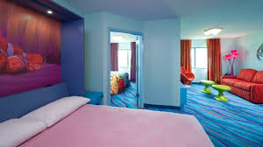
Accommodation
There are many motels, hotels, B&Bs and caravan parks in the Fraser Coast region. Staying in Maryborough will allow for quick and easy travel to the Brolga Theatre each day.
Note: There are at least two other large events in the Fraser Coast at the same time as the Big Sing.
Book early to ensure your reservations meet your needs.
TIP! You will get a better deals if you contact accommodation places directly.

Slide 14
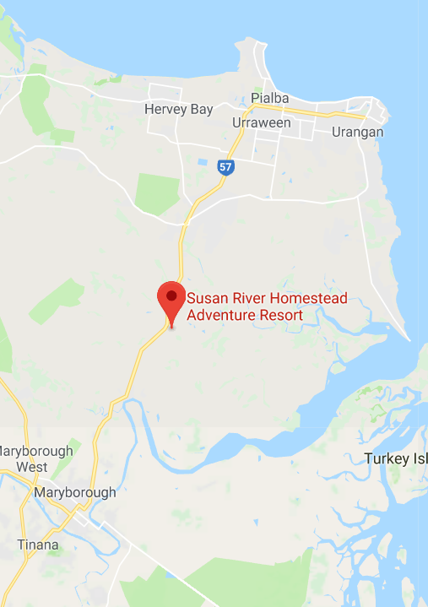
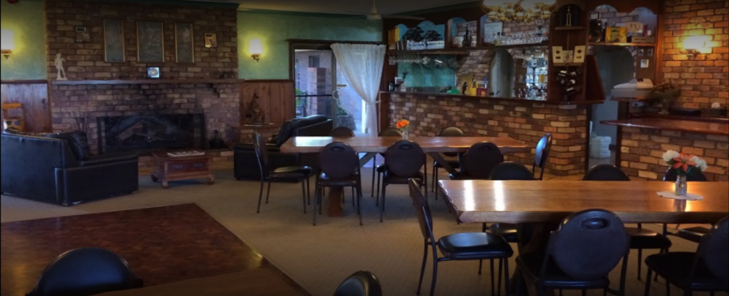
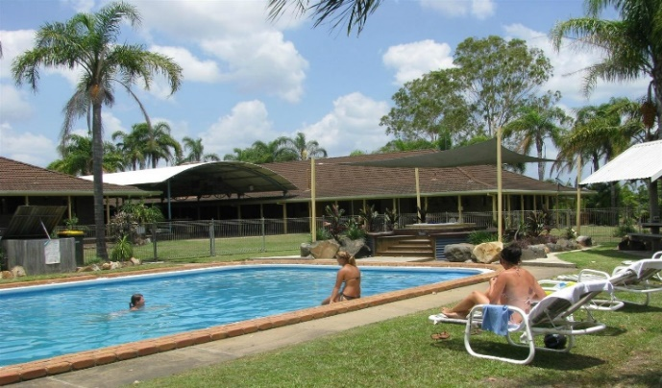
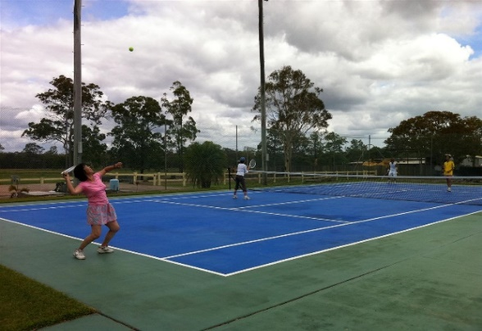
Saturday Evening Dinner
Susan River Homestead Adventure Resort is situated half way between Maryborough and Hervey Bay (15 minutes drive)
The dining area is rustic, yet elegant and provides a wonderful atmosphere to relax and enjoy the night.
This venue seats 120, so get in quickly to reserve your seat.
(If you’re looking for accommodation, Susan River Homestead provides a diverse range of modern, air-conditioned rooms. Camping sites are also available.)

Slide 15
Meeting Individual Needs
Disability Access
The Brolga Theatre is an easy access venue and is wheelchair friendly. The staff and volunteers provide professional assistance if required.
Dietary Requirements
The caterers for this event are versatile in their ability to tailor meals according to particular needs. Please make note of any dietary requirements on the registration form.
Needs (not specified above)
We will assist in any way possible to make your experience at the ‘Big Sing’ a great one.

Slide 16
The Main Concert
Ticket Prices
$10.00 - Student/Concession
$15.00 – Adult
These tickets can be purchased directly from the Brolga Theatre ticket office.
Parking
On-site parking
Where and When
Brolga Theatre, Maryborough
2pm Sunday, 30 Sept 2018

Slide 17
What Is ANCA? Australian National Choral Association
ANCA is the organising body that runs the Big Sing event.
ANCA is seen as a benchmark for development in quality and quantity of choral directors, choirs and choral literature.
The objectives of the association are to stimulate interest and participation in choral music and related activities, linking choral musicians throughout the country and nurturing growth of all choral activities.

Slide 18
What Can ANCA Do For Me?
To join … or not to join!
ANCA Membership
Cheaper member costs for workshops and other events
Workshops specifically for Choristers and conductors
Public Liability Cover for your choir
Print and online magazines and newsletters subscriptions
… All this and much more

Slide 19
CONTACTS
Maryborough Choral Society Inc.
Email: bigsing2018@gmail.com
f: bigsing2018@MaryboroughChoralSociety
Phone: 0427 223 297 (President – Lana Ballin)
0413 242 668 (Conductor – Linette van Huyssteen)
0429 495 963 (Big Sing Secretary – Heather Jones)
Postal Address: PO Box 1140,
Maryborough Qld 4650
Brolga Theatre
Address: 5 Walker St, Maryborough
Email: brolga@frasercoast.qld.gov.au
Website: http://www.ourfrasercoast.com.au/Brolga-Theatre/About
Phone: 07 4122 6060
Fraser Coast Regional Council
Website: http://www.frasercoast.qld.gov.au/
Fraser Coast Tourism
https://www.visitfrasercoast.com/
There are limited places, so secure your place in this exciting event soon.
Gather your choir and prepare yourselves for a great weekend of singing!…

Slide 20
Looking forward to seeing you there!

