Slide 1

Microsoft
Maintaining Health
Speaker

Slide 2
Objectives and Takeaways
Objectives
  Walk through the Art & Science of CQM
  Demonstrate the value via real-world examples
Takeaways:
  Understand what the KHI & CQM frameworks provide
  Understand how to use it with your customers
Notes:
We talked a lot about architecture, how to setup and implement Skype for Business for your customers.
Once you‘re past this we want to make sure that your customers continue to have a excellent experience with the solution. We know that it typically is not Skype for Business that degrades your customers experience, it is the underlying infrastructure, components, network connections or user behaviour.
But end customers don’t care what may cause an issue, they do expect a world-class communication experience. This session will walk you through proven concepts to deliver this experience.

Slide 3
Questions?

Slide 4
Where are we in the process
The project hasn’t finished yet!
Readiness
Communications Transformation
User Feedback
Adopt
Plan
Business Case
Strategic Plan
Use Cases
Run
Deploy
Deployment Topologies
Client Strategy
Rollout
Operations
Change Control
Call Quality

Slide 5
What’s in for me?
Operational training is part of every project
Additional revenue streams
Increases customer satisfaction
Notes:
We have seen a number of projects where a Lync solution has been planned very well, implemented, tested and deployed but than all of a sudden the customer finds himself alone, all the smart people (consultants, architects, however you want to call them) are gone. And problems start to arise. This often leads into customer dissat. We like to help you to avoid this, we all want to have happy customers.
We consider a project to be incomplete if operations and support is not covered during the project.

Slide 6


Plan for Operations from Day 1
Deploy
Run
Fix
Once you are deploying it’s too late …

Slide 7
Key Areas of a Healthy Lync Deployment
Call Quality Methodology
Monitoring Server
SCOM Management Pack
Lync SDN
Key Health Indicators (KHI)
SCOM Management Pack
Synthetic Transactions
Monitoring Server
Server Health
Call Quality
Network Assessment
3rd Party Solutions
Lync SDN
QoS & CAC
Synthetic Transactions
User Surveys
Rate my call
Network Health
User Experience
Notes:
SLA
Support Structure Mapping

Slide 8
Call Quality Methodology

Slide 9
What you’re going to learn
Fundamentals – the Science of CQM
Application – the Art of CQM
Introducing the Microsoft Call Quality Methodology Scorecard for Lync Server

Slide 10
Fundamentals - the Science of CQM

Slide 11

The Quality Problem
“Lync felt slow today”
It’s not clear which performance counters matter

Slide 12

The Quality Problem
“Why is it taking so long
to join conferences today..”
Identifying server infrastructure hot-spots
Catch what standard monitoring won’t
Notes:
-> Sample rate of typical montoring solution does not cover Lync requirements – average over two samples, each 15min+

Slide 13
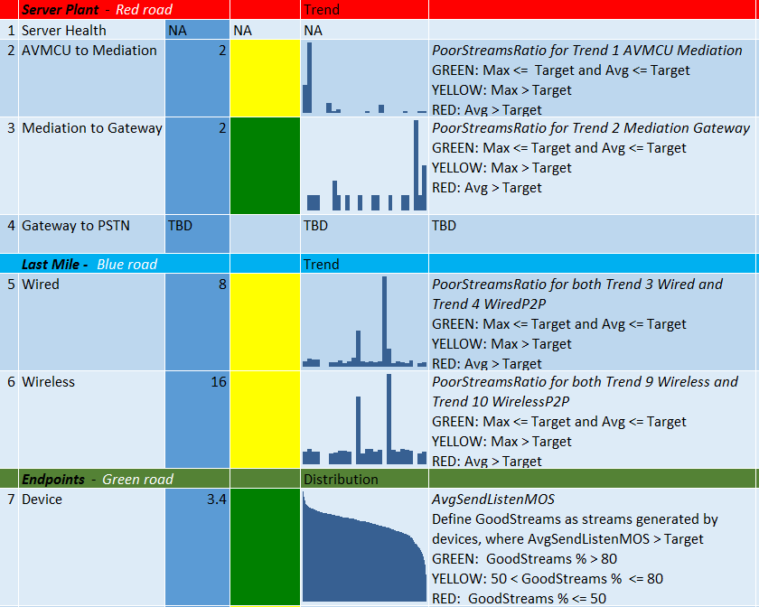
The Quality Problem
Voice support cases often cite call quality
We experienced this ourselves – and we see it as user number scale up
CQM was built to address this problem.

Slide 14
Why is Call Quality hard to achieve?
There is a complex set of dependencies from the endpoint to the access point to the core network to the server.
Degradation in any aspect lowers quality for the entire call or conference.
READ IT!! Lync 2013 Networking Guide

Slide 15
What about our existing tools
We have a rich set of QoE data and tools in the product to troubleshoot issues
We need a systemic operational approach to proactively view and improve call quality – that’s CQM.
CQM doesn’t replace:
SCOM
Monitoring Server Reports
Support

Slide 16
Ten CQM elements across three dimensions
Three Dimensions
Server Plant
Endpoints
Last Mile
There are 10 areas in total
Each Dimension has a prioritized set of focus areas
9 query QoE for data to identify problem areas
Customers can customize the approach
POSTER!! Lync CQM Poster

Slide 17
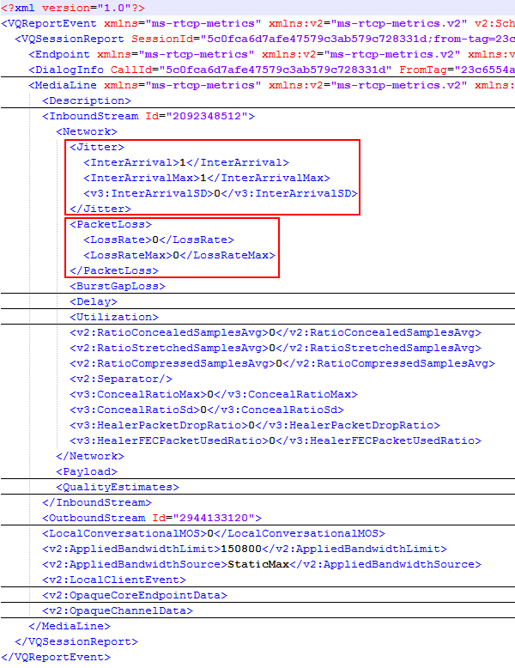
QoE Data collection
  How QoE data gets collected
  After a media session is complete the end point sends QoE data to home pool
  All media end points have these capabilities – Lync Clients, Mediation Server, AVMCU, Edge, CAA, etc.
  These reports are based on RTCP exchanges between the two endpoints

Slide 18
Skype for Business QoE Changes
Monitoring Database assignments
Rate My Call
Schema changes

Slide 19
Monitoring Database assignments
Skype for Business servers require service version 7 Monitoring database (Skype for Business version in topology)
  Can’t use Lync 2013 Monitoring Database
Lync 2013 CU5 servers can use Skype for Business Monitoring database
Need to do the association in Skype for Business Topology Builder

Slide 20
QoE Schema Changes
New Tables
  CallQualityFeedback
  CallQualityFeedbackToken
  SSID
  ConnectionName
  DNSSuffix
Updated Tables
  MediaLine
  AudioStream
  VideoStream
  AppSharingStream
  Session
A host of new Wi-Fi, detailed media stack and new app sharing statistics

Slide 21
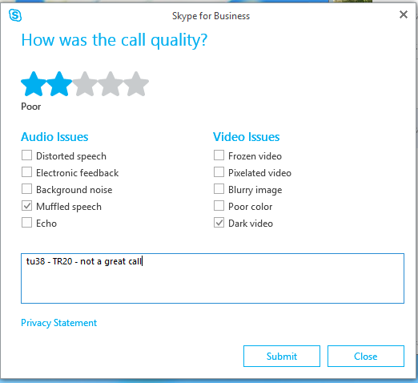
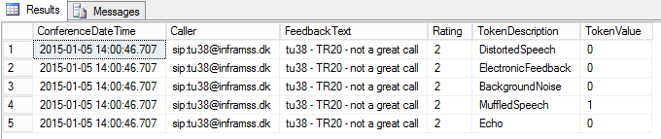
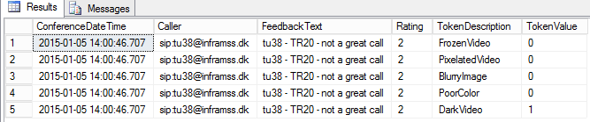
Rate My Call UI and resulting data
SELECT TOP 1000 [ConferenceDateTime],[SessionSeq],[User].URI,TokenDescription,[TokenValue]
FROM [QoEMetrics].[dbo].[CallQualityFeedbackToken]
INNER JOIN [CallQualityFeedbackTokenDef] AS TokenDef WITH (NOLOCK) on
TokenDef.[TokenId] = [CallQualityFeedbackToken].TokenId
INNER JOIN [User] WITH (NOLOCK) on
[User].UserKey = [FromURI]

Slide 22
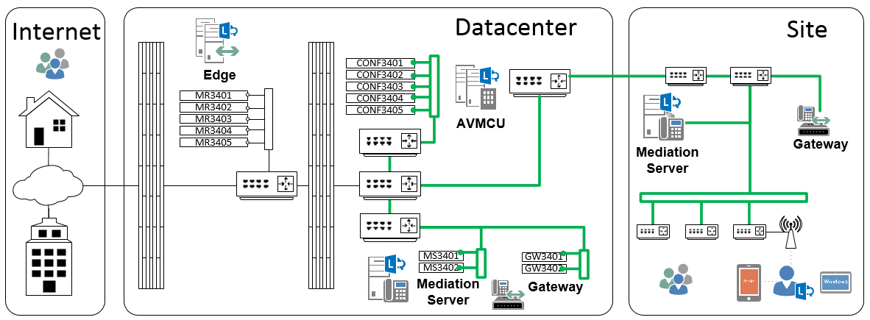
Network Coverage
The Quality of Experience (QoE) Database provides telemetry across the network
Mediation
to
Gateway
Plant_2
PCD
AVMCU
to
Mediation
Plant_1
AVMCU
to
Mediation
Plant_1
Wired
And
Wireless
LastMile_0_and_1
Mediation
to
Gateway
Plant_2
Wired
And
Wireless
LastMile_0_and_1
PCD

Slide 23
Comparing CQM and Monitoring Reports
ClassifiedPoorCall – MediaLine table in Skype for Business
AudioStream Value | QoE | CQM | Explanation
DegradationAvg | > 1.0 | - | Network Mean Opinion Score (MOS) degradation for the whole call. This metric shows the amount the Network MOS was reduced because of jitter and packet loss
RoundTrip | > 500 | - | Round trip time
PacketLossRate | > 0.1 | >0.01 or PacketLossRateMax > .05 | Average network packet loss
JitterInterArrival | > 30 | - | Average network Jitter in milliseconds
RatioConcealedSamplesAvg | > 0.07 | - | Average ratio of concealed samples generated by audio healing to typical samples
http://blogs.technet.com/b/jenstr/archive/2013/09/20/what-is-the-basis-for-classifying-a-call-as-poor-in-lync-2013-qoe.aspx

Slide 24
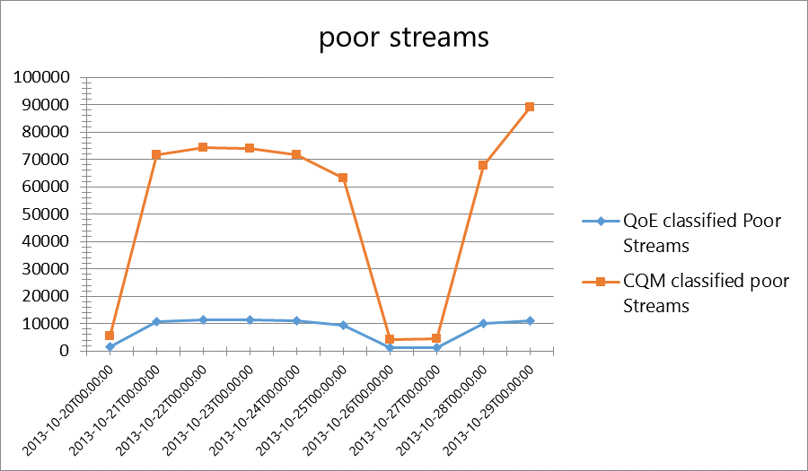
CQM Amplifies Results to spot problems
We do this intentionally to find hot spots
Difference: CQM & QoE

Slide 25
Server Plant
0: Server Health (KHI)
1: AVMCU to Mediation
2: Mediation to IP PSTN GW
3:IP PSTN GW Health

Slide 26
Server Plant – four elements
 | Category | Target & Remediate
 | Server Health | KHIs in healthy range If not, prioritize finding and fixing root cause until healthy
 | AVMCU to Mediation | Poor streams are PacketLossRate > .01 or PacketLossRateMax > .05 Determine your target for poor stream thresholds Default scorecard threshold is 2% Use detailed queries to find hot pairs with poor streams Investigate why so many poor streams Network equipment issue, gateway configuration issue etc
 | Mediation to Gateway
 | Gateway to PSTN | Identify relevant PSTN Gateway or SIP Trunk statistics

Slide 27
Endpoints
0: Device
1: System
2: Media Path
3: Media Transport

Slide 28

Endpoints – four elements
 | Category | Target & Remediate
 | Device | Define target cut-off, default scorecard threshold is 3.6 AvgSendListenMOS < 3.6 for #Streams > 100 Identify problematic devices and come up with strategy to fix/replace
 | System | Define goal (AudioMicGlitchRate < 1) Default scorecard threshold is 1,000 Define golden PC configuration with drivers etc.
 | Media Path | Define goal for Media over VPN (target 0%) Define goal for internal calls using relay (target 0%) Identify problem subnets and investigate firewall rules, packet shapers etc. configuration
 | Media Transport | Define goal for media over TCP (target 0%) Identify problem subnets and investigate firewall rules, packet shapers etc. configuration

Slide 29
Last Mile
0: Wired
1: Wireless

Slide 30
Last Mile – two elements
 | Category | Target & Remediate
 | Wired | Define threshold for Wired Poor Streams query Scorecard default: PoorStreamsRatio < 5% for subnets with > 100 streams Remediate ordered from worst to best Isolate subnets and fix Implement QoS
 | Wireless | Determine if Wireless will be managed Define threshold for Wireless Poor Streams query Scorecard default: PoorStreamsRatio < 10% for sites with > 100 streams Remediate ordered from worst to best Isolate subnets and fix Implement wireless best practices Inventory wireless gear and determine UC capabilities

Slide 31
Application – the Art of CQM

Slide 32
CQM Process Overview
Assert
Maintain
Achieve
Notes:
For a new deployment, the likelihood of issues (configuration, infrastructure, etc.) is higher vs. a mature deployment. Therefore, you should run it more frequently vs. operating in full run state. Below is outlines the suggested frequency an organization should adopt for the KHIs.
Frequency
New Deployment - Weekly
Mature Deployment - Quarterly or after infrastructure changes

Slide 33
Health Assertion Process
Lync KHI’s
Lync KHI’s
Software & Configuration
Platform/System
Design & Capacity Planning

Slide 34
Key Health Indicator

Slide 35
KHI coverage
Generic System
CPU
Memory
FrontEnd
User Services
SIP Processing
NIC
Physical Disk
InterCluster Routing
LYSS
MCU
WebServices
Factory
MediationServer
MediaRelay
Unexpected peer errors
SQL BackEnd
Buffer
Memory
Edge Server
Dropped Connections
Authentication Failures
Throtteling

Slide 36
Analysis Concept
System
Queuing Counters
Everything Else
A way to think
about remediating KHIs
Start by remediating KHIs in the Ring 0
Remediate Ring 1 using Supplementary Guide
Leaving you with Ring 2, which is primarily network related
Ring 0
Ring 1
Ring 2

Slide 37
KHI Reference – Generic System Health
Performance Counter | Description | Healthy Range | Ring
\Processor Information(*)\% Processor Time | CPU Utilization | Less than 80% | 0
\Memory\Available Mbytes | Displays the bytes of physical memory available to processes running on the computer. | More than 2.5GB | 0
\Network Interface(*)\Output Queue Length | Indiciator of how busy a network interface is. | 0 | 0
\Network Interface(*)\Packets Outbound Discarded | Packet loss indicator | 0 | 0
\Network Interface(*)\Packets Received Discarded | Packet loss indicator | 0 | 0
\PhysicalDisk(*)\Avg. Disk sec/Read | Represents the average time of disk read latency | Less than .025 | 0
\PhysicalDisk(*)\Avg. Disk sec/Write | Represents the average time of disk write latency | Less than .025 | 0

Slide 38
KHI Reference – SQL & FE Health
Performance Counter | Description | Healthy Range | Ring
\MSSQL$INSTANCE:Buffer Manager\Page life expectancy | How many seconds SQL Server expects a data page to stay in cache. | Greater than 300 | 0
\LS:Usrv - DBStore\Usrv - Queue Latency (msec) | The average time a request is held in the request queue to RTCDyn database | Less than 100ms sustained | 1
\LS:Usrv - DBStore\Usrv - Sproc Latency (msec) | The average time it takes to execute a sproc call against RTCDyn database. | Less than 100ms sustained | 1
\LS:Usrv - DBStore\Usrv - Throttled requests/sec | The number of requests that were rejected with a retry since the database queue latency was high. | 0 | 1
\LS:Usrv - REGDBStore\Usrv - Queue Latency (msec) | The average time a request is held in the request queue to RTC database | Less than 100ms sustained | 1
\LS:Usrv - REGDBStore\Usrv - Sproc Latency (msec) | The average time it takes to execute a sproc call against RTC database. | Less than 100ms sustained | 1
\LS:Usrv - REGDBStore\Usrv - Throttled requests/sec | The number of requests that were rejected with a retry since the database queue latency was high. | 0 | 1
\LS:Usrv - SharedDBStore\Usrv - Queue Latency (msec) | The average time a request is held in the request queue to RTCShared database | Less than 100ms sustained | 1
\LS:Usrv - SharedDBStore\Usrv - Sproc Latency (msec) | The average time it takes to execute a sproc call against RTCShared database. | Less than 100ms sustained | 1
\LS:Usrv - SharedDBStore\Usrv - Throttled requests/sec | The number of requests that were rejected with a retry since the database queue latency was high. | 0 | 1

Slide 39
KHI monitoring process
Create data collection
Run collection for at least 8 hours
Review AVG and MAX
Can also use PS1 script
Recommended Interval 15 sec
not more than 1 minute
Healthy range included in excel Spreadsheet
Leverage existing monitoring tools
Notes:
Talking points:
How often should you / your customer go through this process? Like we said earlier, start with a weekly review, once everything is fine, you can move to a monthly process
It is recommended to switch back to a weekly monitoring whenever larger changes happen, and start with a closer monitoring before this change happens (like massive user enablement)
Possible triggers could be:
User move / enablement
Change in the environment (new pool, new site)
User feedback

Slide 40

Demo
Analysis Best Practices via the KHI Analysis Tool

Slide 41
Server Plant 0: Health Achieved!
0: Server Health
1: AVMCU to Mediation
2: Mediation to IP PSTN GW
3:IP PSTN GW Health

Slide 42
The Microsoft Call Quality Methodology Scorecard

Slide 43
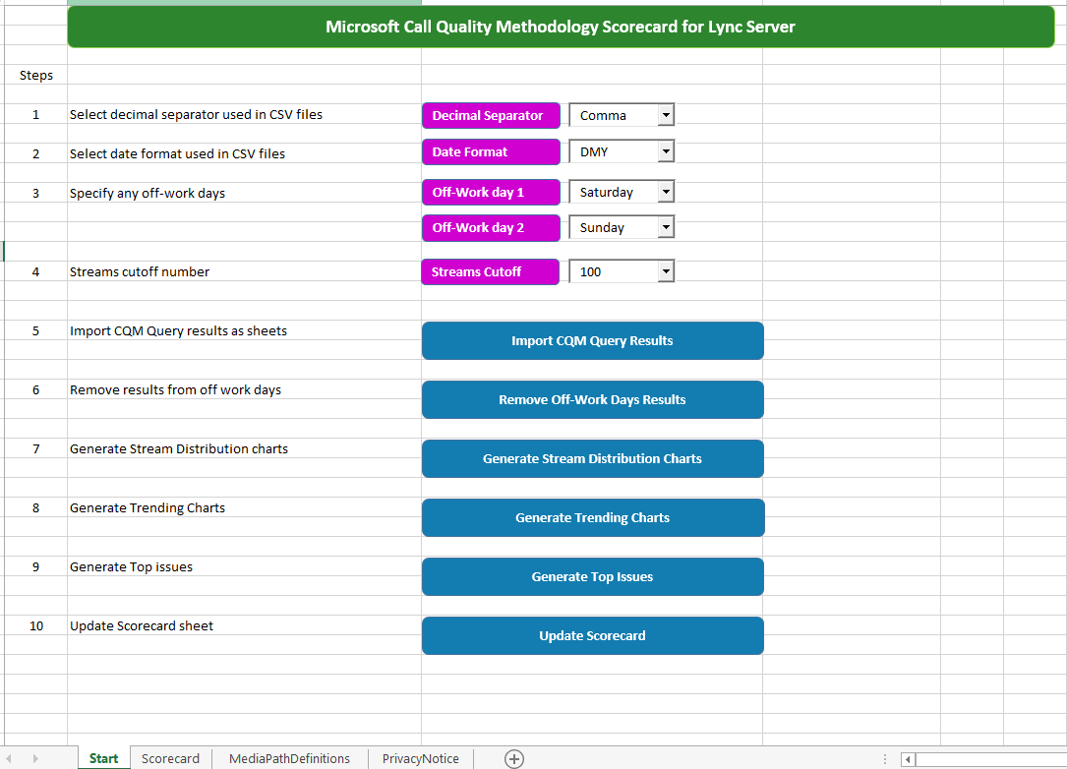

Slide 44
The Scorecard
CQM SQL queries
  2010 and above
  No support for SQL Server 2005
PowerShell script to run the CQM queries
  Different poor stream conditions
Excel 2013 macro-enabled workbook
  Load the results
  Remove off-work results
  Display charts
  Display Top 10 Issues
  Update Scorecard

Slide 45
CQM PowerShell Script
Support for different poor stream conditions
  CQM – original condition (packet loss rate based)
  ClassifiedPoorCall – product definition (packet loss rate, RTT, jitter, degradation, concelated ratio)
  Custom – you define it
Script require date format used in SQL Server
  mdy, dmy, ymd, ydm, myd, dym
  GetSqlDateFormat PS script to display which is used

Slide 46
CQM Scorecard
Excel 2013 macro-enabled workbook
  Only works with Excel 2013
Need results generated by CQM.ps1 and v1.4 of the queries
  Checks version of result files

Slide 47
CQM Scorecard
Date Format
  Date format used in CSV files – check one of the Trend query results
    "1/23/2014","1820","301","16.5","Trend_4_Wired_P2P“
    Above is MDY
  Scorecard will default to the local PC format
Decimal Separator
  Decimal separator used in CSV files – check one of the Trend query results
    "1/23/2014","1820","301","16.5","Trend_4_Wired_P2P“
    Above is Dot
  Scorecard will default to the local PC format

Slide 48
CQM Scorecard
Off-work days
  Ability to remove results from 2 days of the week
  Defaults to Saturday and Sunday
Why do this?
  Results from off-work days can skew poor stream rates
  2 streams on a Saturday with 1 being poor = 50% poor stream rate

Slide 49
Device sample data
Capture Device Name | AVG SendListen MOS | Streams
Telephone (Polycom CX300) | 3.58 | 3545
Microphone (SoundMAX Integrated Digital HD Audio) | 3.08 | 1687
Microphone (High Definition Audio Device) | 3.50 | 1120
UCPhone | 3.46 | 915
Internal Microphone (Conexant 20561 SmartAudio HD) | 3.07 | 701
Microphone (Logitech Mic (Pro 5000)) | 1.72 | 348
Microphone (USB Audio Device) | 2.84 | 212
Notes:
Remember: filtered on Devices having average SendListenMOS < 3.6
Discuss where to start
Highest stream count?
That would be CX300 with 3.58
Or maybe the integrated one?
In this scenario this seems to be a good process:
Start with internal devices – remediation action is a user education & awareness activity to avoid the usage of internal devices
Logitech pro 5000 is a video camera with integrated mic – not qualitifed, maybe needs replacement, maybe education to use headset & camera might work here
Identify users using this generic USB Audio device and deploy certified devices

Slide 50
Sample Data - Plant_1_AVMCU_MS
ReportDate | AVMCU | MS | AllStreams | PoorStreams | PoorStreamsRatio
10.03.2014 | LyncFE01 | LyncMS01 | 270 | 7 | 2,6
10.03.2014 | LyncFE02 | LyncMS01 | 236 | 6 | 2,5
10.03.2014 | LyncFE03 | LyncMS01 | 204 | 4 | 2
06.03.2014 | LyncFE01 | LyncMS01 | 320 | 6 | 1,9
14.03.2014 | LyncFE02 | LyncMS01 | 208 | 3 | 1,4
21.03.2014 | LyncFE02 | LyncMS01 | 210 | 3 | 1,4
28.03.2014 | LyncFE01 | LyncMS02 | 210 | 3 | 1,4
04.03.2014 | LyncFE01 | LyncMS01 | 298 | 4 | 1,3
04.03.2014 | LyncFE03 | LyncMS01 | 226 | 3 | 1,3
28.03.2014 | LyncFE02 | LyncMS02 | 162 | 2 | 1,2
07.03.2014 | LyncFE01 | LyncMS02 | 188 | 2 | 1,1
Notes:
Prioritization is key! Use this and the next slide to talk about the prioritization process
Let's take a closer look to the output of the Plant_1_AVMCU_MS query, what do we see here?
First, the overall quality isn‘t that bad – you would think
But consider a thing here. These are Servers talking to each other, why should we have *any* packet loss here? Probably not, unless you can explain it. And are okay with the explanation, of course.
Second, LyncMS01 is over-represented here, whereas LyncMS02 isn‘t the often represented. So you want to troubleshoot LyncMS01 and his network conditions first.

Slide 51
Sample Data - Plant_1_AVMCU_MS
ReportDate | AVMCU | MS | AllStreams | PoorStreams | PoorStreamsRatio
10.03.2014 | LyncFE01 | LyncMS01 | 270 | 7 | 2,6
10.03.2014 | LyncFE02 | LyncMS01 | 236 | 6 | 2,5
10.03.2014 | LyncFE03 | LyncMS01 | 204 | 4 | 2
06.03.2014 | LyncFE01 | LyncMS01 | 320 | 6 | 1,9
14.03.2014 | LyncFE02 | LyncMS01 | 208 | 3 | 1,4
21.03.2014 | LyncFE02 | LyncMS01 | 210 | 3 | 1,4
28.03.2014 | LyncFE01 | LyncMS02 | 210 | 3 | 1,4
04.03.2014 | LyncFE01 | LyncMS01 | 298 | 4 | 1,3
04.03.2014 | LyncFE03 | LyncMS01 | 226 | 3 | 1,3
28.03.2014 | LyncFE02 | LyncMS02 | 162 | 2 | 1,2
07.03.2014 | LyncFE01 | LyncMS02 | 188 | 2 | 1,1
Notes:
Let's take a closer look to the output of the Plant_1_AVMCU_MS query, what do we see here?
First, the overall quality isn‘t that bad – you would think
But consider a thing here. These are Servers talking to each other, why should we have *any* packet loss here? Probably not, unless you can explain it. And are okay with the explanation, of course.
Second, LyncMS01 is over-represented here, whereas LyncMS02 isn‘t the often represented. So you want to troubleshoot LyncMS01 and his network conditions first.

Slide 52
Wired Subnet sample data
Client Subnet | Occurrence in past 30 days | All Streams | Poor Streams | Poor Stream Ratio
10.35.46.0 | 24 | 8909 | 512 | 5.75
10.35.44.0 | 23 | 6260 | 298 | 4.76
10.121.132.0 | 15 | 2052 | 178 | 8.67
10.121.130.0 | 27 | 7520 | 147 | 1.95
10.121.134.0 | 11 | 1435 | 141 | 9.83
10.121.128.0 | 22 | 3712 | 134 | 3.61
10.121.250.0 | 22 | 4402 | 126 | 2.86
10.35.48.0 | 6 | 738 | 108 | 14.63
10.121.248.0 | 16 | 3348 | 81 | 2.42
157.56.66.0 | 4 | 588 | 61 | 10.37
1
2
1
2
3
4
5
3
Site | Occurrence | All Streams | Poor Streams | Poor Stream %
10.35.x | 24 | 15907 | 918 | 5.77
10.121.x | 27 | 19121 | 726 | 3.80
Notes:
Where to start?
from a pure count view you may want to start with the first two subnets 10.35.46.0 and 10.35.44.0
However, if you scroll down the list further there are a number of 10.121.13x subnets – maybe it is worth to start here? Maybe they are all close to each other and there is a common thing like a backend-router that is causing issues as QoS isn‘t implemented properly on this guy?
Talk about setting the data into context and the priorization of issues.
I probably would start with 10.35.x site as the total stream count is in the same area but the poor stream ratio is higher -> a change to this poor streams has more impact.

Slide 53
Demo:
CQM Scorecard

Slide 54
Call Quality Dashboard

Slide 55
Journey to Call Quality Dashboard
Lync 2013 Network Guide
Call Quality Methodology
Call Quality Dashboard
~150 pages
Sample SQL queries
~30 SQL queries
PowerShell
Excel workbook
QoE Archive
Analysis Cube
Web API
Report portal
Notes:
Call Quality Dashboard is a culmination of a journey from sample queries in Lync 2013 Network Guide that resulted in Call Quality Methodology whitepaper and tools, which consolidates archive of QoE data to produce database cube for analysis using SQL Server Analysis Services. CQD allows for extensibility through Web API and provides an out of the box report portal.

Slide 56
CQD features
QoE archive
Cube-based reports based on SQL Server Analysis Services (SSAS)
<1s query return performance against SSAS
Web API access to cube data
HTML5 + JavaScript Report portal
Report editing and design
Web download same ship with Skype for Business Server
Notes:
CQD is essentially archive of QoE data that’s processed by SQL Server Analysis Services to produce a cube-based reports. Query return performance is targeted toward less than 1 second, and Web API is provided to access the data cube.
The portal itself is based on HTML5 + JavaScript, and allows for report editing and design.
CQD is provided as a Web download that will be shipped at the same release date of Skype for Business Server.

Slide 57
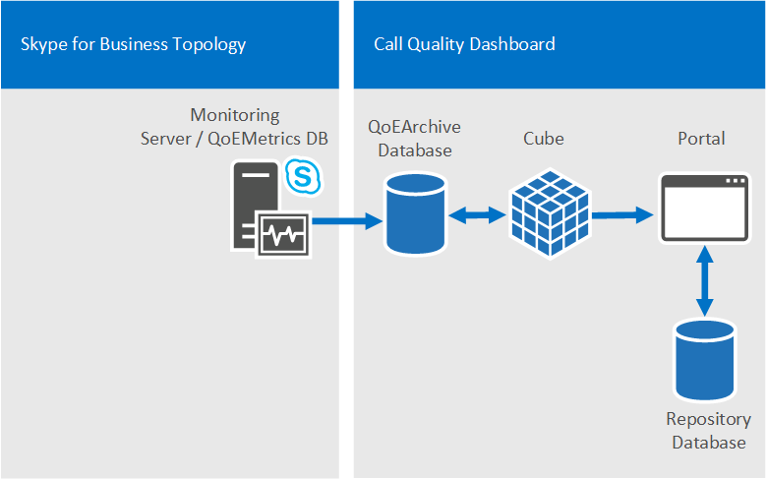
CQD Components
Supported SQL Server:
SQL Server 2008 R2,
SQL Server 2012,
SQL Server 2014

Slide 58
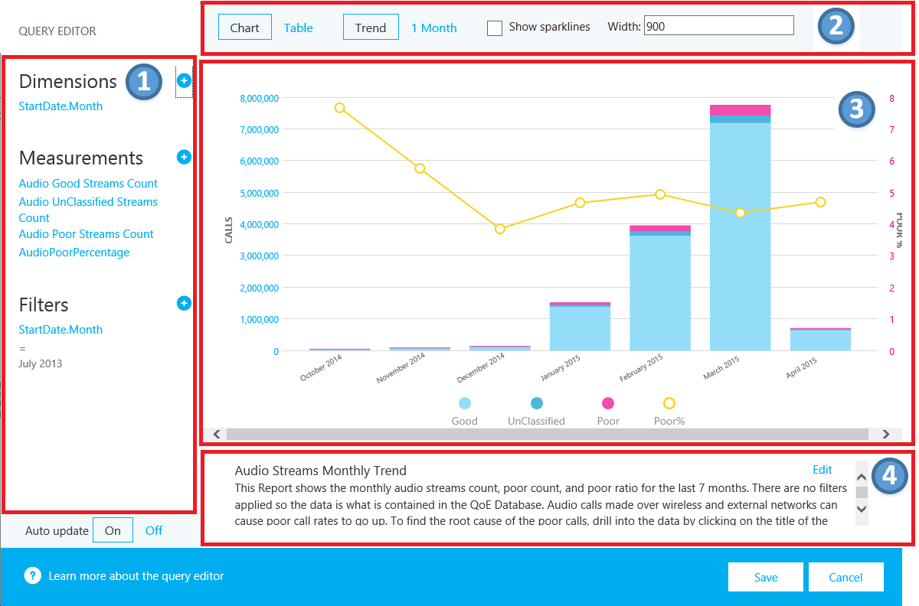
Call Quality Dashboard (CQD)

Slide 59
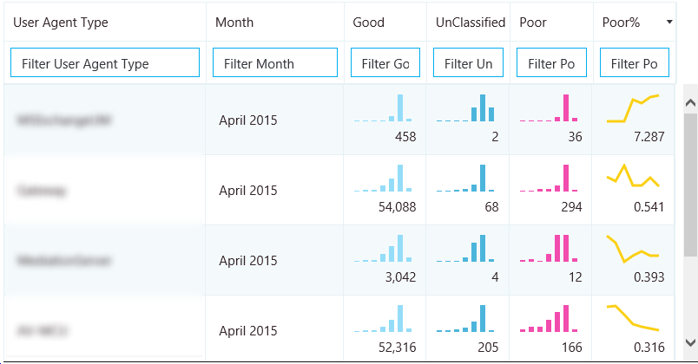
Sparklines in Tables

Slide 60
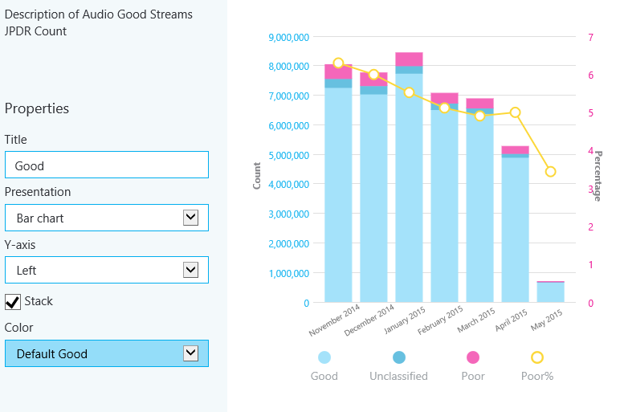
Measurement

Slide 61
CQD Demo

Slide 62
CQD Links
Skype for Business Server 2015, Call Quality Dashboard
  https://www.microsoft.com/en-us/download/details.aspx?id=46916
Plan for Call Quality Dashboard for Skype for Business Server 2015
  https://technet.microsoft.com/en-us/library/mt126221.aspx
Sample Call Quality Methodology Scorecard based on data from Call Quality Dashboard
  http://blogs.technet.com/b/jenstr/archive/2015/05/27/sample-call-quality-methodology-scorecard-based-on-data-from-call-quality-dashboard.aspx
Displaying Network and Building Information in the Call Quality Dashboard
  http://blogs.technet.com/b/jenstr/archive/2015/05/26/displaying-network-and-building-information-in-the-call-quality-dashboard.aspx

Slide 63
Real-World Scenarios

Slide 64
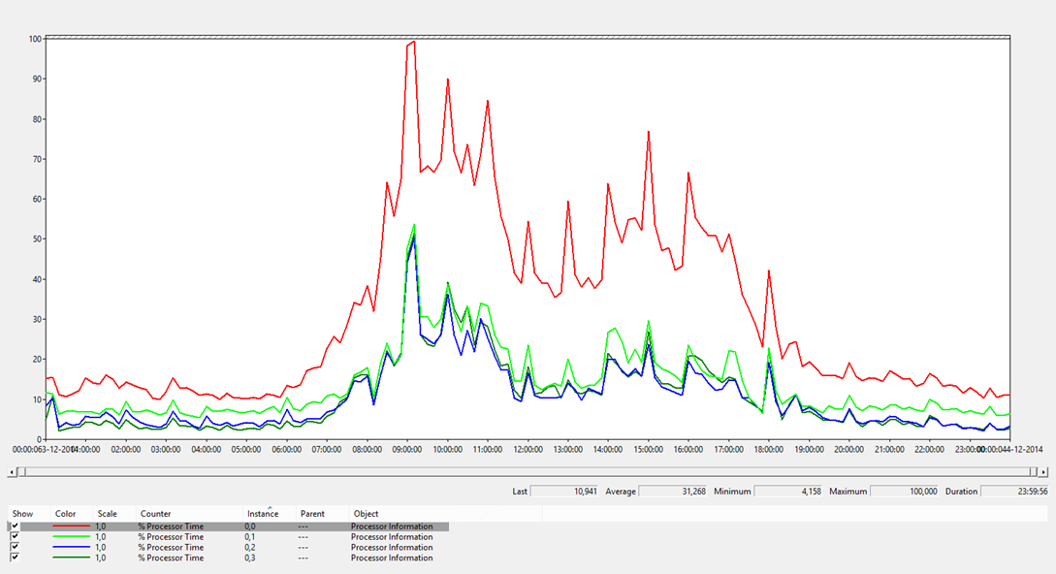
CPU
Counter | Description | Healthy Range
% Processor Time | CPU utilization | <80% (highest core
Notes:
SQL Express
RSS

Slide 65
Compute Capacity Limits of SQL Server
SQL Server Edition | Maximum Compute Capacity Used by a Single Instance (SQL Server Database Engine) | Maximum Compute Capacity Used by a Single Instance (AS, RS)
Express | Limited to lesser of 1 Socket or 4 cores | Limited to lesser of 1 Socket or 4 cores
Standard | Limited to lesser of 4 Sockets or 16 cores | Limited to lesser of 4 Sockets or 16 cores
Enterprise Edition: Core-based Licensing | Operating system maximum | Operating system maximum
https://msdn.microsoft.com/en-us/library/ms143760.aspx

Slide 66
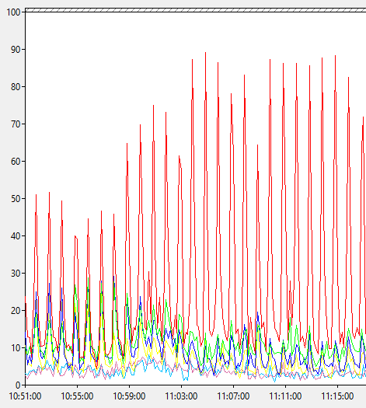
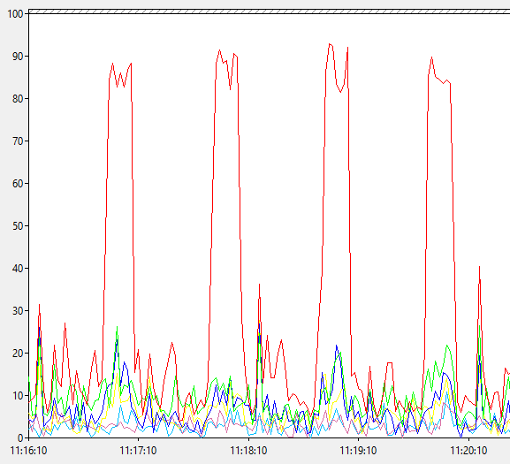
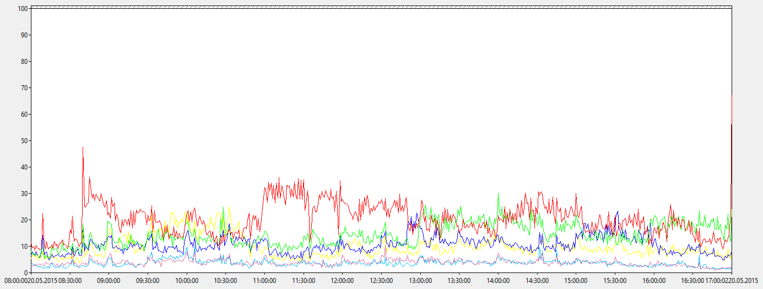
CPU - all good?

Slide 67
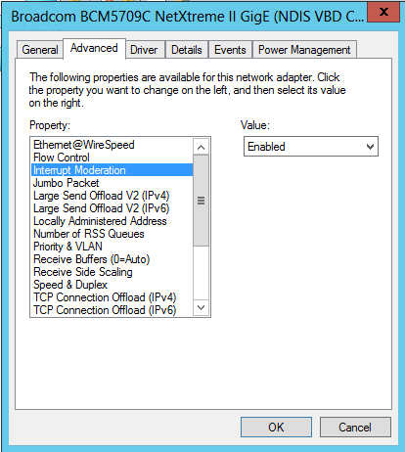
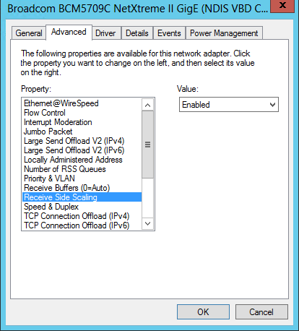
Unbalanced CPU load - RSS
Enable RSS
Spreads load across CPU cores
Enable Interrupt moderation

Slide 68
Customer Case Study
Escalation during CQM Scorecard development
Partnership with Lync, Network and Desktop teams
Daily activities based on Scorecard TopIssues Tab
Results:
  300+ USB devices replaced
  1,000+ XP workstations prioritized for replacement
  Corrected firewall config forcing TCP on Edge
  Old Cisco network hardware identified and repaired or replaced
  QoS Implementation back on track
  WiFi problems identified; user education on quality implications

Slide 69
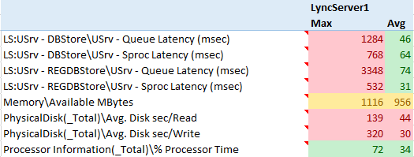
Disk Performance Due to Anti-Virus Scan or Undersized Configuration
Lync Anti-Virus exclusions are crucial to a stable deployment
Poor Disk Performance = SPROC and Queue latency
SPROC and Queue Latency = Poor End User Experience
Undersized disk configuration WILL cause similar performance problems

Slide 70
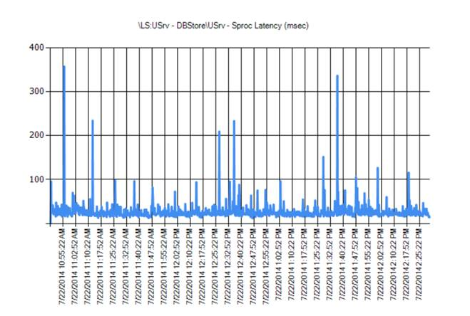
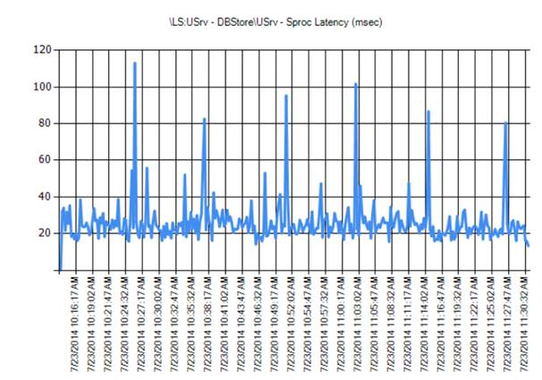
Disk Performance Due to Anti-Virus Scan or Undersized Configuration
No Exclusions
With Exclusions

Slide 71
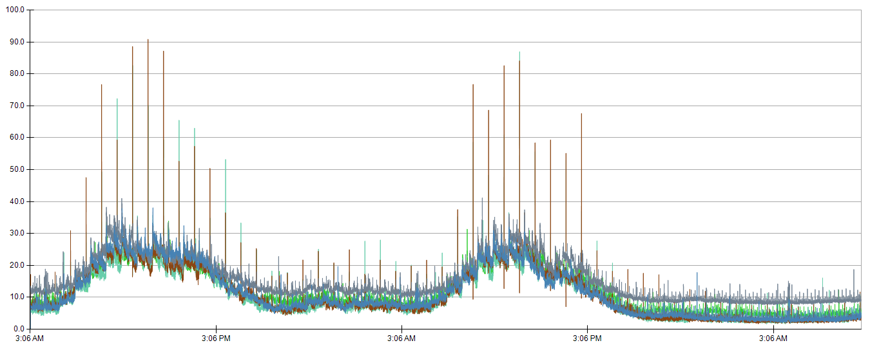
Customer example
Spikes occur at 00:42 past the hour on Edge Servers were contributing to audio quality issues
Root Cause: Job applying security policy updates
Percent CPU
06/26
06/27
06/28

Slide 72
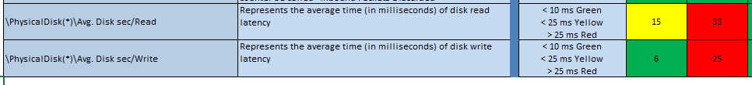
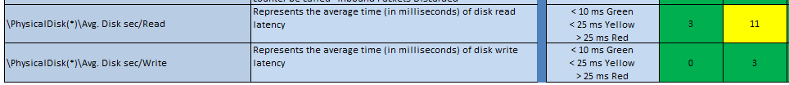
Customer example
Lync Server 2010 Deployment
  KHI Counters quickly identified one pools disk array was having IO issues
  SQL Disk Array deployed on RAID 5, not RAID 10
  Rebuilt Disk Array RAID 10 during maintenance window
  Much better, and we tracked the maximum 11 value to disk being used to store backups and spiked when backups were being run from SQL

Slide 73
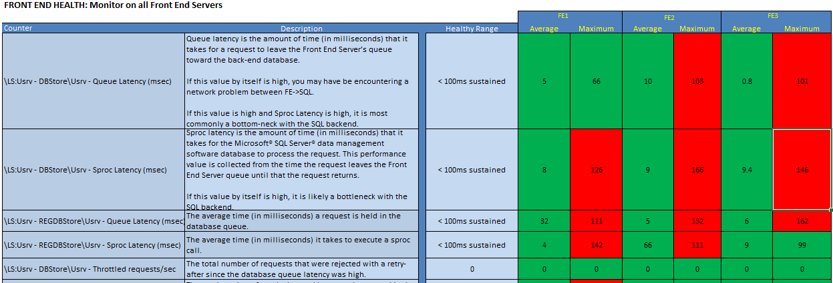
Customer
Lync Server 2013 Deployment
  Performance Issues were monumental on the Front Ends and was our First Focus

Slide 74
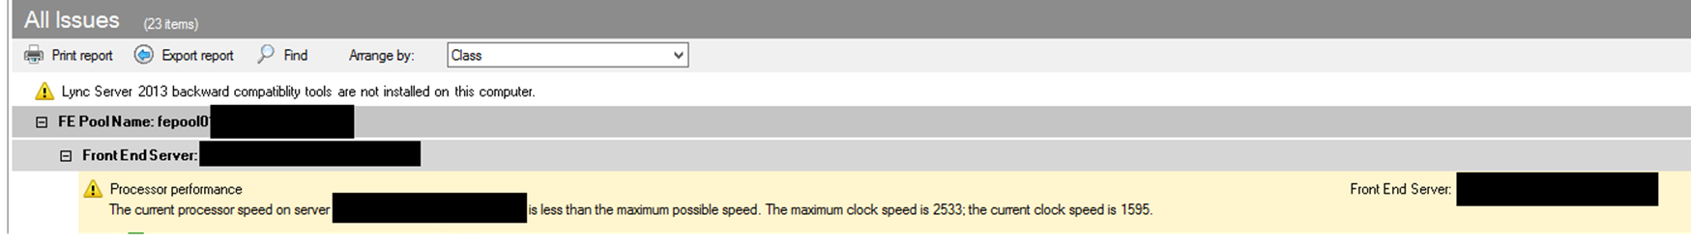
Customer
Lync Server 2013 Deployment
  Performance Issues were monumental on the Front Ends and was our First Focus
  Best Practices Analyzer saved our bacon!

Slide 75
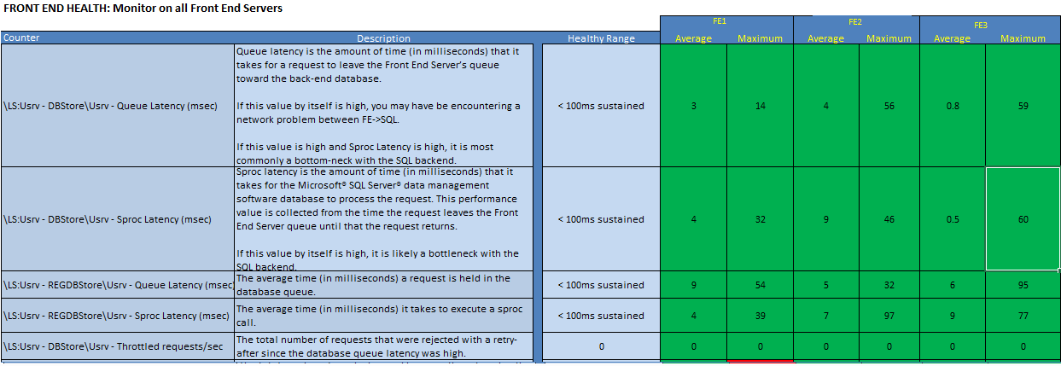
Customer
Lync Server 2013 Deployment
  Performance Issues were monumental on the Front Ends and was our First Focus

Slide 76
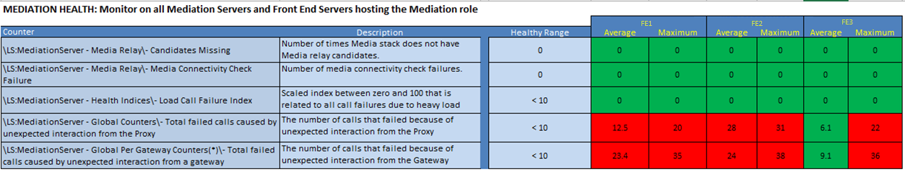
Customer
Lync Server 2013 Deployment
  Dropped Calls was our Second Area of Focus for KHI
  Using Basic Gateway – Cisco ISR
  Got access to ISR Configuration and compared to OIP Site
  Found customer on untested IOS Version

Slide 77
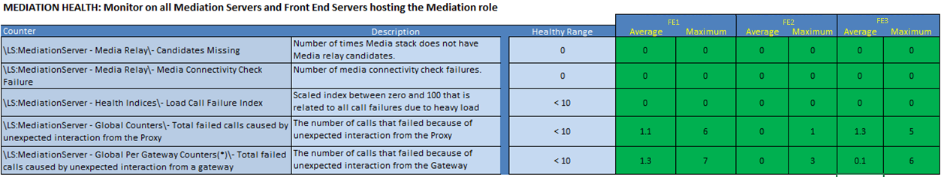
Customer
Lync Server 2013 Deployment
  Dropped Calls was our Second Focus for KHI
  Using Basic Gateway – Cisco ISR

Slide 78


Customer
Takeaways from our KHI Madness
  Lync is the canary in the coal mine
  KHI helped find what was killing
  the canary
  KHI is time consuming,
  but highly rewarding

Slide 79
Other KHI Findings
NUMA Scheduling in virtualization Layer
Single core CPU vs. multi Core CPU in virtualization Layer
Disk Performance
If you’re troubleshooting SQL, make sure you are at this patch level before drawing conclusions:
SQL 2012 either apply CU4, CU10 of SP1 or SP2.

Slide 80
CQM and KHIs
Better Together.

Slide 81
Takeaways
Health is not a status to achieve, it is a rhythm you get into.
Training and implementing procedures based in CQM drives Lync deployment health.
CQM helps earning and increasing trust with your customers an leads into additional service opportunities.

Slide 82
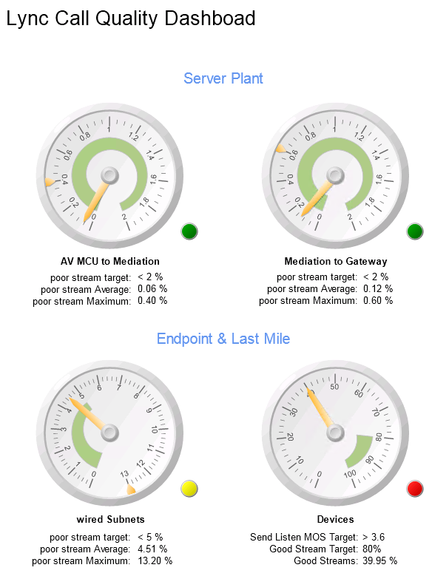
Resources
  http://www.microsoft.com/en-us/download/details.aspx?id=39084 networking guide
  Scorecard post: http://blogs.office.com/2014/07/01/call-quality-methodology-scorecard-for-lync-server/
  Premier Workshop

Slide 83
Questions?

Slide 85
NUMA Scheduling Causing CPU Performance Issues
Lync Server
Guest
vCPU
vCPU
vCPU
vCPU
AVMCU Process Thread
vCPU
vCPU
vCPU
vCPU
A\V Traffic to Remote NUMA node can lead to performance issues noticed by End Users
Lync Server
Guest
vCPU
Memory
Memory
Bus
Bus
Virtual Host Server
Core
Core
Core
Core
Core
Core
Bus
Bus
Virtual Host Server
Core
Core
Core
Core
Memory
Memory
Numa Node #1 (Home)
Numa Node #2 (Remote)
Numa Node #1 (Home)
Numa Node #2 (Remote)

Slide 86
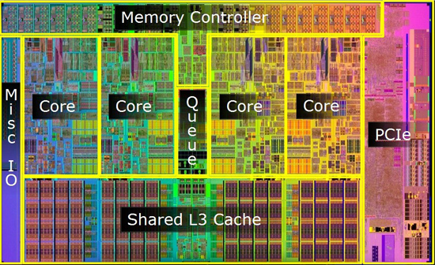

NUMA Scheduling Causing CPU Performance Issues (cont.)
KHI Measures Individual Cores (not _Total)

Slide 87
KHI Reference – Generic System Health
Performance Counter | Description | Healthy Range | Ring
\Processor Information(*)\% Processor Time | CPU Utilization | Less than 80% | 0
\Memory\Available Mbytes | Displays the bytes of physical memory available to processes running on the computer. | More than 2.5GB | 0
\Network Interface(*)\Output Queue Length | Indiciator of how busy a network interface is. | 0 | 0
\Network Interface(*)\Packets Outbound Discarded | Packet loss indicator | 0 | 0
\Network Interface(*)\Packets Received Discarded | Packet loss indicator | 0 | 0
\PhysicalDisk(*)\Avg. Disk sec/Read | Represents the average time of disk read latency | Less than .025 | 0
\PhysicalDisk(*)\Avg. Disk sec/Write | Represents the average time of disk write latency | Less than .025 | 0

Slide 88
KHI Reference – SQL & FE Health
Performance Counter | Description | Healthy Range | Ring
\MSSQL$INSTANCE:Buffer Manager\Page life expectancy | How many seconds SQL Server expects a data page to stay in cache. | Greater than 300 | 0
\LS:Usrv - DBStore\Usrv - Queue Latency (msec) | The average time a request is held in the request queue to RTCDyn database | Less than 100ms sustained | 1
\LS:Usrv - DBStore\Usrv - Sproc Latency (msec) | The average time it takes to execute a sproc call against RTCDyn database. | Less than 100ms sustained | 1
\LS:Usrv - DBStore\Usrv - Throttled requests/sec | The number of requests that were rejected with a retry since the database queue latency was high. | 0 | 1
\LS:Usrv - REGDBStore\Usrv - Queue Latency (msec) | The average time a request is held in the request queue to RTC database | Less than 100ms sustained | 1
\LS:Usrv - REGDBStore\Usrv - Sproc Latency (msec) | The average time it takes to execute a sproc call against RTC database. | Less than 100ms sustained | 1
\LS:Usrv - REGDBStore\Usrv - Throttled requests/sec | The number of requests that were rejected with a retry since the database queue latency was high. | 0 | 1
\LS:Usrv - SharedDBStore\Usrv - Queue Latency (msec) | The average time a request is held in the request queue to RTCShared database | Less than 100ms sustained | 1
\LS:Usrv - SharedDBStore\Usrv - Sproc Latency (msec) | The average time it takes to execute a sproc call against RTCShared database. | Less than 100ms sustained | 1
\LS:Usrv - SharedDBStore\Usrv - Throttled requests/sec | The number of requests that were rejected with a retry since the database queue latency was high. | 0 | 1

Slide 89
KHI Reference – FE Health cont.
Performance Counter | Description | Healthy Range | Ring
\LS:SIP - Authentication\SIP - Authentication System Errors/sec | The per-second rate of authentication failures caused by system errors (due to low memory conditions or otherwise). | Less than 1 | 2
\LS:SIP - Load Management\SIP - Average Holding Time For Incoming Messages | The average time that the server held the incoming messages currently being processed. | Less than 1 | 1
\LS:SIP - Load Management\SIP - Incoming Messages Timed out | The number of incoming messages currently being held by the server for processing for more than the maximum tracking interval. | Less than 2 | 2
\LS:SIP - Peers(*)\SIP - Average outgoing Queue Delay | Average outgoing queue delay in seconds | Less than 2 | 1
\LS:SIP - Peers(*)\SIP - Flow-controlled Connections | The number of connections that are currently being flow-controlled (no socket receives are posted) | Less than 2 | 1
\LS:SIP - Peers(*)\SIP - Sends Timed-Out/sec | The total number of sends dropped because they stayed in the outgoing (send) queue for too long. | 0 | 1
\LS:SIP - Protocol\SIP - Average Incoming Message Processing Time | The average time (in seconds) it takes to process an incoming message. | Less than 1 | 1
\LS:SIP - Protocol\SIP - Incoming Requests Dropped/sec | The per-second rate of incoming requests dropped because they could not be processed (due to bad headers, insufficient routing information, server resource allocation failure). | Less than 1 | 1
\LS:SIP - Protocol\SIP - Incoming Responses Dropped/sec | The per-second rate of incoming responses dropped because they could not be processed (due to bad headers, insufficient routing information, server resource allocation failure). | Less than 1 | 1
\LS:SIP - Responses\SIP - Local 503 Responses/sec | The total number of 503 responses generated by the server per second | 0 | 2

Slide 90
KHI Reference – FE Health cont.
Performance Counter | Description | Healthy Range | Ring
\LS:RoutingApps - Inter Cluster Routing\RoutingApps - Number of primary registrar timeouts | Number of requests for which backup registrar timed out | 0 | 2
\LS:RoutingApps - Inter Cluster Routing\RoutingApps - Number of backup registrar timeouts | Number of requests for which backup registrar timed out | 0 | 2
\LS:LYSS - Storage Service API\LYSS - Current percentage of space used by Storage Service DB. | Current percentage of space used by Storage Service DB. | Less than 80 | 2
\LS:LYSS - Storage Service API\LYSS - Current number of Storage Service stale queue items | Current number of Storage Service queue items which are not owned and last attempted a long time ago. | 0 | 2
\LS:Usrv - Cluster Manager\Usrv - Number of data loss events with state change | Total number of data loss events with state change | 0 | 2
\LS:Usrv - Cluster Manager\Usrv - Number of data loss events without state change | Total number of data loss events without state change | 0 | 2
\LS:Usrv - Cluster Manager\Usrv - Number of failures of replication operations sent to other Replicas per second | The per-second rate of replication operation failures | 0 | 2
\LS:XMPPFederation - SIP Instant Messaging\XMPPFederation - Failure IMDNs sent/sec | Failure IMDNs sent/sec | 0 | 2

Slide 91
KHI Reference – FE Health cont.
Performance Counter | Description | Healthy Range | Ring
\LS:RoutingApps - Emergency Call Routing\RoutingApps - Number of incoming failure responses | Number of times an Emergency Call failure response was received from Gateway. | 0 | 0
\LS:CAA - Operations\CAA - Incomplete calls per sec | The per second rate of incomplete calls to Conferencing Attendant. This includes calls disconnected by the user and by the system due to invalid conference id, passcode, etc. | Less than 20 | 2
\LS:USrv - Conference Mcu Allocator\USrv - Create Conference Latency (msec) | The average time (in milliseconds) taken to complete a create conference call. | Less than 5000 | 1
\ASP.NET Apps v4.0.30319(*)\Requests Rejected | The number of requests rejected because the request queue was full. | Less than 80 | 1
\LS:JoinLauncher - Join Launcher Service Failures\JOINLAUNCHER - Join Failures | The number of join failures | 0 | 2
\LS:WEB - Address Book File Download\WEB - Failed File Requests/Second | The per-second rate of failed Address Book file requests | Less than 5 | 2
\LS:WEB - Address Book Web Query\WEB - Failed search requests/sec | The per-second rate of failed address book search requests | 0 | 2
\LS:WEB - Auth Provider related calls\WEB - Failed validate cert calls to the cert auth provider | Number of failed validate cert calls to the cert auth provider | 0 | 2
\LS:WEB - Distribution List Expansion\WEB - Timed out Active Directory Requests/sec | The per-second rate of timed out Active Directory requests | Less than 5 | 2
\LS:WEB - UCWA\UCWA - HTTP 5xx Responses/Second | The per second rate of responses with HTTP 5xx code | 0 | 2

Slide 92
KHI Reference – FE Health cont.
Performance Counter | Description | Healthy Range | Ring
\LS:ASMCU - MCU Health And Performance\ASMCU - MCU Health State | The current health of the MCU. | Less than 2 | 2
\LS:AVMCU - MCU Health And Performance\AVMCU - MCU Health State | The current health of the MCU. | Less than 2 | 2
\LS:DATAMCU - MCU Health And Performance\DATAMCU - MCU Health State | The current health of the MCU. | Less than 2 | 2
\LS:IMMCU - MCU Health And Performance\IMMCU - MCU Health State | The current health of the MCU. | Less than 2 | 2
\LS:IMMCU - IMMcu Conferences\IMMCU - Throttled Sip Connections | The number of throttled Sip connections | 0 | 1

Slide 93
KHI Reference – Mediation Server Health
Performance Counter | Description | Healthy Range | Ring
\LS:MediationServer - Global Counters\- Total failed calls caused by unexpected interaction from the Proxy | The number of calls that failed because of unexpected interaction from the Proxy | Less than 10 | 1
\LS:MediationServer - Global Per Gateway Counters(*)\- Total failed calls caused by unexpected interaction from a gateway | The number of calls that failed because of unexpected interaction from the Gateway | Less than 10 | 1
\LS:MediationServer - Health Indices\- Load Call Failure Index | Scaled index between zero and 100 that is related to all call failures due to heavy load | Less than 10 | 1
\LS:MediationServer - Media Relay\- Candidates Missing | Number of times Media stack does not have Media relay candidates. | 0 | 2
\LS:MediationServer - Media Relay\- Media Connectivity Check Failure | Number of media connectivity check failures. | 0 | 2

Slide 94
KHI Reference – Edge Server Health
Performance Counter | Description | Healthy Range | Ring
\LS:A/V Edge - UDP Counters(*)\A/V Edge - Authentication Failures/sec | The per-second rate of failed attempts to authenticate with the relay over UDP. | Less than 20 | 2
\LS:A/V Edge - UDP Counters(*)\A/V Edge - Allocate Requests Exceeding Port Limit | The per-second rate of allocate requests over UDP that exceeded the port limit. | Less than 20 | 2
\LS:A/V Edge - UDP Counters(*)\A/V Edge - Packets Dropped/sec | The per-second rate of packets over UDP dropped by the relay. | Less than 300 | 0
\LS:A/V Edge - TCP Counters(*)\A/V Edge - Authentication Failures/sec | The per-second rate of failed attempts to authenticate with the relay over TCP. | Less than 20 | 2
\LS:A/V Edge - TCP Counters(*)\A/V Edge - Allocate Requests Exceeding Port Limit | The per-second rate of allocate requests over TCP that exceeded the port limit. | Less than 20 | 2
\LS:A/V Edge - TCP Counters(*)\A/V Edge - Packets Dropped/sec | The per-second rate of packets over TCP dropped by the relay. | Less than 300 | 0
\LS:DATAPROXY - Server Connections(*)\DATAPROXY - System is throttling | This value indicates that system wide throttling is on. | Less than 1 | 2

Slide 95
KHI Reference – Edge Server Health cont.
Performance Counter | Description | Healthy Range | Ring
\LS:SIP - Peers(*)\SIP - Above Limit Connections Dropped (Access Proxies only) | The total number of connections that were dropped because the limit on number of incoming connections from a federated partner or clearinghouse was exceeded. | Less than 1 | 2
\LS:SIP - Peers(*)\SIP - Sends Timed-Out/sec | The number of sends dropped per second because they stayed in the outgoing (send) queue for too long. | Less than 10 | 1
\LS:SIP - Peers(*)\SIP - Flow-controlled Connections | The number of connections that are currently being flow-controlled (no socket receives are posted). | Less than 100 | 1
\LS:SIP - Protocol\SIP - Incoming Requests Dropped/sec | The per-second rate of incoming requests dropped because they could not be processed (due to bad headers, insufficient routing information, server resource allocation failure). | Less than 1 | 1
\LS:SIP - Protocol\SIP - Average Incoming Message Processing Time | The average time (in seconds) it takes to process an incoming message. | Less than 3 | 1
\LS:XmppFederationProxy - Streams\XmppFederationProxy - Failed inbound stream establishes/sec | The per-second number of inbound stream establishment failures. | 0 | 2
\LS:XmppFederationProxy - Streams\XmppFederationProxy - Failed outbound stream establishes/sec | The per-second number of outbound stream establishment failures. | 0 | 2

Slide 96
Questions?

Slide 97
THANK YOU FOR CHOOSING MICROSOFT
LAST MODIFIED BY
OUN MEHDI
INSTAGRAM:@o.u.n.a.l.y

