Slide 1

SQLTC LAUNCH
On the 15/09/2016 our School Quality Learning & Teaching Campaign structure was launched, the function was very successful, all the stakeholders were represented at the function and the following were present:
Co-ordinator- Mafoko K.S
Principal – Mokgatlhe O.J
Secretary- Ludick J.P
SGB Chairperson- Moswete N.J
SAFETY –Tlalang G.D
NAPTOSA Rep.Mokgosi L.D
SADTU Rep. Moletsane L.M
Traditional Leader Rep.- Sebego J
Pastor –K. Khunou
School Health Team Rep.- Sister Nkosi DR & Sister Modisane
Health practitioner/specialist Dr. S.Mooketsi-
Community Rep.- Khutswane M.L
ADOPT A-Cop- Ms Botlholo & Mr. G Kotsi
All these stakeholder attended the function.

Slide 2
Among others who attended the function were :
Mr. Chabane the IGSS coordinator
Mr. Tsepe I from IGSS office
Mr. Modipane from IGSS Office
Mr. Z Cassims the Motswedi cicuit Manager
Mr. Modisane from NSNP office at the District office
Mr. Sekoto From NSNP
Ms Mosadi O from Ramotshere Moilwa NSNP Office
Marekwa Primary School Principal –Mrs Mphatlhele
Tlhomeso Primary School Rep.
Ramokgethwa Primary School Rep.
Lefoko Primary School Rep.
Borakalalo Primary School Principal-Mr. Dijwe
Tshwaragano SBG Rep

Slide 3
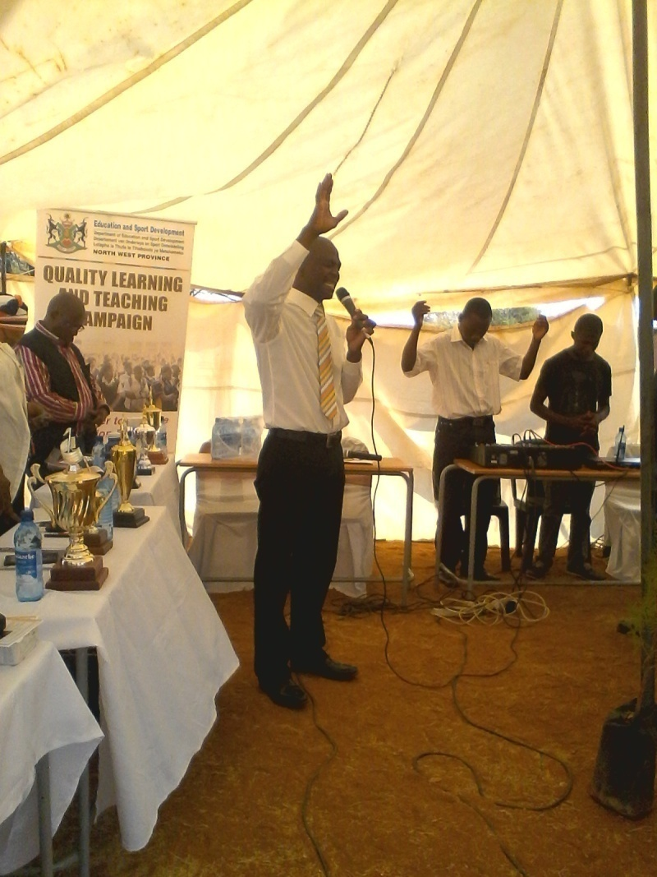
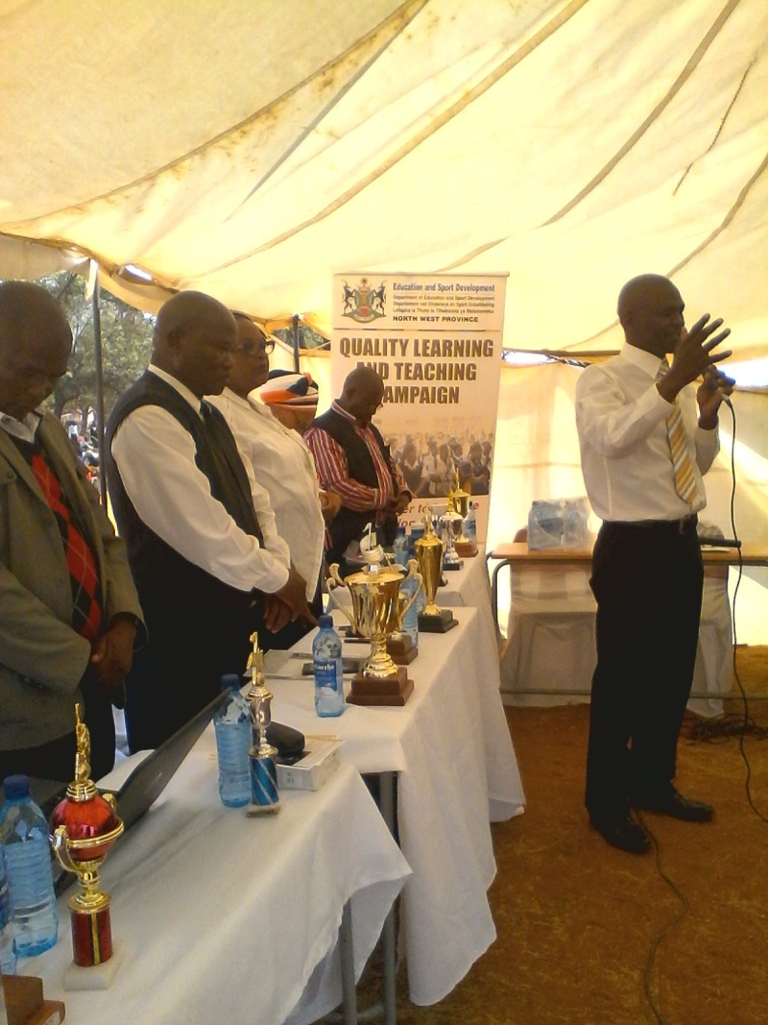
Pastor khunou opened with the sermon and prayer

Slide 4
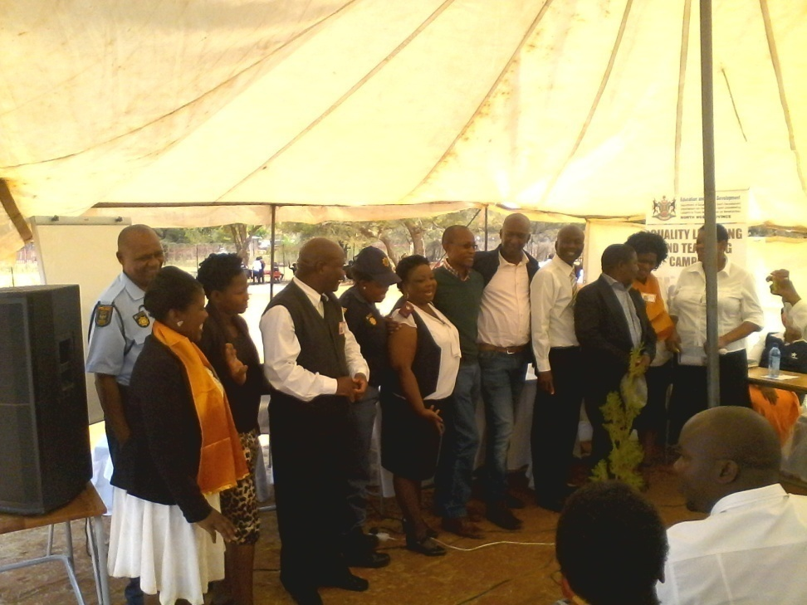
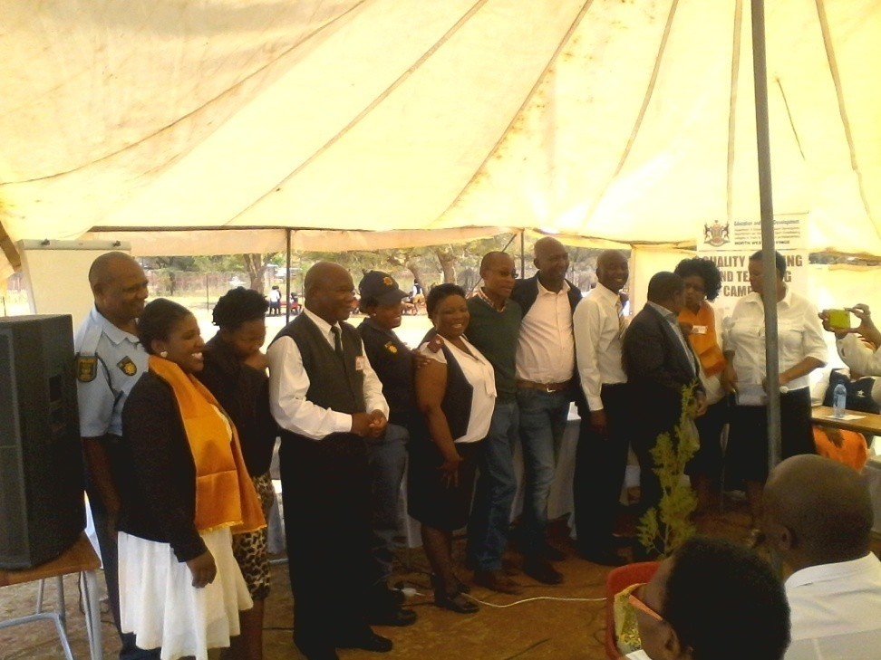
SQLTC STRUCTURE INTRODUCED

Slide 5
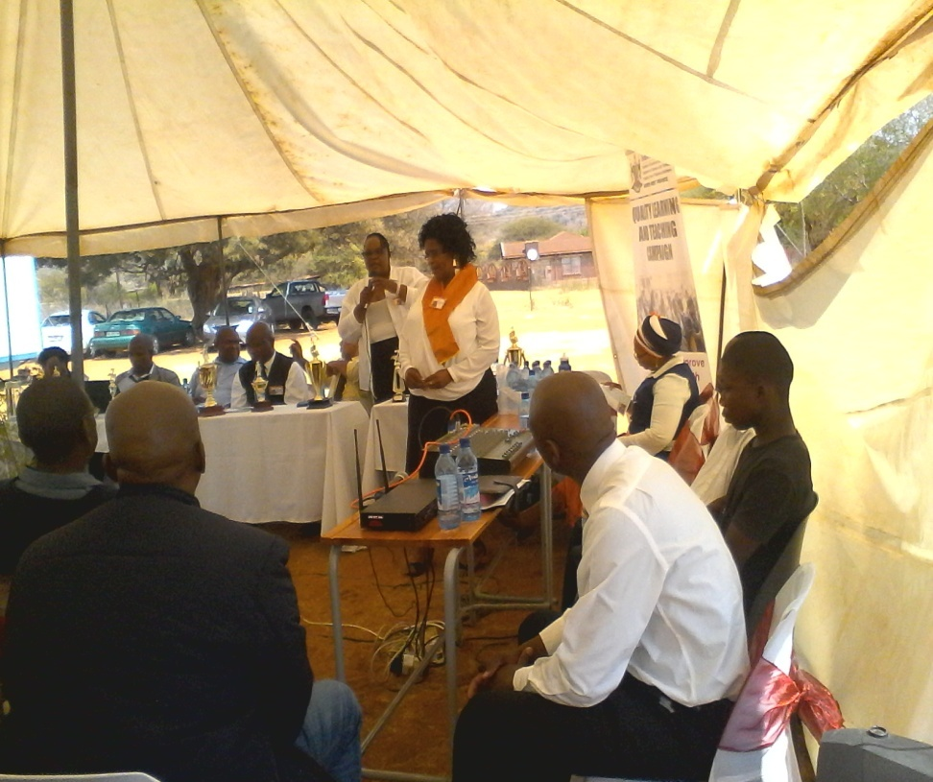
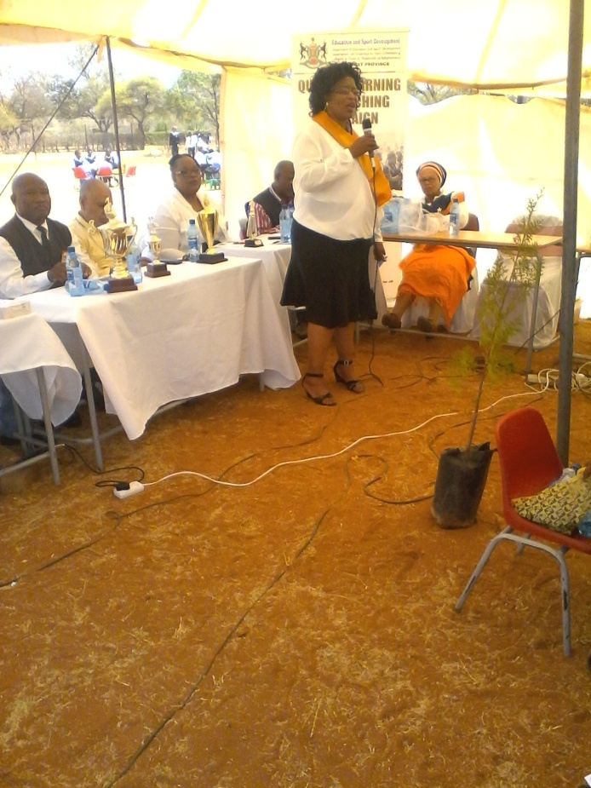
QLTC COORDINATOR GIVING PURPOSE OF THE DAY
MS Mafoko saying together we can make it.
Ms Mafoko with the motto “Tlou e kea rona”

Slide 6
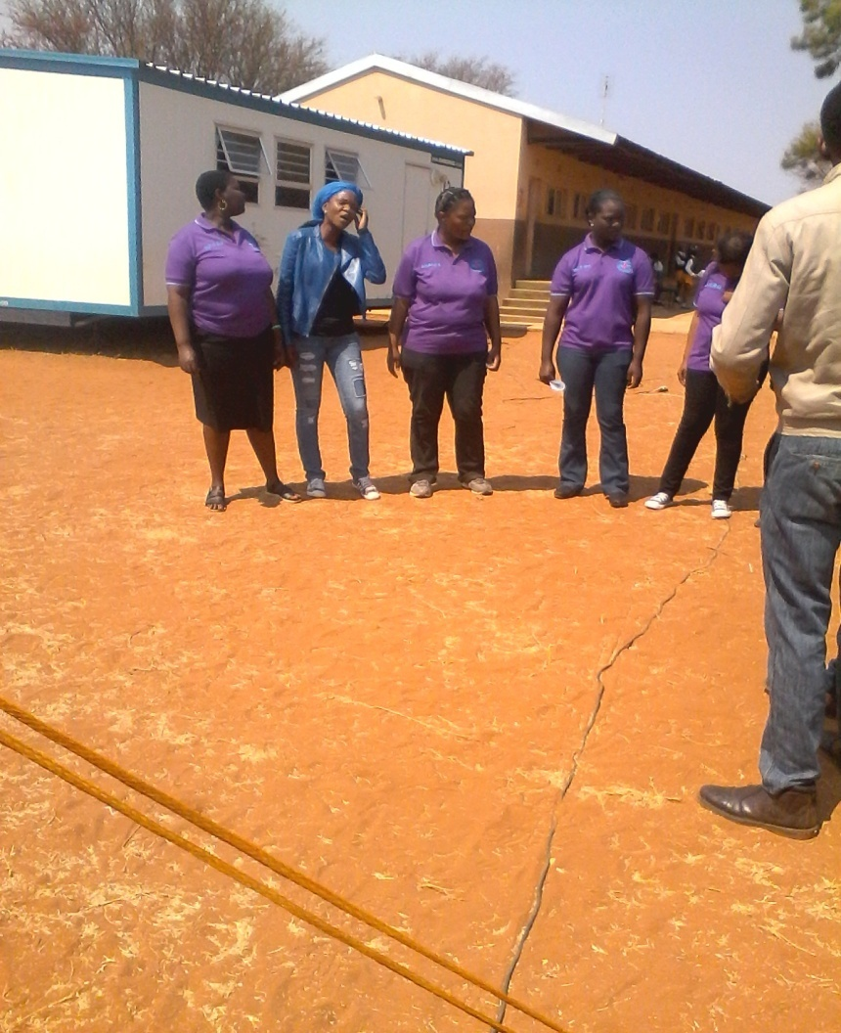
TALENTED TSHEPANANG YOUTH CHOIR

Slide 7
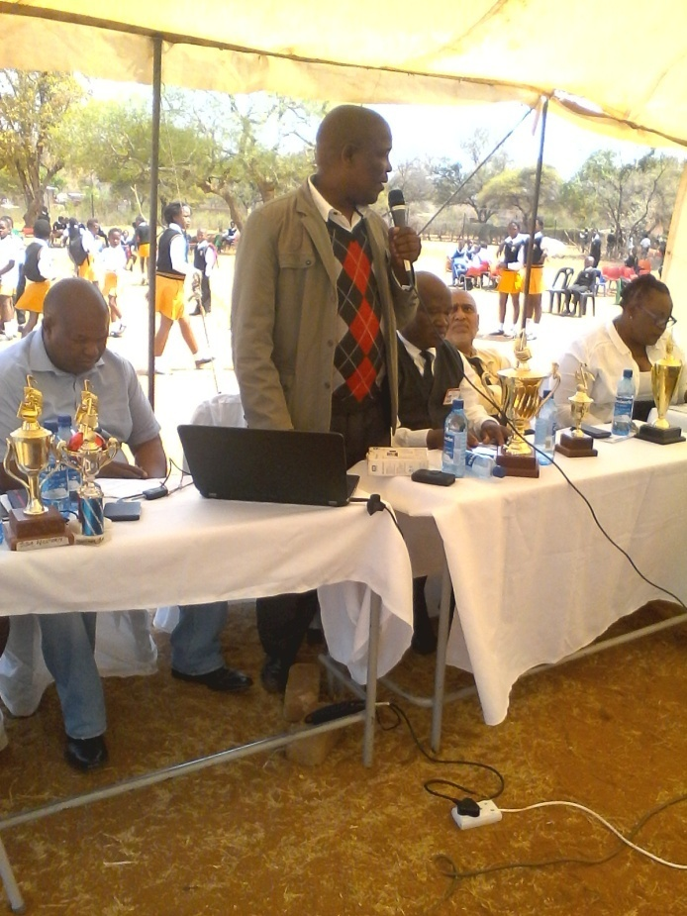
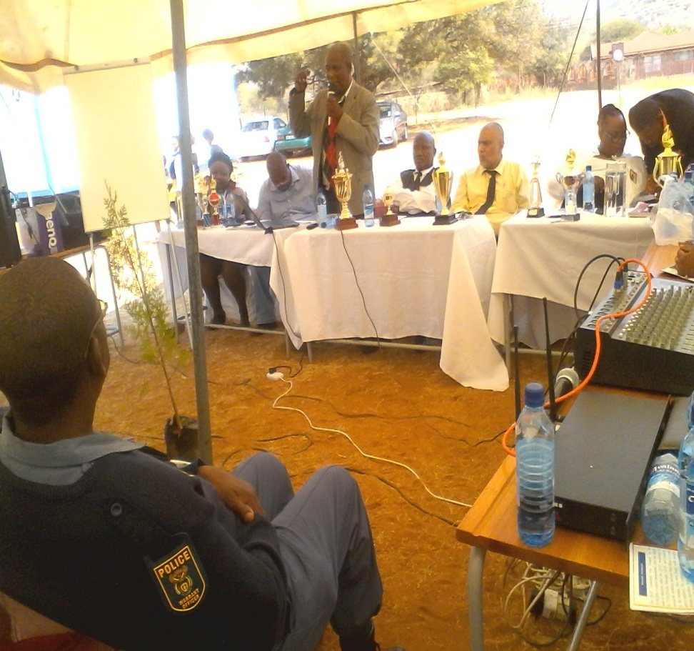
MR. TSEPE I-explained to the people what QLTC is all about

Slide 8
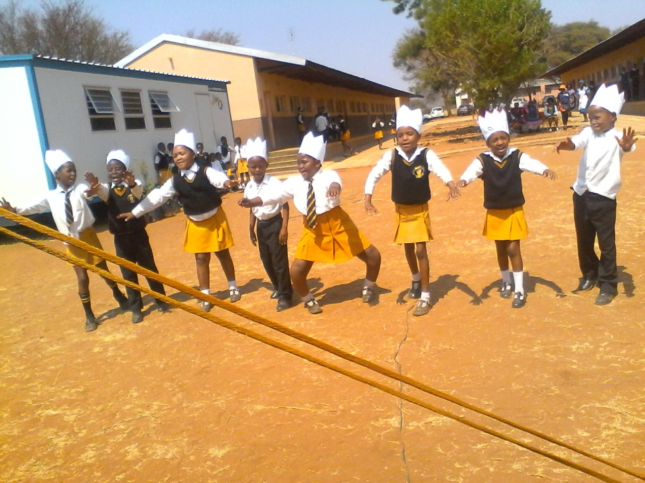
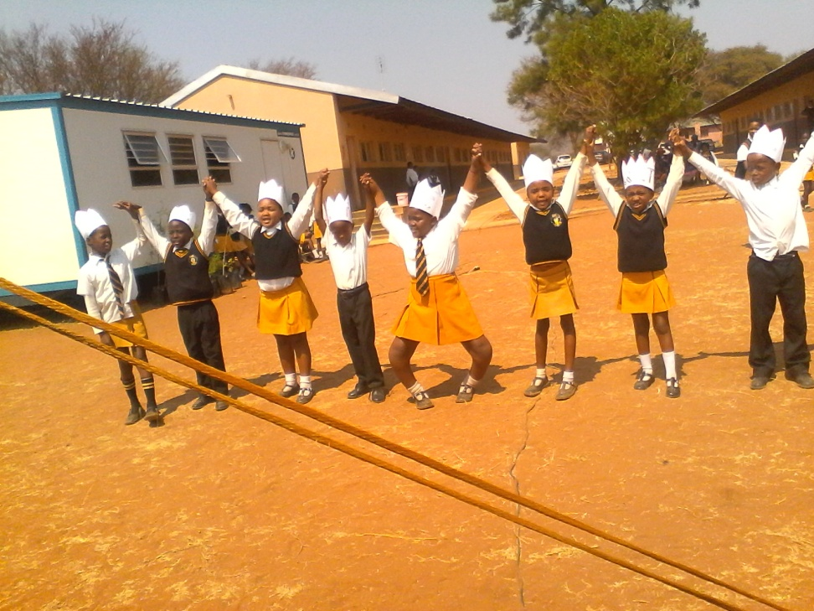
Our talented and skilful grade 2 poets saying all stakeholders participate
Welcome all
Let us work together

Slide 9
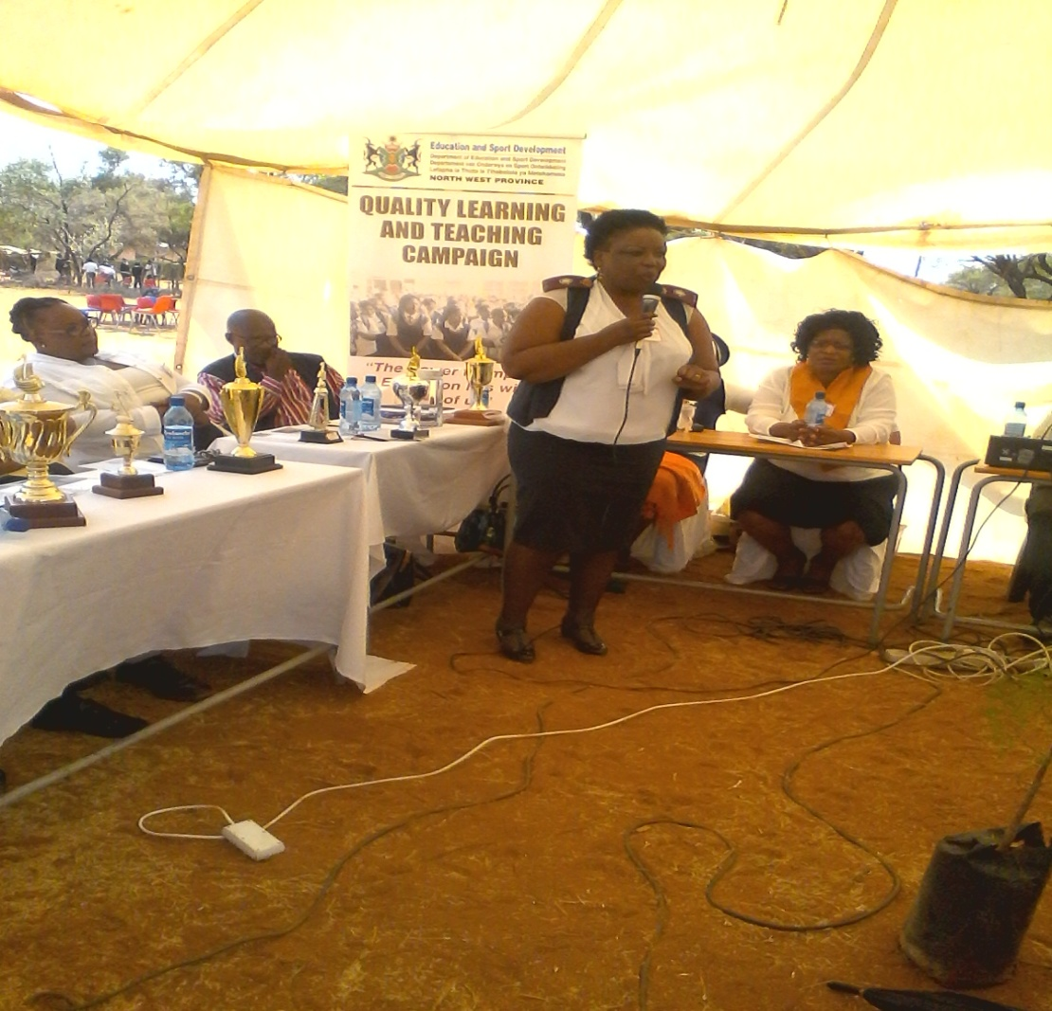
Sister Nkosi explains problems found in schools

Slide 10
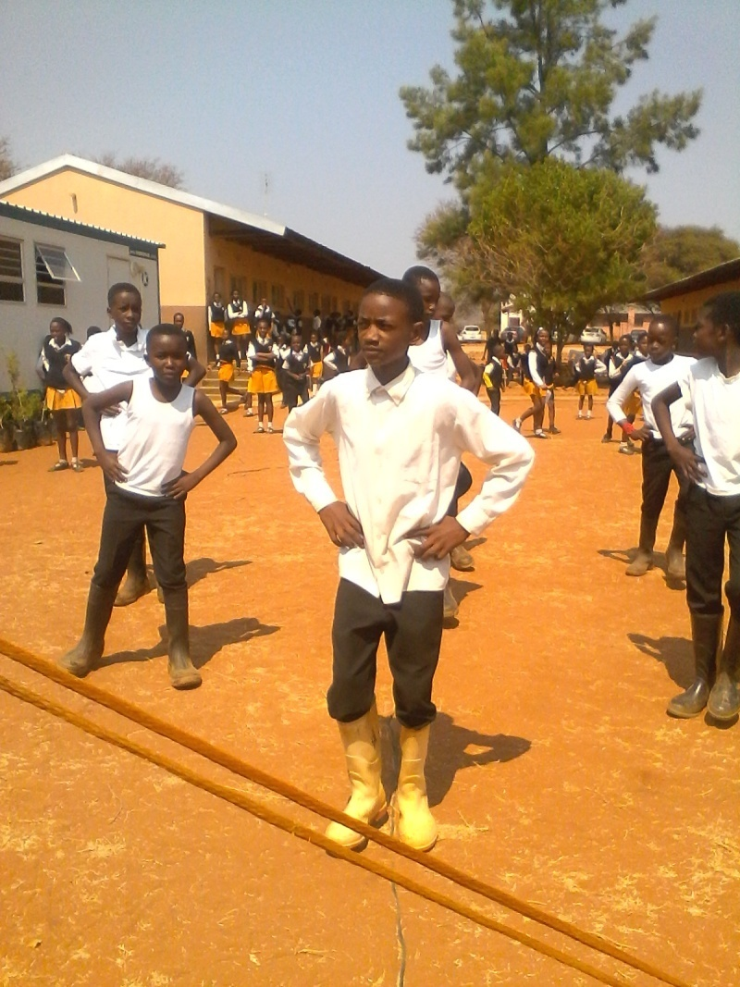
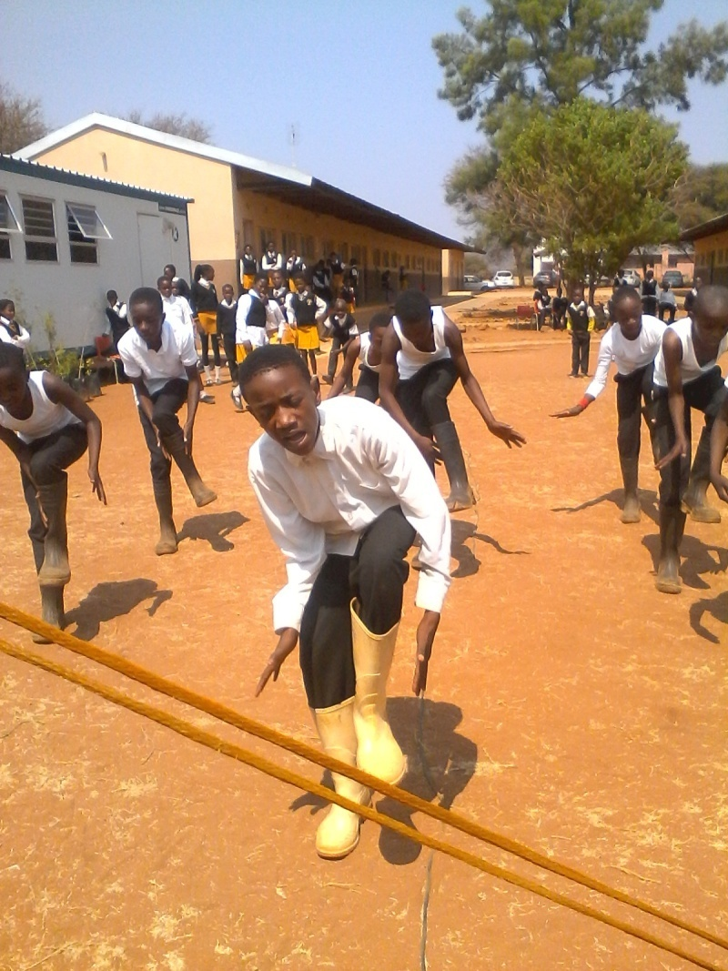
Gumbuts saying “mme ntshware”

Slide 11
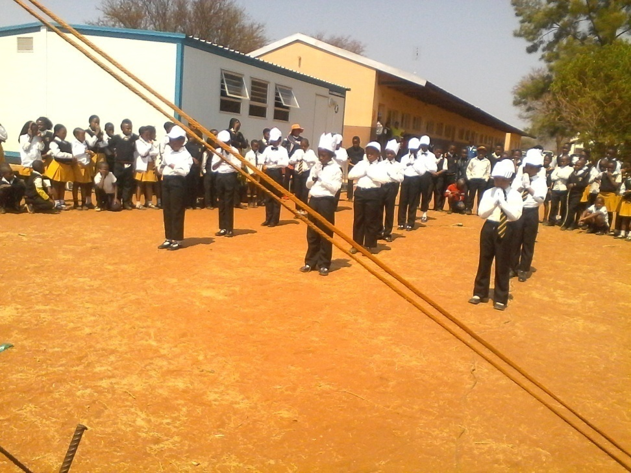
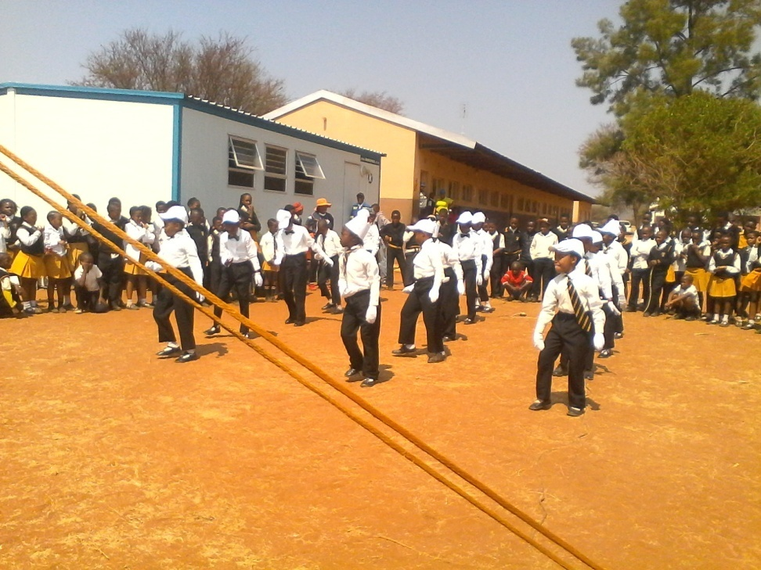
Talented modern movers

Slide 12
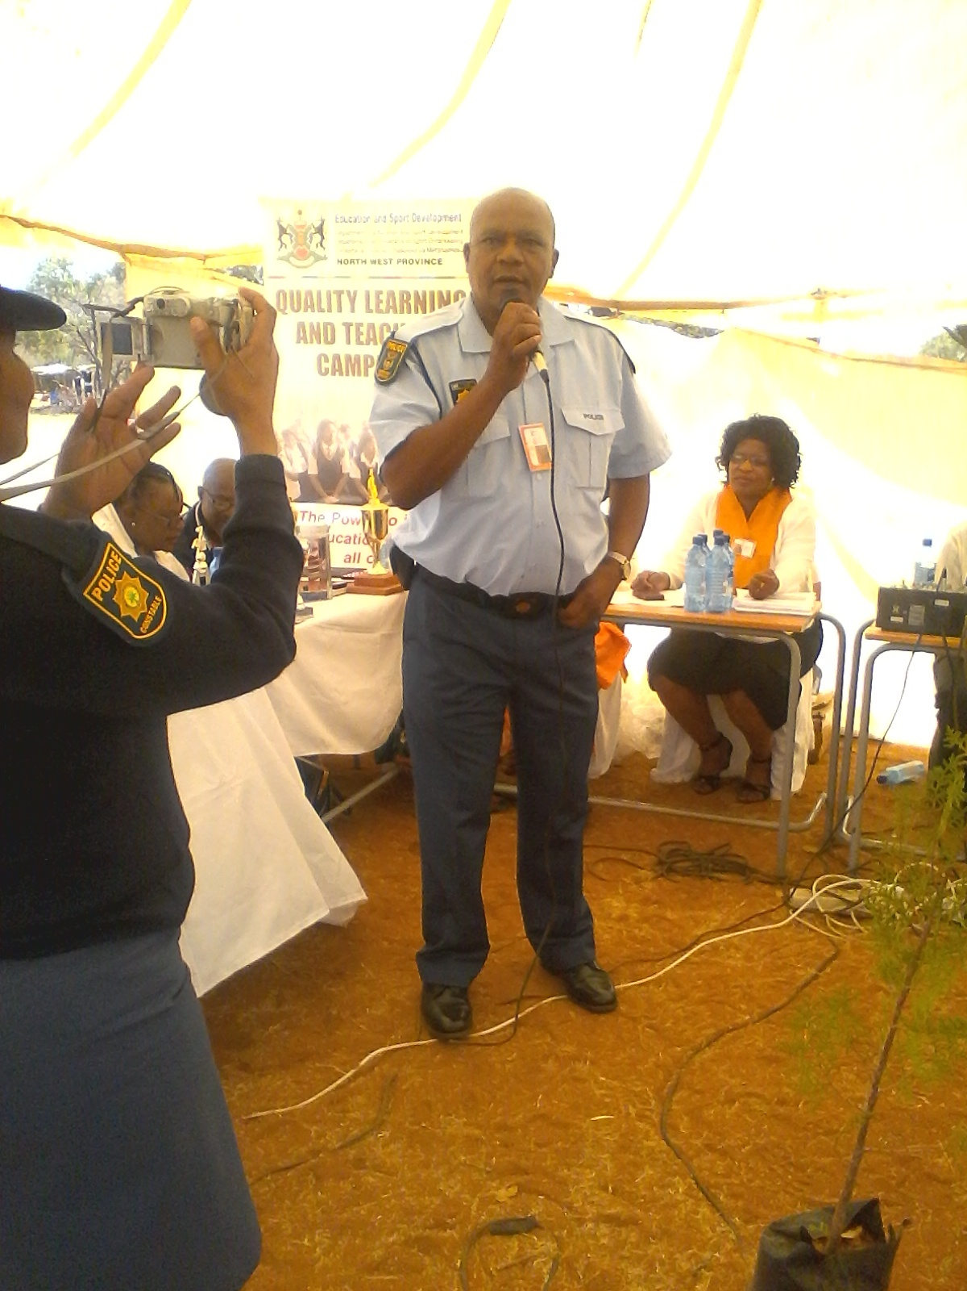
Mr. Kotsi “Adopt-a-Cop”saying never seen such QLTC in his life-”I thought I have seen QLTC in some schools but this is the first”

Slide 13
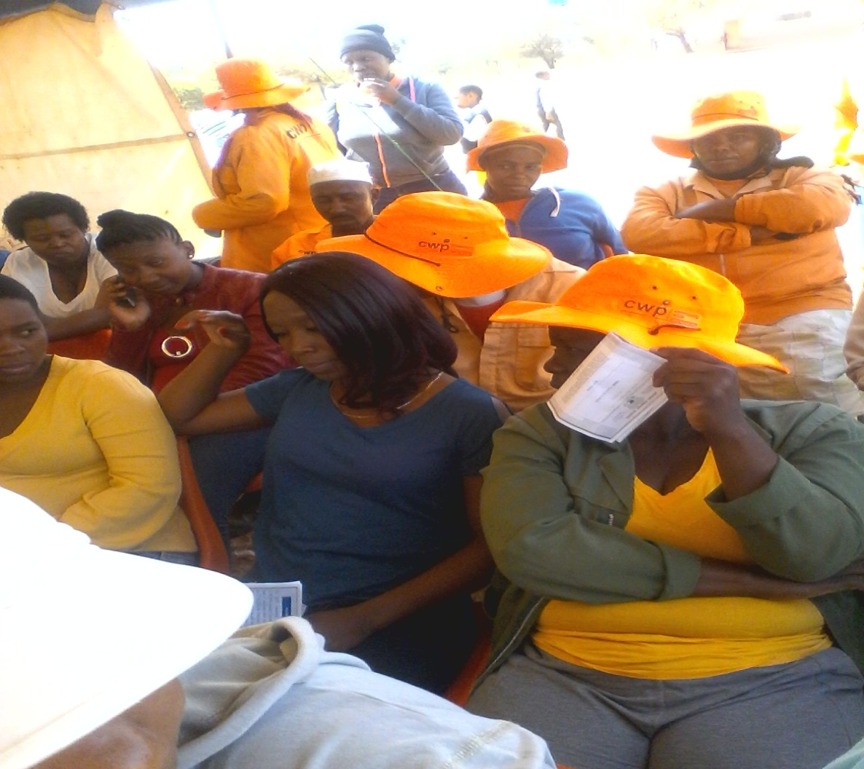
CWP well represented

Slide 14
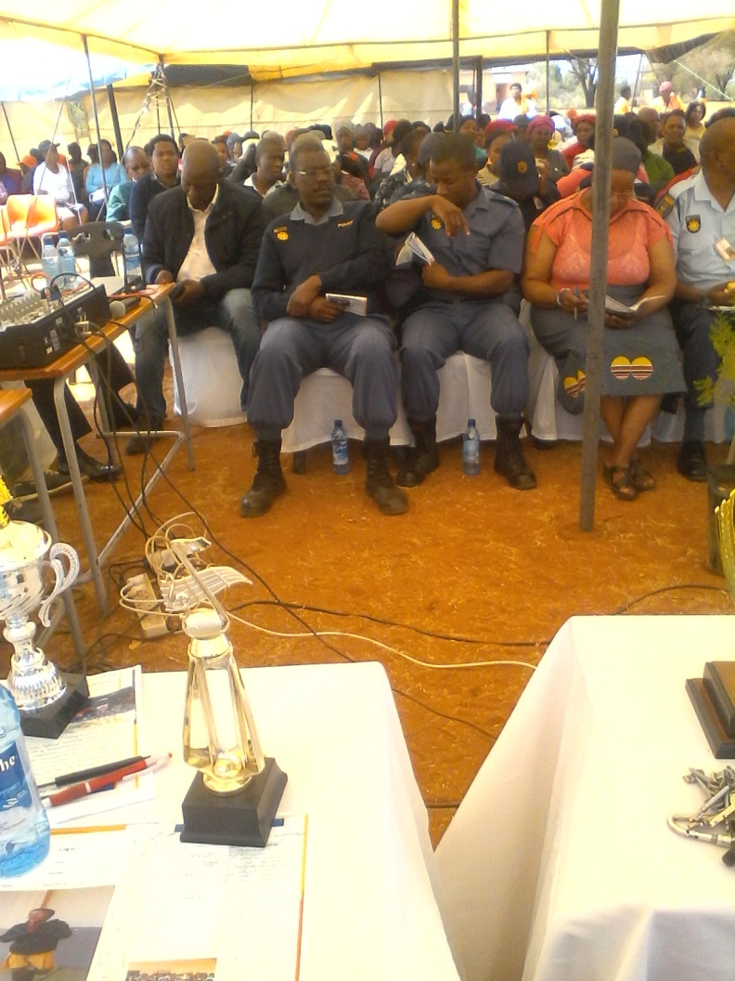
POLICE WELL REPRESENTED

Slide 15
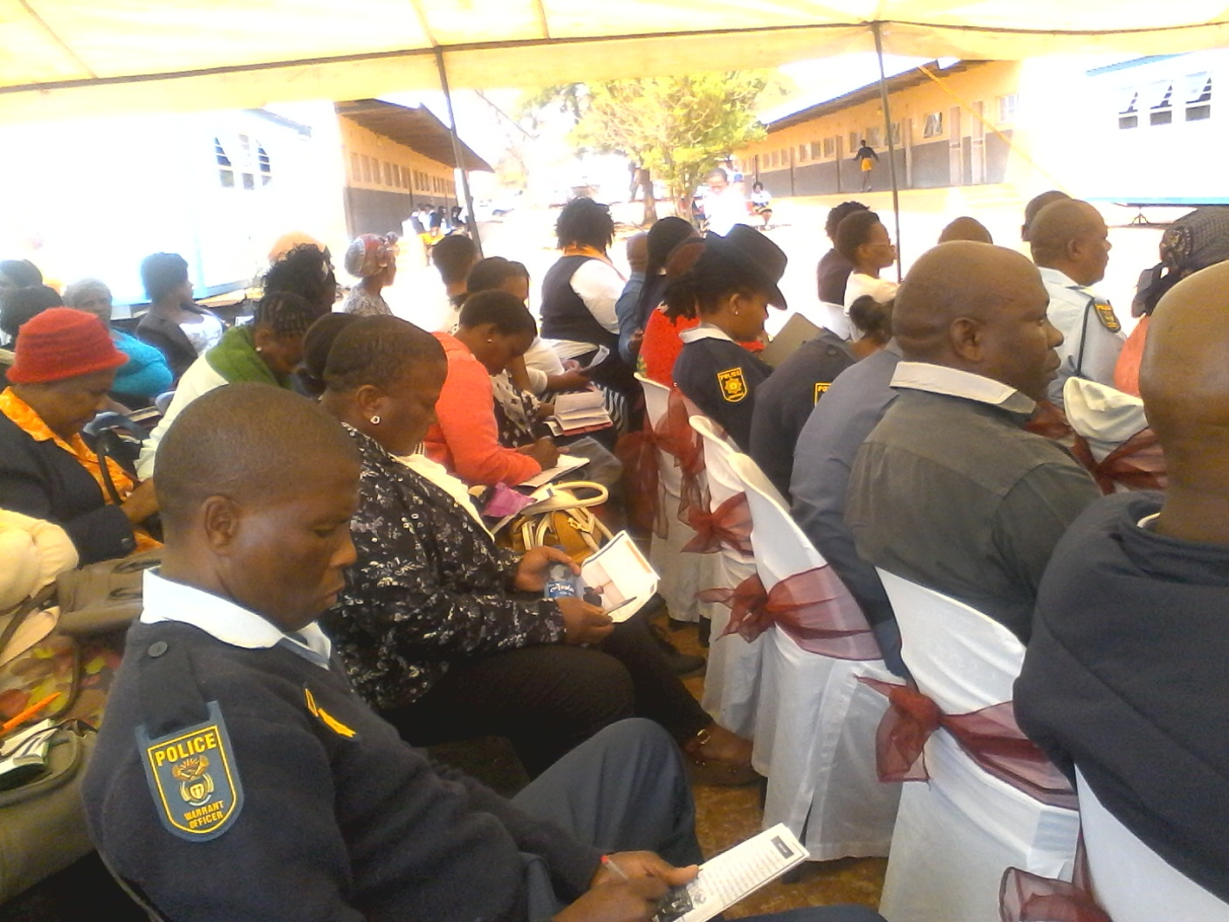
AUDIENCE PAYING ATTENTION

Slide 16
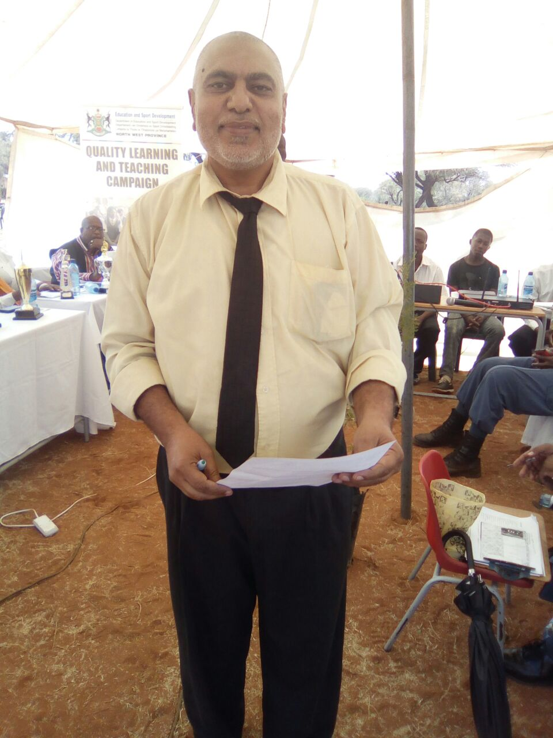
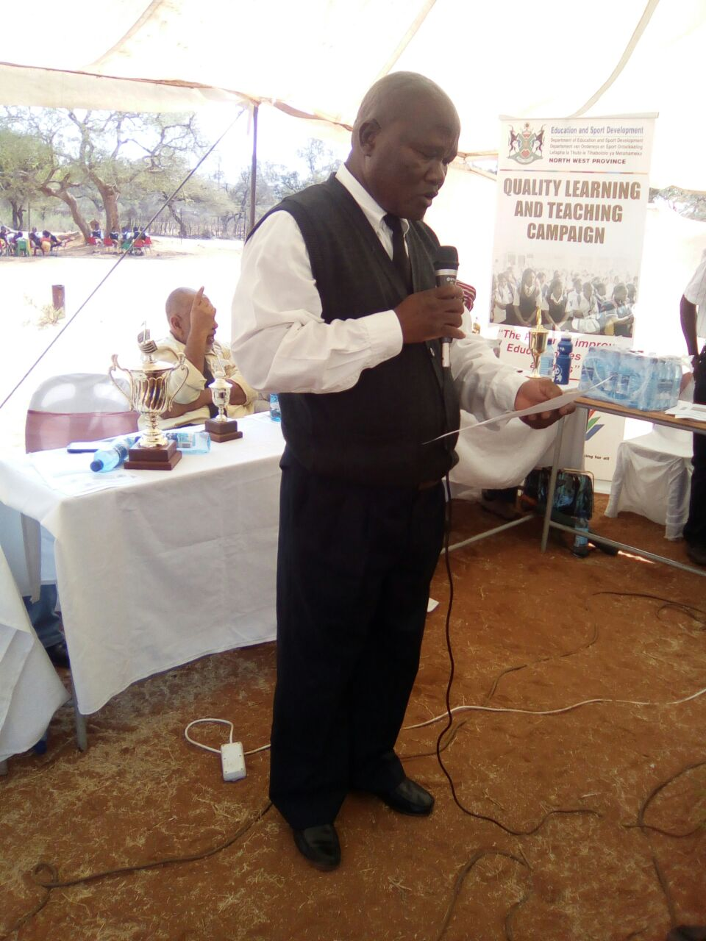
TIME FOR PLEDGES
The circuit manager Mr. Z Cassims pledging that he will support the school principal to make sure that quality education will be delivered
The Principal saying so help me God to make sure that I deliver quality Education that is expected by the people and department

Slide 17
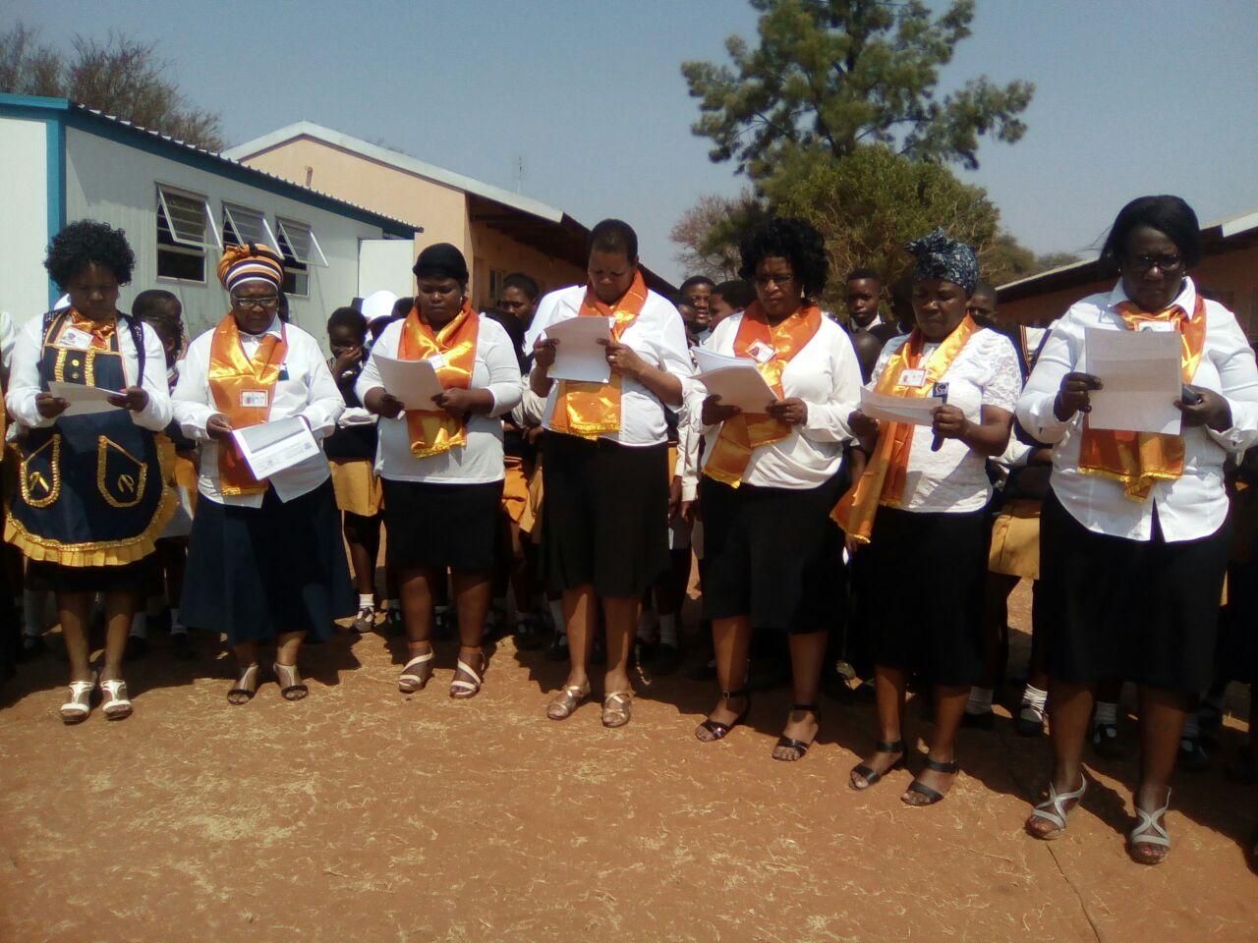
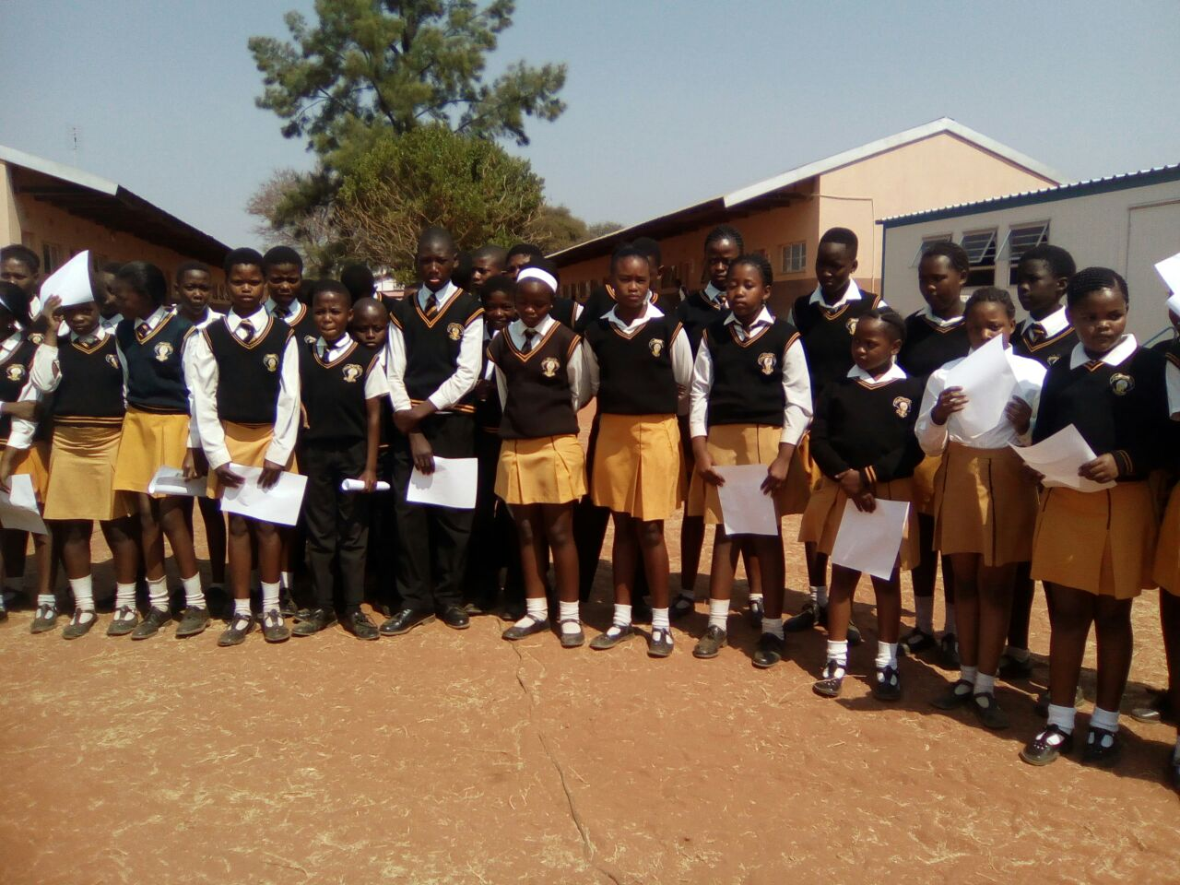
TEACHERS AND LEARNERS PLEDGING
Teachers saying “we will be in the classes in time Teaching ”
Learners saying “we will be in the classes in time learning and respecting our teachers”

Slide 18
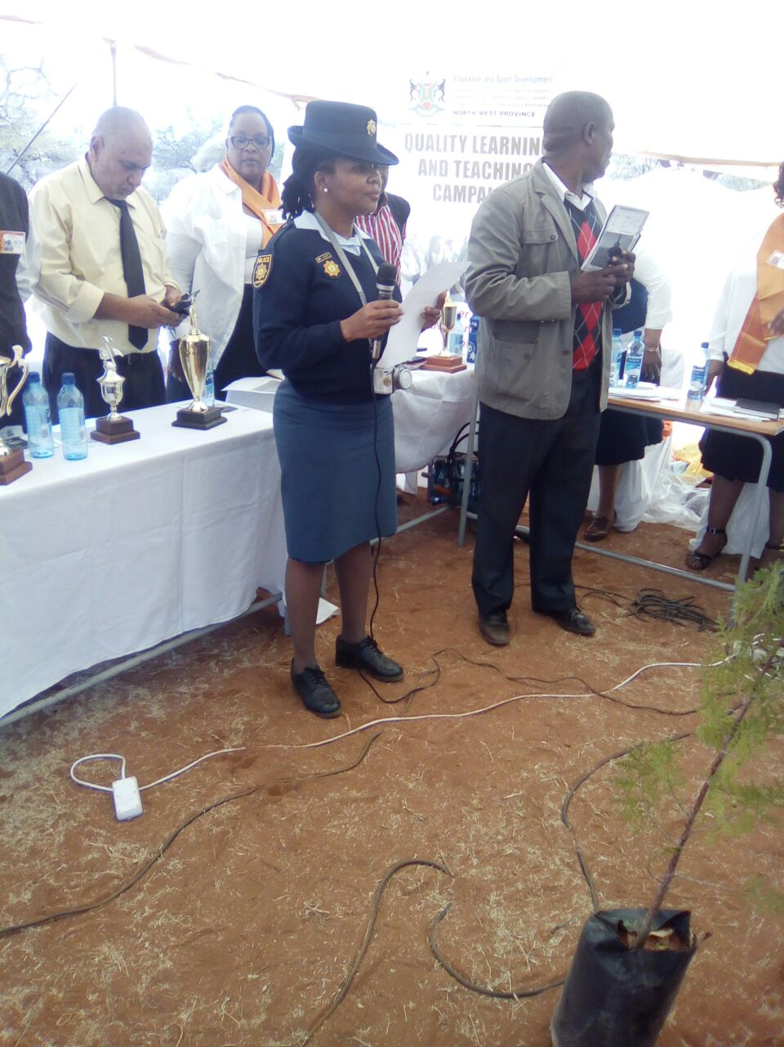

Parents & Community Pledges
Ms Mokoto a parent of Kgothatso Mokoto representing parents on pledges,saying “we as parents, we will support our children and & educators to make sure that they learn what is quality.
The Community members saying “we will love this school, take care of it, we will not allow thieves to steal or any act of vandalism in this school

Slide 19
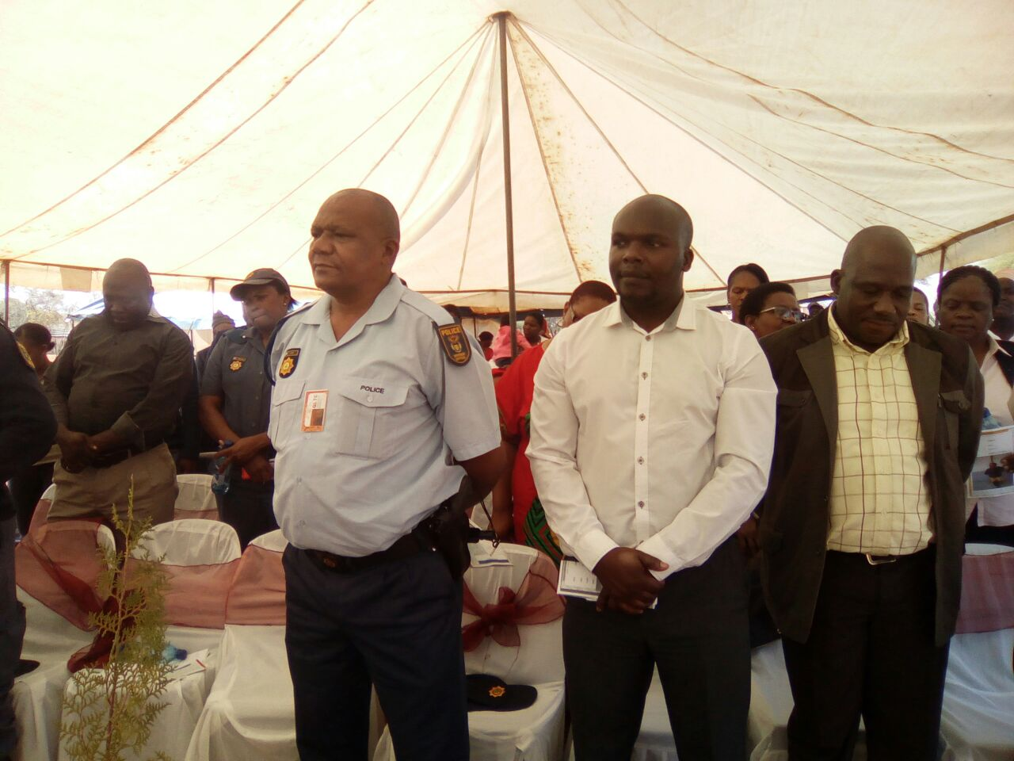
Honouring pledges of different stakeholders

Slide 20
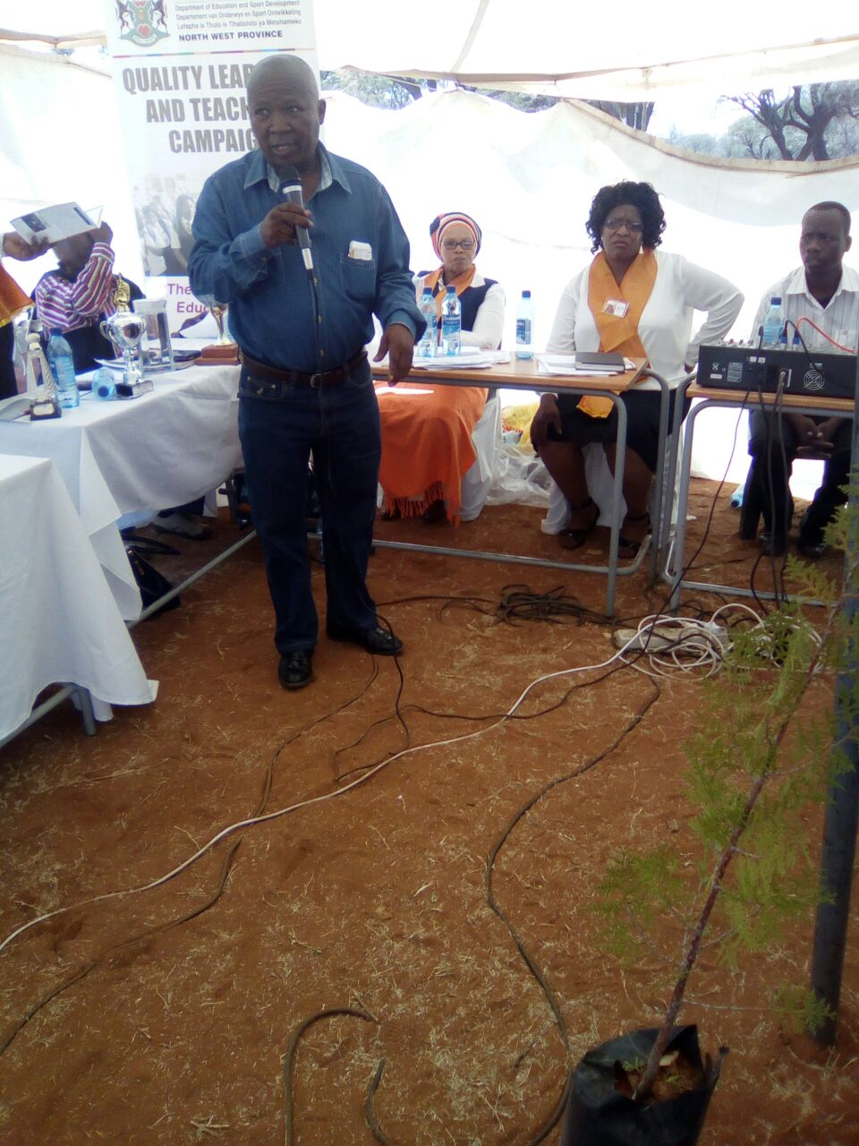
ARBOR CELEBRATION
The event of was not yet over until Mr. Modisane the NSNP “Boss” explain the purpose of celebrating Arbor day, saying it is very important to observe this day as the nature should be well taken care of, saying the fruit & shade trees are needed in our environment. He further explained that his office came all the way from Mafikeng to teach the schools and community how to plant the trees, what kinds of trees the schools may plant .

