Slide 4
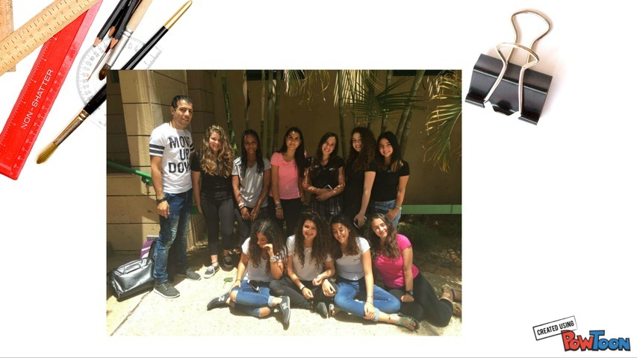

Slide 16
www.powtoon.com

