Slide 1
Transformational Leadership
By Alex Walker

Slide 2
Definition
“A leadership approach that causes change in individuals and social systems. In its ideal form, it creates valuable and positive change in the followers with the end goal of developing followers into leaders…transformational leadership enhances the motivation, morale and performance of followers through a variety of mechanisms.”
Notes:
In essence, transformational leadership is a style of leadership with a charismatic leader at the helm, who is able to identify a needed change and then clearly define a vision for enacting that change for the organization. He/she acts as a role model for his/her supporters to emulate, and inspires , supports, and motivates them to move beyond self-interests to participate in a collaborative process, in which they view themselves as one part of a team working together toward achieving a unified goal. (click)
https://www.langston.edu/sites/default/files/basic-content-files/TransformationalLeadership.pdf

Slide 3
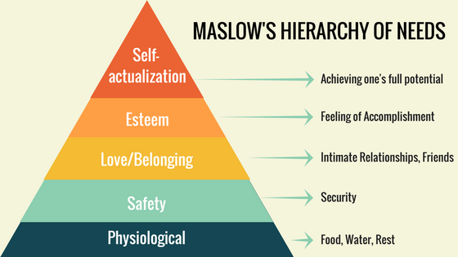
History: Original Concept
James MacGregor Burns (1978)
Established Two Concepts:
Transforming Leadership
Transactional Leadership
Two Mutually Exclusive Styles of Leadership
Notes:
James MacGregor Burns –is considered the father of the concept of transforming leadership. He examined different leadership models in his 1978 book Leadership. His work was influenced by Abraham Maslow’s Theory of Human Needs (click) which essentially asserted that human behavior is influenced by needs and seeking ways to fulfill those needs. It was the higher range of needs that Burns was interested in exploring.
His central focus was identifying the difference between transactional and transformational leadership to understand how to best motivate followers.
Transactional leadership: He believed that most leadership models focus on transactions (or exchanges) between the leader and followers as a way to increase performance. Specifically, the transactional leaders works within set established goals and organizational boundaries and emphasizes organization, performance evaluation and rewards, and is task- and outcome-oriented.
Transforming Leadership: while transforming leadership is a process in which "leaders and followers help each other to advance to a higher level of morale and motivation“. He theorized that the transforming approach creates significant change in the life of people and organizations by redesigning perceptions and values, and changes the expectations and aspirations of followers.
Instead of a give and take relationship, transforming leadership is based on the leader’s personality, traits and ability to make a change through example, articulation of an energizing vision and challenging goals. Such leaders are the moral exemplar of working towards the benefit of the team or organization.
He viewed it as a force for good and denied it could apply to negative leaders.
Interestingly, this was the first leadership theory to introduce ethical and moral dimensions as a cornerstone of the theory.
The key to his theory was the idea that the transformational leader was an exceptional role model.
Mutually exclusive: Burns also argued that the two leadership styles were mutually exclusive
Transactional: are not working to change the culture of the organization but instead work within the existing culture through rewards and punishment. Essentially, they work within the status quo.
Transformational: try to change the organizational culture by challenging the status quo (click)

Slide 4
History: Development of the Concept
Bernard M. Bass (1985)
Developments
Psychological Mechanisms Explained
Transformational (replaces transforming)
Measurement of Transformational Leadership & Impact on Follower Motivation and Performance
Full-Range or Full-Continuum of Leadership (not mutually exclusive)
Three Ways to Influence Followers
Notes:
Bernard Bass contributed to and expanded on Burns’ work by focusing on identifying the psychological mechanisms that influence transformational leadership and to provide a test for measuring a leader’s transformational capability
Opted to use the term transformational as opposed to transforming. And while he originally disagreed with Burns and argued that the theory was amoral in other words, that vision and charisma are not always a positive force or a force for good, and instead bad actors may display similar characteristic (for example, Jim Jones) but eventually, after consultation with Burns, he later agreed that the theory had a moral agent and should always be used for good. Otherwise, it was pseudo-transformational leadership.
Like Burns, he was also critical of transactional approaches, which he viewed as leading to stagnation and long term-problems due to a lack of forward vision (“if it’s not broke, don’t fix it” mentality).
Bass believed that the transformational leadership “Broadens and elevates the interest of employees”, “generates awareness and acceptance of the purposes and mission of the group” and can ensure “employees look beyond their own-self interest for the good of the group or organization as a whole.”
And as part of his research he developed a concept for measuring transformational leadership and how it impacts follower motivation and performance.
Bass identified 3 ways to transform or influence subordinates
Enhancing the followers’ awareness of the importance and value of the task
Directing subordinates to achieve the operational goals first, instead of their own personal interests
Activating the followers’ higher-order needs
Importantly, he did disagree with Burns argument that the two theories were mutually exclusive. Instead, he argued that they existed on a continuum of leadership, which leaders could utilize in varying situations to achieve their goals. (click)

Slide 5
The Continuum of Leadership
Ineffective
Passive
Active
Effective
Notes:
According to his continuum there are three models of leadership that range from ineffective to effective:
Laissez-Faire leadership-Characterized by a complete hands-off approach. The leaders have little or no contact with followers, no strategic plan, and provide no feedback. Ex. A company owner not involved in running the company
Transactional leadership: most common and typically works to boost performance using two mechanism
Contingent reward: The leader provides a reward in exchange for effort by the follower. Typically involving direct or implied negotiations.
Management by exception: which takes two forms
Passive form: Is on in which the leader waits until things go wrong and follower is unaware of the coming retribution for their mistake. Corrective action is typically negative in the form of a punishment.
Active form: the leader utilizes detailed performance metrics to track performance and distribute punishments and rewards accordingly.
Transformational leadership: Finally, transformational leaders tend to have a strong set of internal values and they are able to inspire their followers to adopt theses same ideals and share in their vision by creative a collaborative environment of mutual respect and trust. They are able to instill a strong sense of working towards the greater good in their followers and empower them to become leaders themselves through mentoring and coaching.
Transformational leaders are characterized by what Bass termed the four I’s (click)

Slide 6
Four Elements of Transformational Leadership
Idealized Influence
Inspirational Motivation
Intellectual Stimulation
Individualized Consideration
Notes:
These four elements can be thought us as the tools by which leaders can transform their follower’s desires in order to bring them into alignment with the leader’s vision for the organization.
The first is Idealized Influence-in which a charismatic leaders models the behavior they expect, which in turn influences and motivates followers to emulate their example
In essence, the leader practices what they preach.
Such leaders are typically characterized as having strong morals and are thought of as highly ethical. They show conviction regarding the vision they sets out, perseverance regardless of the consequences (including placing themselves at risk), and sharing information with subordinates, which causes relationships to be built between the leader and subordinates that are based on trust and respect and leads subordinates to develop a sense of confidence in and eventually look up to the leaders as a role model.
The leader sparks confidence, motivation, and a clear sense of purpose, which causes the subordinates to internalize the leader’s values and emulate his/her behavior.
This begins the process of internalizing the leader’s ideals
The second element is Inspirational Motivation-In which the leader must articulate and continuously communicate well-defined, well-understood, and inspiring values and goals to the followers.
Subordinates must be constantly aware of what is required of them in order to achieve the big picture.
They must have a strong sense of purpose to motivate them and provide the energy for them to act.
Leader must convey how the contributions of the team will bring success to their shared goals.
Inspirational motivation is based on tangible objectives and optimism about achieving them
The leader must show confidence in subordinates and support them to achieve the goals through a focus on self-development
The goal is to connect the follower’s sense of identity and self to the mission and collective identity of the organization
The third element is Intellectual Stimulation
The leader wants to challenge the status quo and take risks. The leader and subordinates work together to problem solve and develop better ways/processes of achieving the goal/system.
Such a leader places emphasis on the subordinates’ autonomy, intellectual stimulation, shared decision-making and innovation, and freedom to express disagreement.
The leader must also encourage the contribution of ideas and when he/she disagrees must avoid saying an approach is wrong, instead encourage them to think about it a different way and come up with an alternative solution.
The final element is Individualized Consideration-In which the leader listens and attends to each follower’s needs/concerns , then acts as a mentor or coach to help motivate them towards self development.
Such a leader celebrates team efforts but also acknowledges the contribution of individuals which provides individual motivation for self-development.
Transformational leadership is based on Maslow’s Hierarchy of Needs and the transformational leader recognizes that not all of the desires and needs of followers are the same.
Individuals have different motivations and the leader must address the individual subordinates’ personal needs and desires in all areas of life (professionally and private) to get the most from the subordinates. By knowing the strengths and weaknesses of each individual, the leader can align tasks that optimize their performance in achieving the overall group’s goals and the leader can accomplish this by finding ways to address a subordinate’s needs and aligning them with the larger goals of the organization.
One on one coaching and mentorship crucial for this element. (Click)
https://www.youtube.com/watch?v=8HMp56_mu_g
https://www.langston.edu/sites/default/files/basic-content-files/TransformationalLeadership.pdf

Slide 7
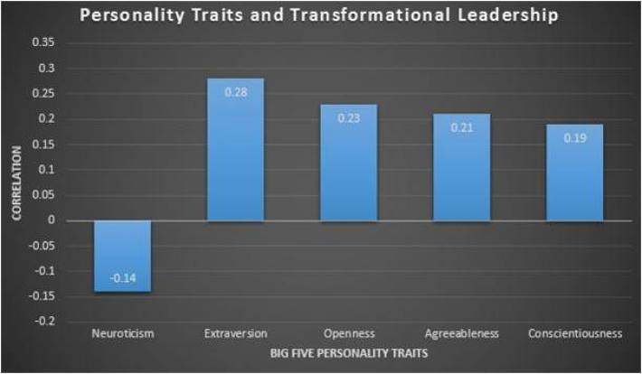
Measuring Transformational Leadership: Multifactor Leadership Questionnaire (MLQ
Notes:
In order to measure the leader’s level of transformational leadership Bass developed the multifactor leadership questionnaire. A process by which the leader rates himself based on the five factor model of personality
The test is known as a 360 degree evaluation because other members of the organization (subordinates and superiors) also rank the leader so that the leader can compare their impressions of themselves to those of everyone else
Tool to identify strengths and weaknesses and provide a roadmap for personal development
As you can see there are five personality traits associated with transformational leaders based on the 5 factor model of personality with extroversion being the most important and neuroticism being the least important. (Click)
Openness to experience
Transformational leaders seek to challenge the status quo and are constantly seeking new experiences. They are always looking to improve, so they must have new experiences, which increases their creativity. Creativity is important to convince subordinates’ to be invested in his/her goals.
Conscientiousness
Desire for achievement and willingness to make changes necessary in order to achieve those goals.
Extraversion
Most important trait of transformational leader.
Leaders must mutually engage with the subordinates.
Extraverts are typically charismatic and usually have strong communication skills, which they can use to persuade others.
Agreeableness
Related to charisma, which is further associated with the traits of generosity, affection, empathy, consideration, etc. This forms and strengthens the relationships between the leader and subordinates.
Neuroticism
Least linked trait for a transformational leader. Transformational leaders lead groups, and have high self-esteem/self-confidence.

Slide 8
Strengths:
Goal is to create change. Change is inevitable and necessary for success.
Well-researched theory with proven effectiveness
Interactive process that develops relationships
Complimentary to (not dismissive of) other approaches
Develops followers into leaders with transformational leadership qualities
Notes:
First, this theory puts change and innovation at the core of the organization and in business the need for change is inevitable
A stagnant approach to running a business can lead to problems, especially in the long run, as an organization must always have its eyes on the future to stay relevant. Think about the old type writer companies who used to dominate the business sector, a few decided not to look towards the future and remained stubborn and dedicated to the typewriter, soon IBM supplanted them all.
Second, this is a well-researched theory with proven effectiveness-in fact Ronal E. Riggo, a psychologist and leadership expert, found that this leadership model leads to “higher levels of performance and motivation”
The reason it is effective is because of its focus on a clear vision. When a leader provides a clear vision, it’s easy for the subordinates to follow.
Such a leader provides clearly defined objectives and structures that support the vision by establishing short-term objectives in order to reach the long-term goals. So it straddles the line between short and long term aspirations.
Third, this is an interactive process between leaders and followers that develops relationships conducive to collaboration
It emphasizes community/team work instead of personal gains, which requires mutual respect, and trust.
Studies show cooperation is more effective in achieving goals than competition – game theory
Fourth, it is complimentary to (not dismissive of) other approaches
Finally, and most importantly, it develops followers into leaders with transformational leadership qualities themselves (click)

Slide 9
Weaknesses:
Lacks conceptual clarity
Lack of research in organizational transformation
Potential for abuse
Reality blindness
Self-promotion above all else
Notes:
First, there is a lacks conceptual clarity
It is difficult to define what transformation means.
Second, there is a lack of research in organizational transformation specifically
However there is recent research by Bennis and Nanus that studied how transformational leaders transform organizations and they identified four strategies typically used to change organizations. So research is building in this area.
Third, there is a potential for abuse
Fostering a positive and supportive atmosphere may make subordinates unwilling to critique the leader or the project
The charisma and vision of the leader could be used for harm rather than good
When the leader calls for unity, it can cause conformity instead of collaboration and make it easy to go along with the leader regardless of what he/she says.
Example: Mau Tse Dung
However, when used for ill purposes, the theory becomes pseudo transformational due to the coercive use of power to enact change
Fourth, there may be a reality blindness present in which the leader is so fixated on the vision or goal that he/she is unwilling to investigate things further or confront inconvenient facts
This can lead to a sort of overdependence-the group wastes time on unrealistic or unattainable goals due to the leader’s enthusiastic approach
Finally, there is a risk that such a leader will place self-promotion above all
Leading through example risks slipping into self promotion -leader may become so preoccupied with preserving and promoting their self image that support for subordinates diminishes (Click)

Slide 10
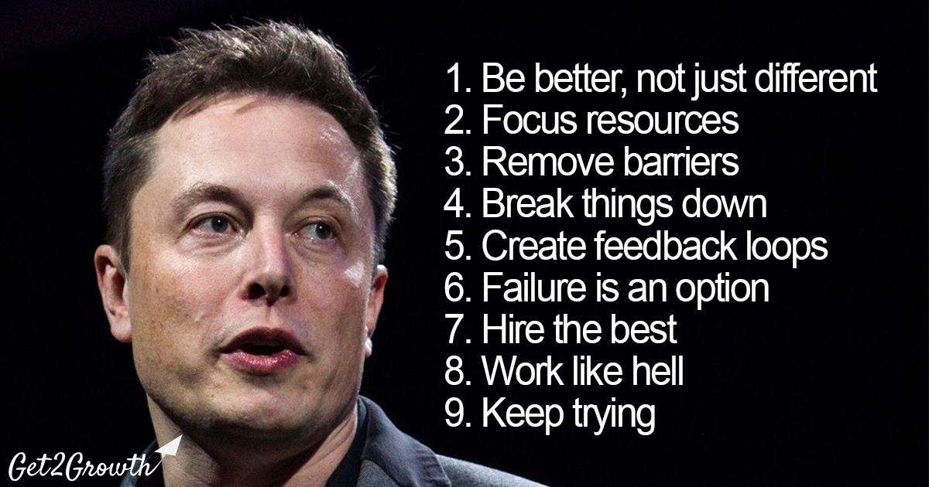
Examples
Jeff Bezos
Elon Musk
Notes:
Jeff Bezos:
Charismatic-able to inspire confidence and secure the commitment of talent and investors to his vision.
His vision helped transform the face of business. Amazon went from being an online book retailer to offering more than 15 million products today. They have also expanded into other services such as cloud services, Prime membership program, Kindle, and other areas.
Challenged the status quo and helped people expand the way they think. Amazon started by shaking up retail book sales, but Bezos encourage and inspired his team to think much broader. For example, they have continued to expand and innovate the product delivery services for customers. They are even testing drones for delivery of packages.
Elon Musk-clearly fits the definition of a transformational leader:
He articulates a clear vision that is attractive, simple, understandable, and beneficial. His vision motivates and inspires his followers, and he demonstrates perseverance as he strives to actualize his vision.
He not only inspires his employees to accept his standards and philosophy, but supports his team even when things go wrong and views failure as an opportunity to learn.
For example, when the SpaceX rocket failed on the first launch attempt, he addressed his employees directly, encouraging them to press ahead and stating that he would never give up on helping the organization reach his vision. Now, we have entered a new stage of space transportation as direct result of his dedication to the vision. He saw an opportunity to change space flight and now we have reusable boosters that can land themselves autonomously after take off, saving millions per flight.
He earns the trust of his followers.
He demonstrates a level of predictability and reliability that demonstrates his commitment to the organization. For example, he personally funded Tesla motors through its various financial crisis.
He influences and sets the bar for the industries he has a presence in.
Solar city-founded to help combat global warming
Tesla-made electric cars more financially accessible and commonplace; makes Tesla’s technology patents available to the rest of the industry to encourage them to increase their electric vehicle offerings
Space X-partners with NASA to make space flight financially accessible to the average person and to explore colonization as a solution to mass extinction on Earth
He is gifted as spotting what is not working, creating a vision for changes, and enacting his vision by tapping skilled followers that can help make his vision a reality.
Hyperloop-saw a problem with the California High Speed Rail System and set about developing an alternative, which if completed, will revolutionize travel
He is confident in his abilities and acknowledges his weaknesses
To compensate for any areas of weakness he hires professionals at the top of their field and trust them to word to his standard of excellence in performance.
He is known for immersing himself in the tasks and goals of his organization. In fact, he has a reputation for sleeping very little and working directly on projects with his team.
(Click) Finally, Musk operates under 9 principles which point to his transformational leadership style:
Focus on delivering the best quality produce that you possibly can that creates real value for the customer.
Do your one thing exceptionally well
Break down hierarchies and silos to encourage open dialogue, idea sharing, and collaboration
Take problems back to first principles and understand the fundamentals in order to build out solutions
Actively self analyze, and look for criticism and feedback of your thinking and ideas from others
Accept failure, practice for it, and don’t be afraid
Focus on building the best possible team and don’t compromise
Be prepared to put in the effort and roll your sleeves up to get the job done
Be persistent and don’t sell yourself short (Click)

Slide 11
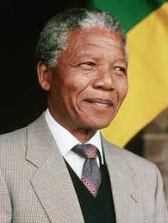
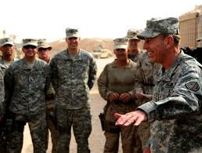
Examples
Nelson Mandela
General David Petraeus
Notes:
Mandela transformed a whole society. He demonstrated the characteristics of a leader that everyone wanted to aspire to. He raised the level of motivation and morality in followers. For example, he forgave the people that imprisoned him and showed that by coming together, society can achieve its goals. He was able to articulate his vision in a compelling and influential way. He took risks and made personal sacrifices regardless of the cost that continue to inspire people to this day.
Petraeus also displayed transformational leadership:
He clearly demonstrated the proper use of the continuum by resorting as much as possible to a transformational leadership style while also falling back on a transactional style when the situation called for it.
Clear vision with specific goals and objectives laid out (p.8). He set the tone for the vision for his organization
Challenged the status quo (He saw a problem and did not wait for others to act or accept that it was unsolvable).
Created a group identity-for example he made it clear that public safety was a shared goal
He got his followers, Iraqis and soldiers, involved by showing that this affected them so they would be motivated
“We need to create as many Iraqis as possible that have a stake in the success of the new Iraq” (p. 24)
Supported his subordinates, who then took on followers themselves (this is an example of subordinates taking on the transformational characteristics of the leader).
For example, his subordinates (in this case battalion commanders) spent time with each police precinct chief, took them along on patrol to model how the US did it, and then developed a plan for joint daily patrols (assigned tasks that they knew they could complete in order to reach the shared goal).
He identified strengths and weaknesses in his followers and assigned tasks accordingly:
For example, Petraeus and his commanders believed that a top down, one size fits all approach to police personnel was not right for every location.
He fostered collaboration between himself and his subordinate commanders
(“Petraeus used to talk with his subordinate commanders, share his sense of the situation, hear their assessments and initiates, and set the course for the division” (p. 21).
Assumed the role of a coach and mentor as he tried to empower Iraqi leaders to exercise as much authority as possible by providing civil training.
He was mindful of the example that he and his organization set for Iraqis and he worked to ensure that his followers demonstrated that example. He also had a moral component to his actions that is a key characteristic of transformational leadership
He implemented ways to keep the whole organization in sync. Communication is key to this style of leadership (p. 22)

Slide 12
Questions?

