Slide 1
The Honey Bee Health Survey
Laura Pottorff
Colorado Department of Agriculture

Slide 2
National Honey Bee Health Survey and Pesticide Prevalence 2011 – 2013 - 2016
Funded by USDA, APHIS and the Bee Informed Partnership through the Farm Bill
Purpose
Quantify endemic health threats
Verify absence of
Tropilaelaps spp.
Asian honey bee (Apis cerana)
Slow Bee Paralysis Virus

Slide 3
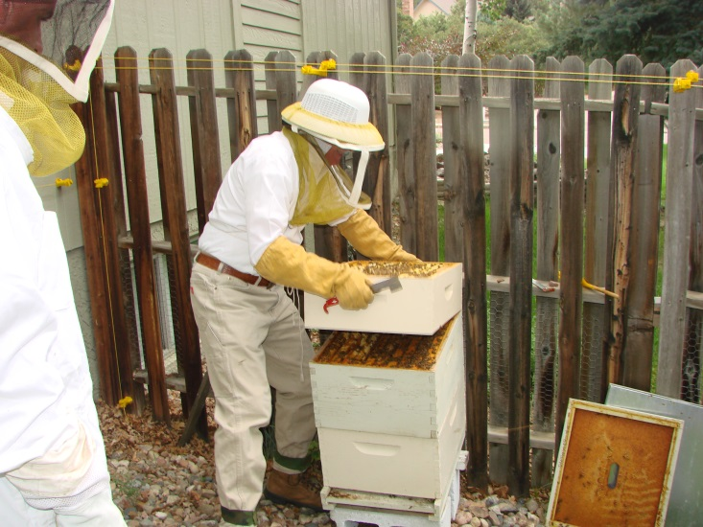
Eligible Apiaries
Apiaries with a minimum 8 hives
Bias towards Commercial beekeepers
CDA received permission to sample Apiaries with a minimum of 4 hives in 2016 to try to capture data from more hobby beekeepers.

Slide 4
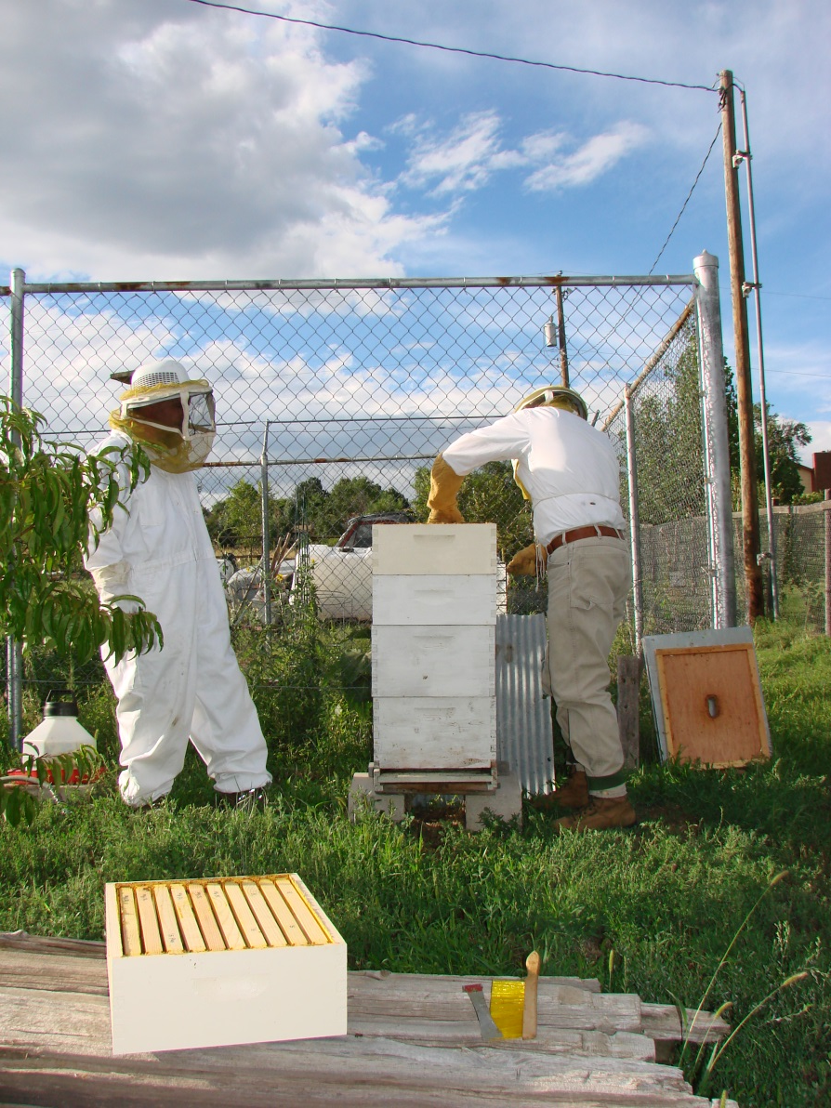
Where have we sampled?
67 apiaries
21 Counties
49 Commercial
18 Hobby

Slide 5
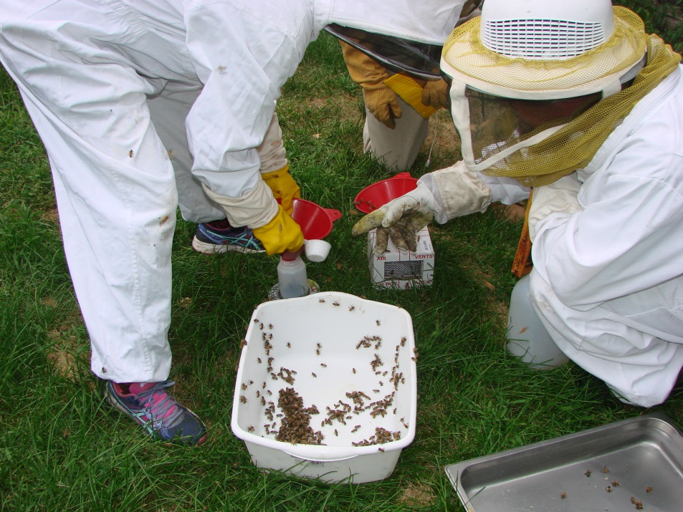
What is sampled?
Adult bees
¼ cup bees in alcohol – for Varroa, Nosema
¼ cup bees sent live – for molecular virus analysis
Frame is ‘bumped’ to dislodge brood – for Tropilaelaps detection
Sampled material is sent to ARS Bee Research Lab in Beltsville MD
Pollen or bee bread is sampled for pesticides
Gastonia NC lab

Slide 6
What does the Bee Lab analyze for?
Target pests
Common Name Scientific Name
Acute Bee Paralysis Acute Bee Paralysis Virus
Bee Slow Paralysis Bee Slow Paralysis Virus (SPB)
Black Queen Cell Black Queen Cell Virus (BQCV)*
*Lake Sinai Virus LSV-2 (replaces BQCV)
Chronic Bee Paralysis Chronic Bee Paralysis Virus
Deformed Wing Iflavirus Deformed Wing Virus (DWV)
Israeli Acute Bee Paralysis Israeli Acute Paralysis Virus (IAPV)
Nosema Disease Nosema apis
Nosema Disease Nosema ceranae
Parasitic mite Tropilaelaps sp./spp.
Varroa Mite Varroa destructor

Slide 7
In Colorado
Samples collected from 24 apiaries in 2011 & 2016
Samples collected from 19 apiaries in 2012-13
Pollen sampled from 10 hives for each survey period (total 30 samples) – for pesticide detection

Slide 8
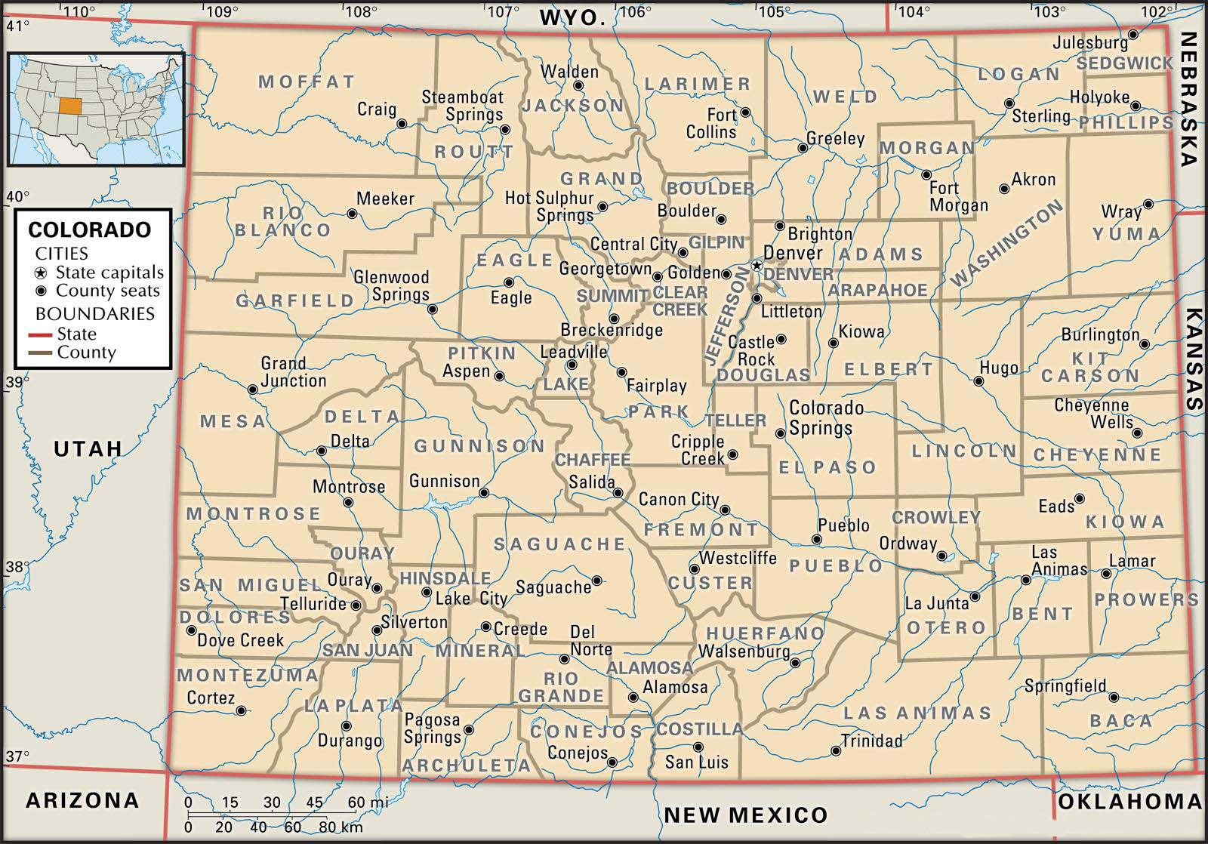

Slide 9
Data from 32 States 2010 - 2014

Slide 10
Results CO– Bee Health
2011-2013
2016
Varroa mite found in 84% of apiaries sampled
Viruses found in 78% of apiaries sampled
In 2011-12
Deformed Wing Virus found (23 of 25)
Black Queen Cell Virus (15 of 25)
Three viruses previously unreported in CO
Kashmir Bee Virus
Chronic Bee Virus
Acute Bee paralysis Virus
Israeli Acute Paralysis Virus
Nosema found in 50% of apiaries sampled
Varroa Mite – 82% (19 of 23 apiaries)
30% of the apiaries with Varroa had levels that exceeded the treatment threshold
Nosema found in 13% or apiaries sampled, the majority of infections found (60%) exceeded treatment thresholds.
Parasitic Mite Syndrome

Slide 11
Samples 74% Commercial vs. 26% Hobby

Slide 12
Other diseases detected
Sac Brood
1 commercial apiary - 2016
Chalk Brood
3 commercial apiaries - 2016
1 hobby apiary - 2015
European Foul Brood
3 hobby apiaries - 2015

Slide 13
Pesticides detected

Slide 14
Results – Pesticide in Pollen/Bee Bread
174 pesticides screened, 80 found nationally.
No neonicotinoid pesticides have been found to date in CO
Pesticides Found in Colorado Hives
Miticides | Insecticides | Fungicides | Herbicides
Fluvalinate | Prallethrin | Carbendazim | Trifluralin
Chlorfenvinphos | Cyhalothrin |  | Metribuzin
Coumaphos
DMPF
Thymol - Apistan

Slide 15
Colorado Pesticide Data – 2011 - 2016

Slide 16
More attention is due: Nutrition
Commercial bee keepers in CO say their biggest challenge is finding ‘bee pasture’
Basics of bee needs
Food
Shelter
Safety
Addressed by the Health Survey

Slide 17
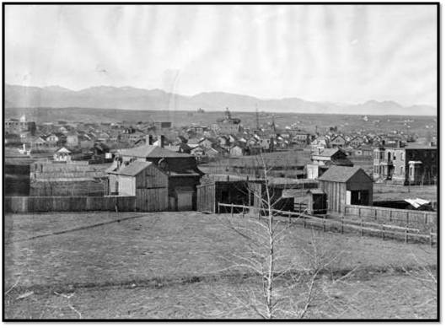
The Front Range Urban Landscape

Slide 18
We need more information for CO
“Manage the landscape so there is enough food; Manage the bees for the landscape”
i.e. what is the carrying capacity of the Colorado urban landscape?
Carrying capacity = the number of people, other living organisms, or crops that a region can support without environmental degradation.
From the City of Chicago:
Hive Densities in an Urban Setting
Beekeepers are advised to closely observe their apiary locations to determine the carrying capacity of the area—both the immediate area and roughly three miles in all directions—and to limit the number of hives accordingly. Signs of over-saturation in an area include slow colony growth, poor honey production, and excessively defensive behavior.

Slide 19
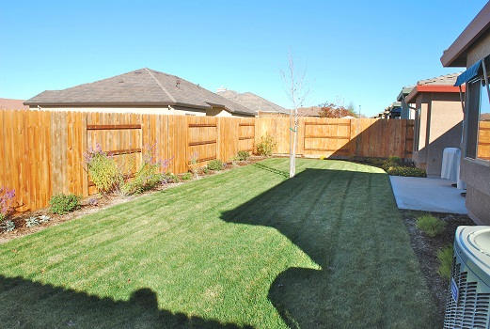
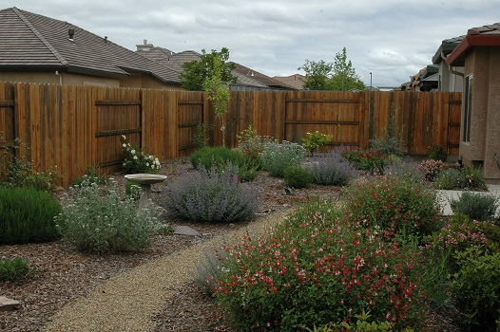
Which landscape provides more ‘pasture’?

Slide 20
Upcoming events
2017 Bee Health Survey
Please participate! Minimum 4 hives/8 preferred
October 20th & 21st - Longmont
Dennis van Englesdorp will be the guest speaker at the CBPA meeting – all welcome.
Grant application submitted to NIFA by CSU/CDA for health survey and education project for hobby bee keepers.

