Slide 1
Huge
Tower?!
SaveOld
Rocky.org

Slide 2
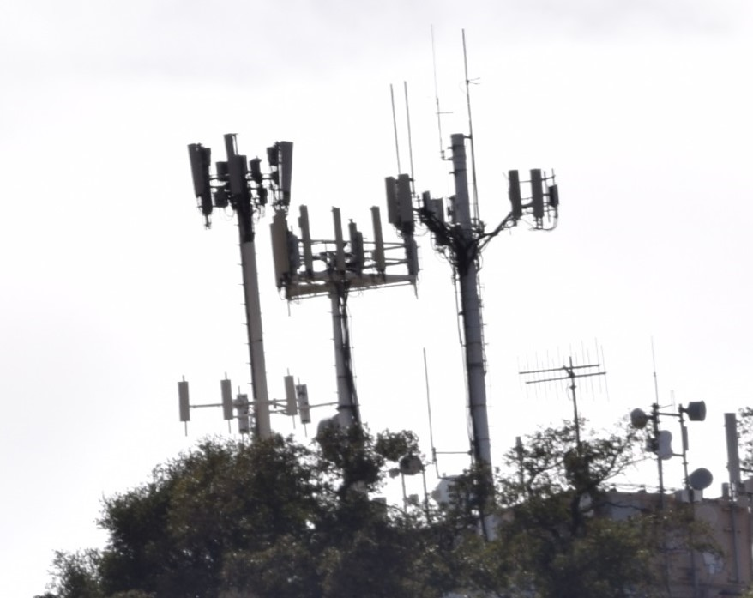
Tower
Cluster?!
SaveOld
Rocky.org

