Slide 1
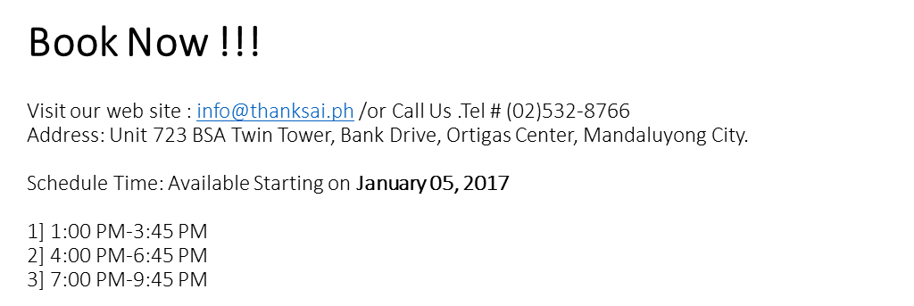
SEMINAR SCHEDULE FOR THE MONTH OF JANUARY 2017
SUN | MON | TUE | WED | THU | FRI | SAT
1 | 2 | 3 | 4 | 5 1) 1:00PM-Avalable 2) 4:00PM-Available 3) 7:00 PM-Available | 6 1) 1:00PM-Available 2) 4:00PM-Available 3) 7:00 PM-Available | 7 1) 1:00PM-Available-2) 4:00PM-Occupied 3) 7:00 PM-Available
8 1) 1:00PM-Occupied 2) 4:00PM-Occupied 3) 7:00PM-AVAILABLE | 9 1) 1:00PM-Occupied 2) 4:00PM-Occupied 3) 7:00PM-Available | 10 1) 1:00PM-Available 2) 4:00PM-Available 3) 7:00PM-Available | 11 1) 1:00PM-Available-2) 4:00PM-Occupied 3) 7:00PM-Occupied | 12 1) 1:00PM-Available 2) 4:00PM-Available 3) 7:00PM-Available | 13 1) 1:00PM-Available 2) 4:00PM-Available 3) 7:00PM-Occupied | 14 1) 1:00PM-Available 2) 4:00PM-Available 3) 7:00PM-Available
15 1) 1:00PM-Available 2) 4:00PM-Available 3) 7:00PM-Available | 16 1) 1:00PM-Occupied 2) 4:00PM-Occupied 3) 7:00PM-Occupied | 17 1) 1:00PM-Occupied 2) 4:00PM-Available 3) 7:00PM-Available | 18 1) 1:00PM-Available 2) 4:00PM-Occupied 3) Opening Seminar | 19 1) 1:00PM-Available 2) 4:00PM-Available 3) 7:00PM-Occupied | 20 1) 1:00PM-Occupied 2) 4:00PM-Occupied 3) 7:00PM-Available | 21 1)1:00P-Occupied 2) Opening Seminar 3) 7:00PM-Available
22 1) 1:00PM-Available 2) 4:00PM-Available 3) 7:00PM-Available | 23 1) 1:00PM-Available 2) 4:00PM-Available 3) 7:00PM-Available | 24 1) 1:00PM-Available 2) 4:00PM-Available 3) 7:00PM-Available | 25 1) 1:00PM-Available 2) 4:00PM-Available 3) Opening Seminar | 26 1) 1:00PM-Available 2) 4:00PM-Available 3) 7:00PM-Available | 27 1) 1:00PM-Occupied 2) 4:00PM-Available 3) 7:00PM-Available | 28 1) 1:00PM-Occupied 2) 4:00PM-Occupied 3) 7:00PM-Available
29 1) 1:00PM-Occupied 2) 4:00PM-Occupied 3) 7:00PM-Available | 30 1) 1:00PM-Available 2) 4:00PM-Available 3) 7:00PM-Available | 31 1) 1:00PM-Occupied 2) 4:00PM-Occupied 3) 7:00PM-Available

Slide 2
SEMINAR SCHEDULE FOR THE MONTH OF FEBRUARY 2017
BOOK NOW!!!
visit our office here in the Philippines /or call us Tel # (02) 532-8766
Address: Unit 804 BSA Twin Tower , Bank Drive Ortigas Center, Mandaluyong City.
Schedule TIME:
1:00 PM- 3: 49 PM
4:00 PM- 6:45 PM
7:00 PM- 9:45 PM
SUN | MON | TUE | WED | THU | FRI | SAT
 |  |  | 1 Thanks Ai Opening 2) 4:00 PM- Occupied 3) 7:00 PM-Occupied | 2 1) 1:00PM-Occupied 2) 4:00PM-Available 3) 7:00PM-Available | 3 1) 1:00PM-Available 2) 4:00PM-Available 3) 7:00PM-Available | 4 1) 1:00PM-Available 2) 4:00PM-Available 3) 7:00PM-Available
5 1) 1:00PM-Available 2) 4:00PM-Available 3) 7:00PM-Available | 6 1) 1:00PM-Available 2) 4:00PM-Available 3) 7:00PM-Available | 7 1) 1:00PM-Available 2) 4:00PM-Available 3) 7:00PM-Available | 8 1) 1:00PM-Available 2) 4:00PM-Available 3) 7:00PM-Available | 9 1) 1:00PM-Available 2) 4:00PM-Available 3) 7:00PM-Available | 10 1) 1:00PM-Available 2) 4:00PM-Available 3) 7:00PM-Available | 11 1) 1:00PM-Occupied 2) 4:00PM-Occupied 3) 7:00PM-Available
12 1) 1:00PM-Occupied 2) 4:00PM-Available 3) 7:00PM-Available | 13 1) 1:00PM-Available 2) 4:00PM-Available 3) 7:00PM-Available | 14 1) 1:00PM-Available 2) 4:00PM-Available 3) 7:00PM-Available | 15 1) 1:00PM-Available 2) 4:00PM-Available 3) 7:00PM-Available | 16 1) 1:00PM-Available 2) 4:00PM-Available 3) 7:00PM-Available | 17 1) 1:00PM-Available 2) 4:00PM-Available 3) 7:00PM-Available | 18 1) 1:00PM-Available 2) 4:00PM-Available 3) 7:00PM-Available
19 1) 1:00PM-Available 2) 4:00PM-Available 3) 7:00PM-Occupied | 20 1) 1:00PM-Available 2) 4:00PM-Available 3) 7:00PM-Available | 21 1) 1:00PM-Available 2) 4:00PM-Available 3) 7:00PM-Available | 22 1) 1:00PM-Available 2) 4:00PM-Available 3) 7:00PM-Available | 23 1) 1:00PM-Available 2) 4:00PM-Available 3) 7:00PM-Available | 24 1) 1:00PM-Available 2) 4:00PM-Available 3) 7:00PM-Available | 25 1) 1:00PM-Available 2) 4:00PM-Available 3) 7:00PM-Available
26 1) 1:00PM-Available 2) 4:00PM-Available 3) 7:00PM-Available | 27 1) 1:00PM-Available 2) 4:00PM-Available 3) 7:00PM-Available | 28 1) 1:00PM-Available 2) 4:00PM-Available 3) 7:00PM-Available

