Slide 1
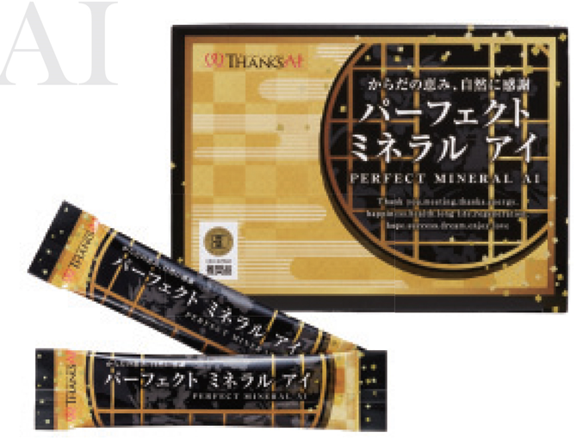
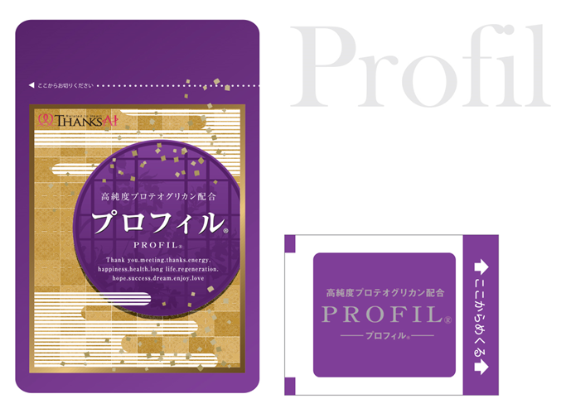
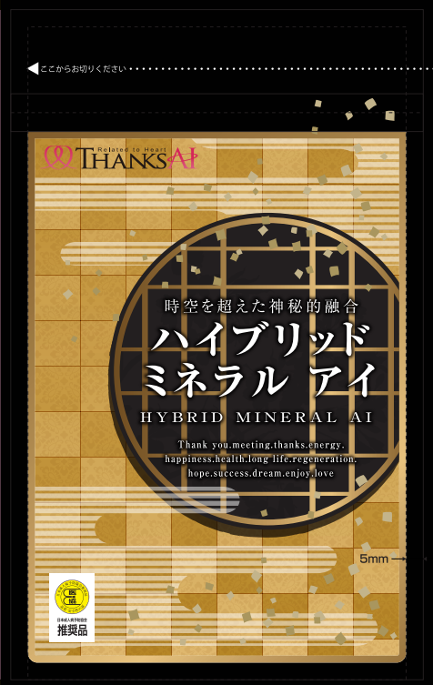
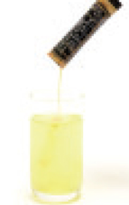
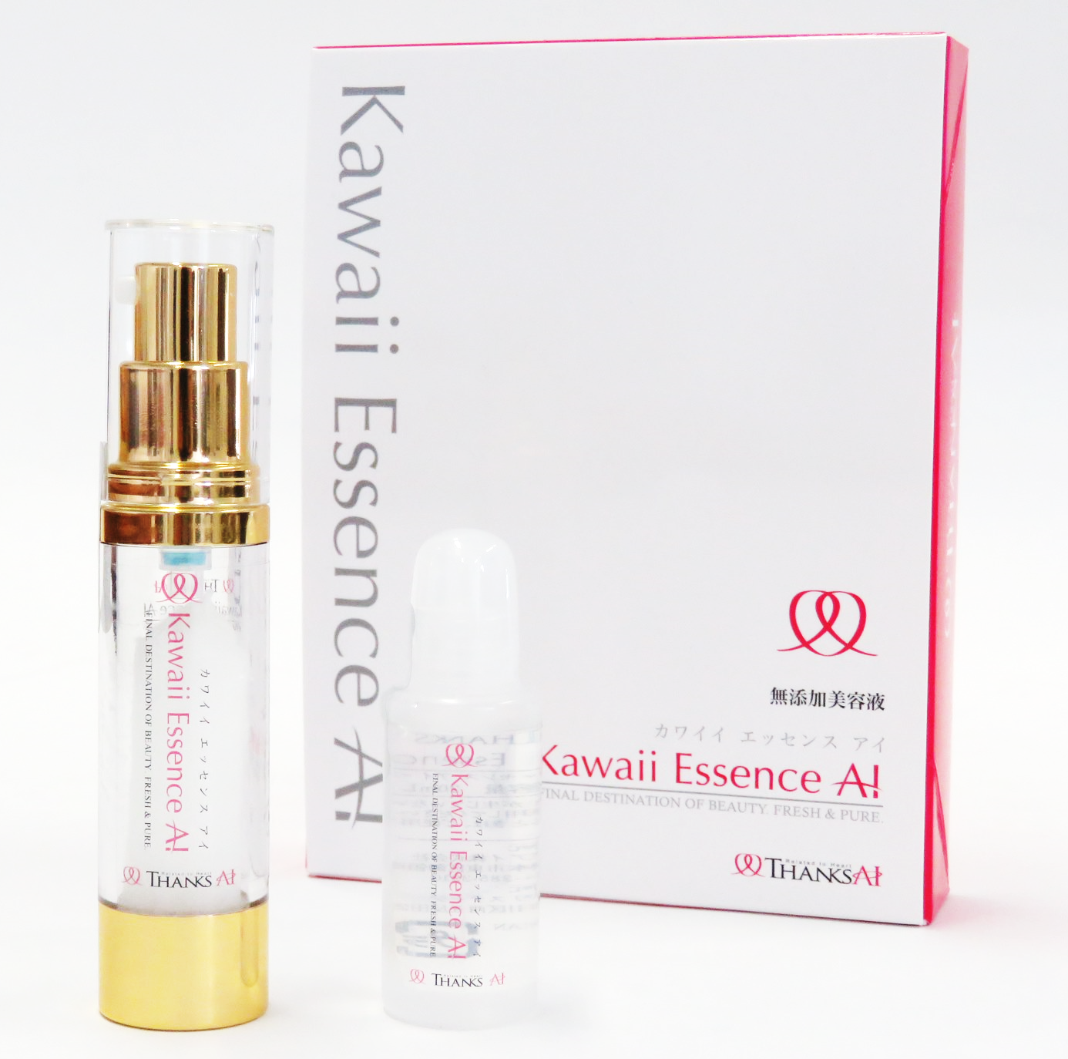
Starting with healthy eating,
we spread Thanks and Love (“Ai”)throughout the world.
Enhance
Skin
Prevention
For
Overall Health!
Whitening!
of
Youthful
For Dieting!
UV Care!
Adult Disease!
Skin!
＊These products are subject to change without notice.
Perfect Mineral Ai
Kawaii Essence Ai
Profil
®
Hybrid Mineral Ai
PLANT MINERAL for daily life! Minerals cannot be produced in our body!
Beauty lotion blended with STEM CELLS and made in Japan!
Next generation FILM TYPE supplement from Japan!
A combination of ANCIENT and MODERN plant- based minerals.
Address : Unit 804 BSA Twin Tower, Bank Drive, Ortigas Center, Mandaluyong City
Tel : 02-532-8766 E-mail : info@thanksai.ph
Head Office : Unit 804 Seminar Room : Unit 723
Business Hours : 13:00 – 22:00 Monday-Sunday
THANKS AI SALES & MARKETING CORPORATION
Price list
(PHP : tax excluding)
Registration | Products | New Purchase |  | Repeat Purchase
 |  | 1box/price | Amount | 1box/price | Amount
1 | 1 | Php12,000 |  | Php7,000
2(1+free) | 3 | Php8,000 | Php24,000 | Php7,000 | Php14,000
1x6mos(+1free) | 7 | Php6,714 | Php47,000 | Php6,000 | Php42,000
2x6mos(+3free) | 15 | Php6,237 | Php94,000 | Php5,600 | Php84,000
1x12mos(+3free) | 15 | Php5,933 | Php89,000 | Php5,600 | Php84,000
2x12mos(+7free) | 31 | Php5,742 | Php178,000 | Php5,419 | Php168,000
You can get a Sponsor Bonus every time you introduce someone.
・10%of the bonus will be deducted from commission as a withholding tax.
・Bonus calculations will be made on the basis of monthly purchases, even in the case of 6-month (6M) bundle purchases, repeat 6-month (R6M) bundle purchases, 12-month (12M) bundle purchases, and repeat 12-month (R12M) bundle purchases.

