Slide 1
Abigail
A woman of good understanding

Slide 2
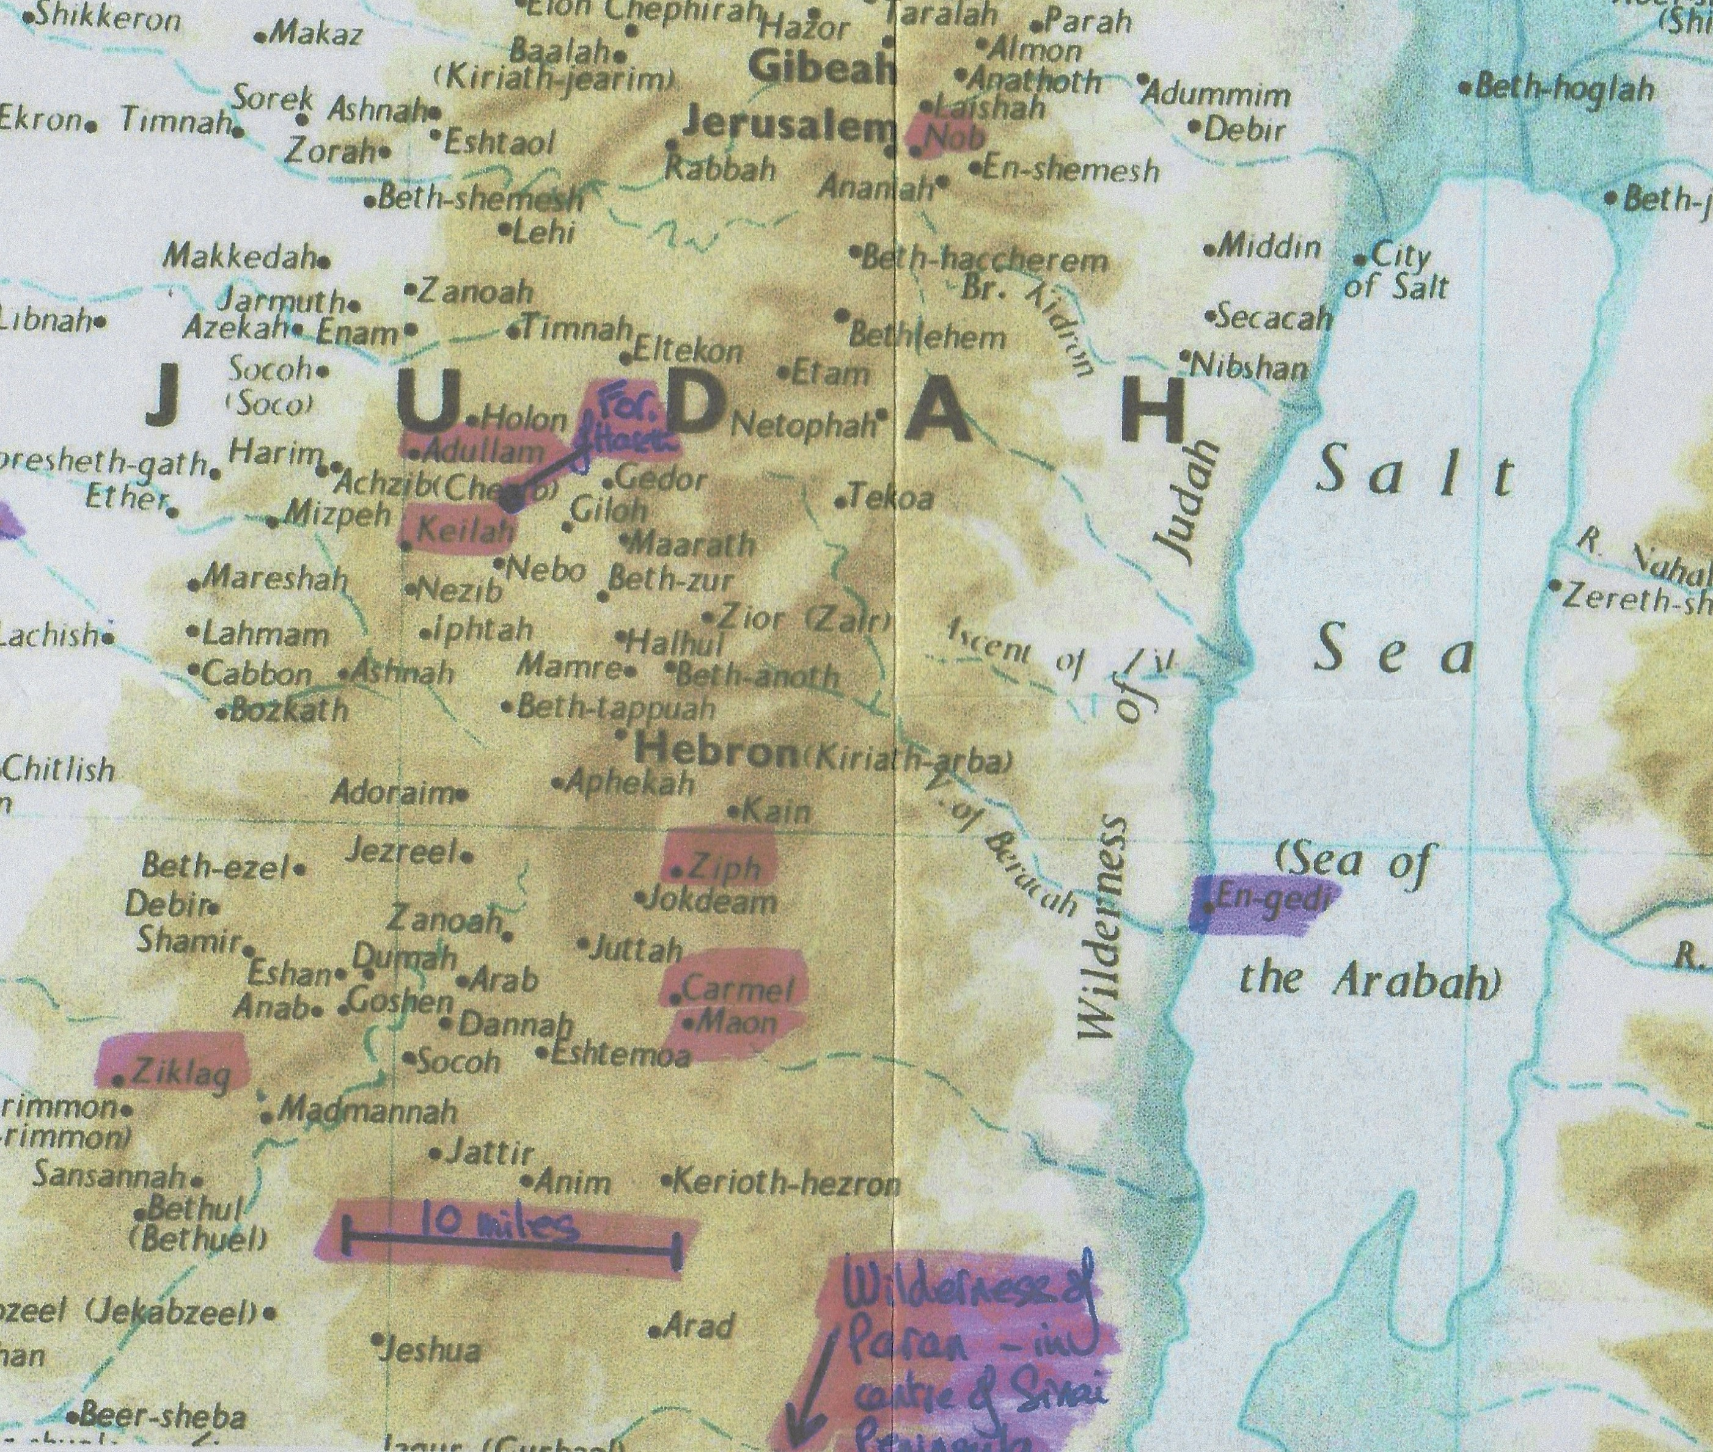

Slide 3
Beautiful countenance
1 Sam 25:3 - Beautiful countenance = yapheh toar – usage of words indicates it refers to physical appearance.
Gen 29:17 re Rachel = beautiful (yapheh toar) and well favoured (yapheh mareh)
Isa 53:2 re Christ – no form (toar) nor comeliness
So yapheh toar re Abigail refers to her physical beauty
Other usages:-
yapheh –
(Gen 12:11,14 – fair) re Sarah;
(1 Sam 16:12 – beautiful) re David;
(Psa 48:2 – beautiful) re Jerusalem;
(Song 1:15,16 etc – fair) re bride.
toar –
(1 Sam 16:18) – comely) re David
All points to later marriage of David & Abigail as type of marriage of Christ & his bride.

Slide 4
The Davidic covenant – a sure house
1 Sam 25:28 = remarkable verse!
Sure house – sense echoed in later promises to David:-
2 Sam 7:12,13,16
and in David’s response - v18,19,26,27,29
Hebrew for sure = aman.
Hebrew for house = bayith (beth).
Both words occur in 2 Sam 7:16 as established and house (and in 1 Chron 17:23,24).

Slide 5
How did Abigail know about this promise before it was given?
Possibly she knew and believed prophecy of man of God to Eli in (1 Sam 2:35) and recognised that David = initial fulfillment? Same two Hebrew words used.
Those words echo God’s comment about Moses in (Num 12:7) – faithful (aman) in all Mine house (beth).
Those words picked up in (Heb 3:2 – cf vv 1-6). EXHORTATION to us to be faithful so the house of God in our day.
1 Sam 25:30 shows Abigail not just repeating words, but recognised that Yahweh had a purpose with David as king – she may have known David already anointed by Samuel – and realised that (1 Sam 2:35) spoke of Mine anointed for ever.

Slide 6
Spiritual significance of marriage of David and Abigail
v42 – 5 damsels – cf 5 wise virgins (Matt 25:1,2)
v43 – David had many wives – difficult to explain on human level – but is a type of the multitudinous bride of Christ
NB that David has been in wilderness of Paran - v1 (=Sinai) where Judgement will take place – thus it is from here that the Rainbowed Angel (multitudinous Christ + Christ himself) emerge to set about establishment of kingdom – cf (Deut 33:2 and Hab 3:3)
Song 7:5,6 – head of bride described as like Carmel, and fair (same Hebrew as beautiful - applied to Abigail in 1 Sam 25:3); (Hebrew for delight not same as Abigail)
See also Isa 62:4 re glorious future of Jerusalem – a bride in whom Yahweh will delight (not Hebrew for Abigail) and will marry – links to Rev 21:2 - new Jerusalem and multitudinous bride of Christ

Slide 7
Consummation of the marriage
Christ and his bride become one spirit / Divine nature - at Sinai – Psa 68:20
Lamb and bride may then spend period of time together – cf (Deut 24:5)
Rainbowed Angel then embarks on warfare against Gog, to deliver Israel and ultimately to obliterate Babylon the Great
Marriage supper of the Lamb then celebrated at Jerusalem

