Slide 1
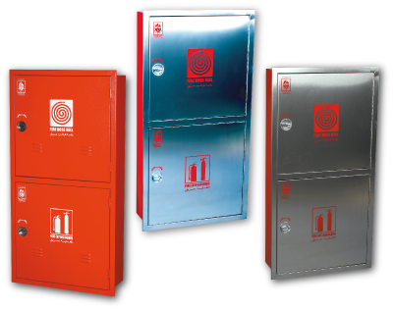
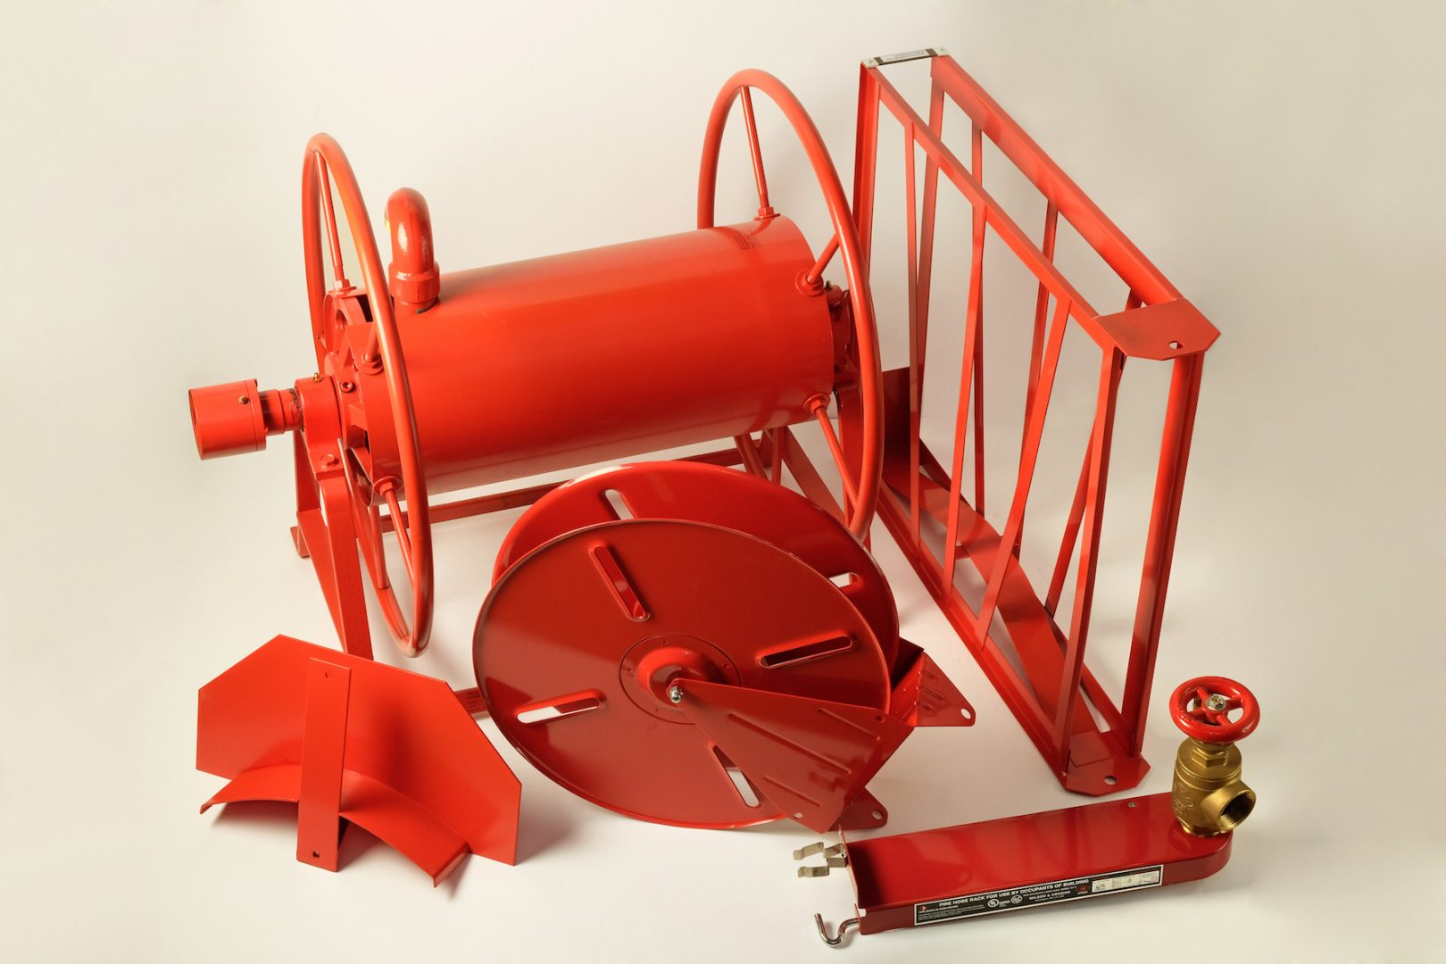
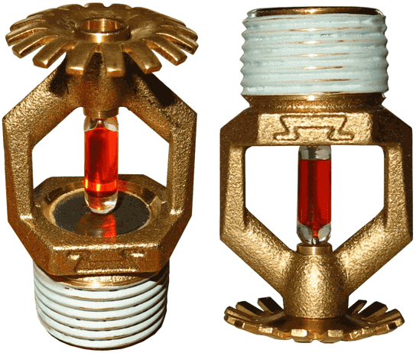
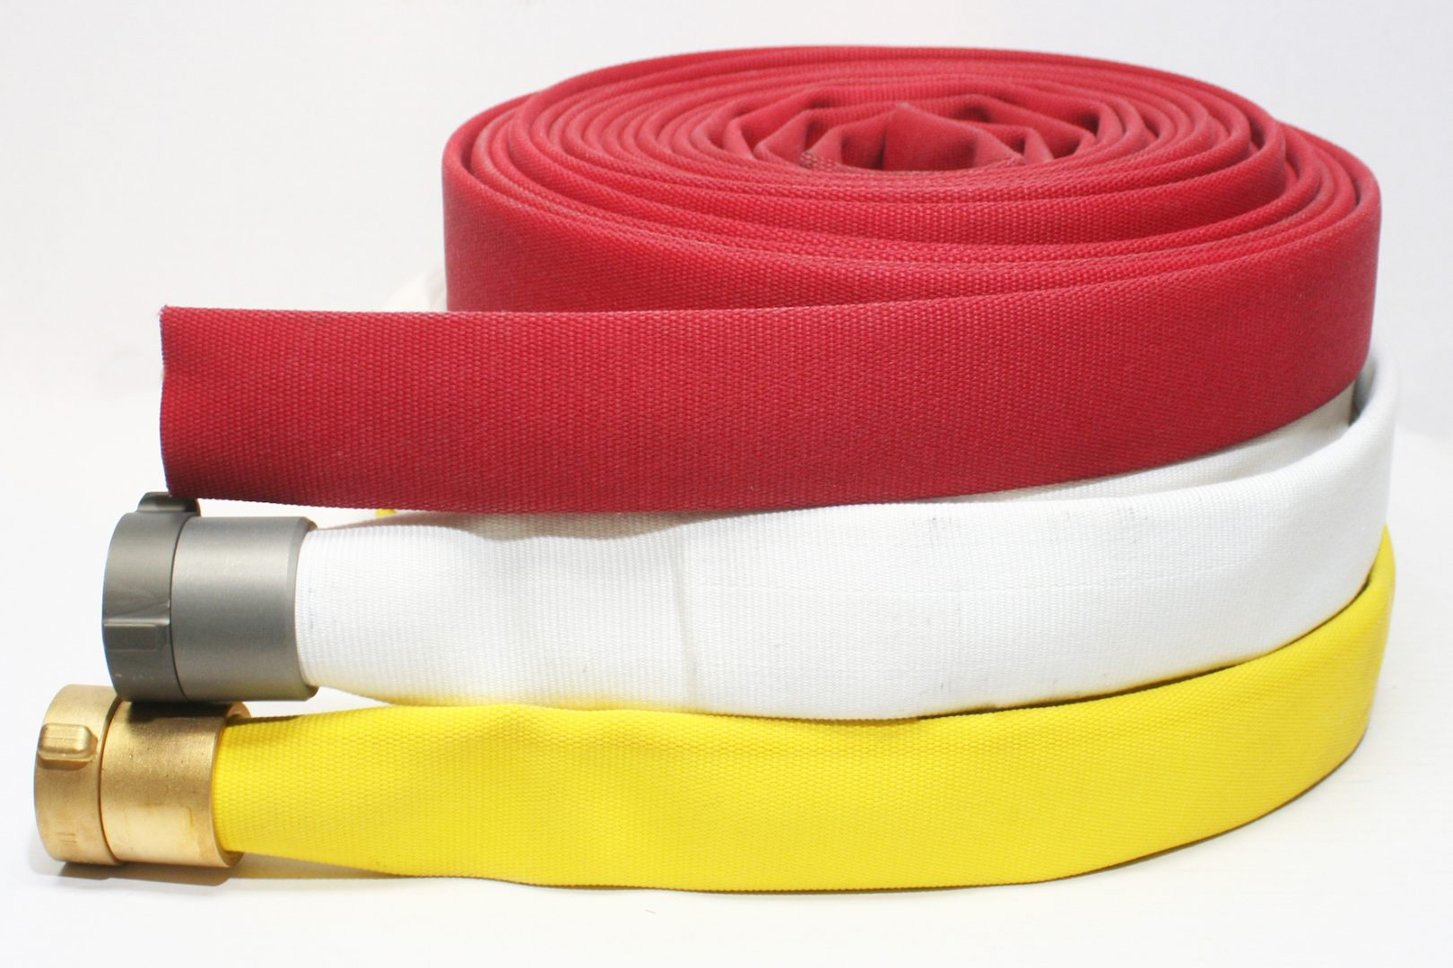
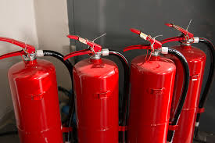
FULL SUPPLY OF FIREFIGHTING EQUIPMENT ANS SERVICES
Fire fighting equipment: Fire shields Scraps (for opening doors, windows and other structures); Fire hunters, hooks with a wooden handle (for dismantling and taking away burning constructions); Kits for cutting electrical wires (scissors, dielectric bots and mats); Forks, shovels (bayonet and shovel); Water tanks and sand boxes firemen (for storage of extinguishing agents); Buckets and hand pumps (for transporting water). etc | Fire fighting equipment and components: Signs of fire safety Sprinklers (Sprinklers) Control nodes Security and fire alarm Foam or powder fire extinguishing Gas fire extinguishing Fire automatics Comprehensive solutions Smoke detectors Detectors Fire hoses and reels Fire extinguisher cabinets Fire extinguishers etc.

