Slide 1
CELL BIOLOGY AND BIO-MEMBRANES
BIOC 132

Slide 2
Lecturer:
MR. W. KABISWA

Slide 3
PRESENTER
MUUNDA MUDENDA
15/BSB/BU/R/0004

Slide 4
Topic:
“Discuss Cellular Processes Resulting into Disease.”

Slide 5
AIM
To understand cellular processes, in relation to the cell membrane, that result into disease.
Focus:
Cancer
Diabetes
Auto-immunity
Neural Degeneration

Slide 6
Introduction
For an organism to survive, there is need for proper cellular co-ordination. Cellular co-ordination is carried out by cell organelles which carry out distinct cell processes. These processes are called “Cellular Processes”.

Slide 7
What are cellular processes?
Cellular processes are a collection of all cell activities that promote proper growth of the organism. These can also be called metabolic reactions or processes.

Slide 8
Continued…
Cellular processes form a fundamental system that involves complicated cascades of biochemical reactions and signaling pathways. In order for proper cell function, these processes are required to be tightly controlled.

Slide 9
Examples of cellular processes
Osmosis
Energy Production (Krebs Cycle, Electron Transport Chain)
Transport
Homeostasis
Cell Differentiation
Photosynthesis
Aerobic Respiration
Anaerobic Respiration
Light Dependent Reactions

Slide 10
Dysregulation of any element of these pathways, from over- or under activity of an enzyme, increase or decrease in the level of a protein, to under- or overexpression of an ion channel, can lead to a vast array of human pathologies and disorders (diseases).

Slide 11
These Include;
Cancer,
Metabolic Diseases,
Musculoskeletal Disorders,
Cardiovascular Disease, And
Neurodegenerative Conditions.
Etcetera…

Slide 12
Note:
From the afore explanations, cellular processes are tightly controlled and regulated and controlled by various components of the cell which include;
The cell organelles such as; mitochondria, chloroplasts, lysosomes, peroxisomes, the nucleus, and the cell membranes.

Slide 13
As, such, any fault in the function of these components will result in dysfunctions that will affect the entire organisms directly or indirectly.

Slide 14
In brief, the term cellular processes can be inter-changeably used with the phrase “Metabolic Reactions.”

Slide 15
Cellular components
Some components of the cell that play crucial roles in metabolic reactions include the cell organelles (Membrane bound compartments of the cell).

Slide 16
Mitochondria

Slide 17
Endoplasmic reticula

Slide 18
lysosomes

Slide 19
peroxisomes

Slide 20
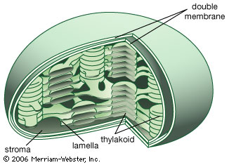
chloroplasts

Slide 21
nucleus

Slide 22
magnetosomes
Magnetosomes are membranous prokaryotic organelles containing mineral crystals present in magnetotactic bacteria.

Slide 27
Magnetosomes contain 15 to 20 magnetic crystals that together act like compass needle to orient magnetotactic bacteria in geomagnetic fields, thereby simplifying their search for their preferred microaerophilic environments.

Slide 28
These are found in prokaryotic organism but research has found out that they also exist in eukaryotic algae.

Slide 29
ABOUT MICROAEROPHILES
Microorganisms, most especially, may be classified according to the need of or tolerance to atmospheric oxygen. Those that utilize oxygen for growth and survival are referred to as aerobes. They use oxygen for metabolizing substances through cellular respiration...

Slide 30
Those that do not use oxygen and prefer anaerobic environments are called anaerobes. There are another group of microorganisms, called microaerophiles, that may use oxygen when carrying out aerobic respiration. They live in an environment where oxygen level is low. Some of the microaerophiles can also perform anaerobic respiration

Slide 31
Examples of microaerophiles are;
Borrelia burgdorferi, a species of spirochaete bacteria that causes Lyme disease in humans, and
Helicobacter pylori, a species of proteobacteria that has been linked to peptic ulcers and some types of gastritis.

Slide 32
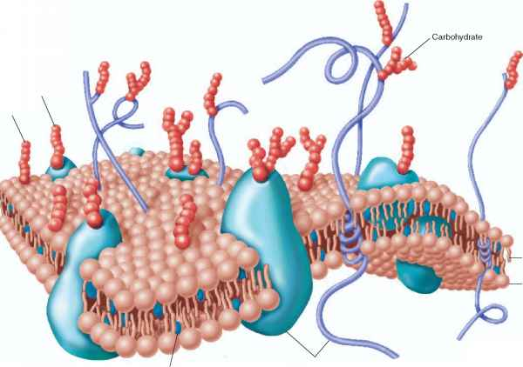
THE CELL MEMBRANE
Not an organelle.

Slide 33
Components of the cell membrane
Phospholipids
Proteins
Cholesterol
Glycoproteins
Glycolipids

Slide 34
proteins
These perform some of the major roles of the cell membranes including;
Transport
Signaling
Channeling
Types
Integral proteins
Peripheral proteins

Slide 35
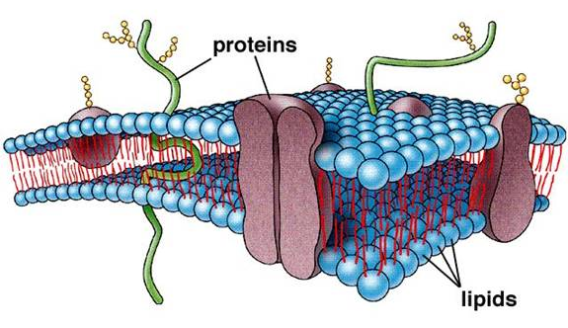
INTEGRAL PROTEINS

Slide 36
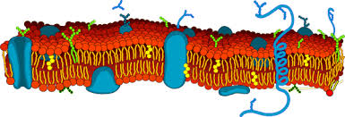
PERIPHERAL PROTEINS

Slide 37
Why all that background?

Slide 38
Any error in the cellular processes co-ordinated by the organelles I have shown you will result into undesirable processes in the organism. Any fault (mistake) in the lysosomes, mitochondria, chloroplasts, peroxisomes, Nucleus or cell membrane will result into problems which we term a DISEASE, “DIS-EASE”.

Slide 39
“Cells use a large number of clearly defined signaling pathways to regulate their activity.”
~ Cell Signalling Biology Michael J. Berridge Module 2 Cell Signalling Pathways 2.1

Slide 40
Listen To This…
“A large number of diseases are caused by defects in signaling pathways. The nature of these defects and how they are induced varies enormously……

Slide 41
…..Most of the serious diseases in humans, such as hypertension, heart disease, diabetes and many forms of mental illness, seem to arise from subtle phenotypic modifications of signaling pathways. Such phenotypic remodeling alters the behavior of cells so that their normal functions are subverted, leading to disease.”
~ Cell Signaling Biology , Michael J. Berridge Module 12 Signaling Defects and Disease 12.1

Slide 42
closer look
Disease in Relation to the cell membrane.

Slide 43
RECAP….
Cell membranes are very crucial in coordinating cellular processes. They do this through channeling, transporting and signaling.

Slide 44
The cells in our bodies are constantly sending out and receiving signals.
But what if a cell fails to send out a signal at the proper time?
Or what if a signal doesn't reach its target?
What if a target cell does not respond to a signal?
Or a cell responds even though it has not received a signal?
These are just a few ways in which cell communication can go wrong, resulting in disease.

Slide 45
In fact, most diseases involve at least one breakdown in cell communication.

Slide 46
Question: What if a signal is lost?

Slide 47
AM TALKING ABOUT DIABETES HERE

Slide 48
NORMAL GLUCOSE REGULATION IN THE BODY
After food enters the body,
It is broken down and sugar enters the bloodstream.
Sugar stimulates cells in the pancreas to release insulin
Insulin travels through the blood to other cells in the body and signals them to take up sugar.

Slide 49
Normally, cells in the pancreas release a signal, called insulin, that tells your liver, muscle and fat cells to store this sugar for later use.

Slide 50
In type I diabetes, the pancreatic cells that produce insulin are lost. Consequently, the insulin signal is also lost. As a result, sugar accumulates to toxic levels in the blood. Without treatment, diabetes can lead to kidney failure, blindness and heart disease in later life.

Slide 51
2. DIABETES
Diabetes is characterized by an excessive excretion of urine. The most common form is diabetes mellitus, which is caused by a disturbance in insulin function that results in an inability to metabolize glucose.

Slide 52
There is a large increase in the plasma level of glucose that, if unchecked, can lead to serious complications such as renal failure, blindness and limb amputation. One of the spectacular successes of modern medicine has been the control of diabetes by administering purified insulin.

Slide 53
Types…
Diabetes Mellitus
Diabetes Insipidus

Slide 54
Type 1 diabetes, which is also known as insulin-dependent diabetes mellitus, is caused by an auto-immune destruction of the insulin-secreting β-cells responsible for synthesizing and releasing insulin.

Slide 55
Type 2 diabetes, also known as non-insulin-dependent diabetes mellitus, usually develops after the age of 40 and is caused by a combination of both insulin resistance and insulin deﬁciency.

Slide 58
CELL MEMBRANE BIOCHEMISTRY OF DIABETES

Slide 59
Mutation of β-cells hexokinase IV (glucokinase), which detects external glucose , reduces insulin release.

Slide 61
Mutations in the Kir6.2 K+ channel or the ABCC8 sulphonyl urea receptor, which constitute the ATP-sensitive K+ (KATP) channels, reduce the ability of ATP to depolarize the membrane sufﬁciently to trigger the release of insulin. Mutations in ABCC8 have been identiﬁed in many cases of neonatal diabetes.

Slide 62
Mutations of the transcription factor hepatocyte nuclear factor 4α (HNF4α) contribute to diabetes by reducing the synthesis of insulin.

Slide 63
In skeletal muscle, the insulin control of skeletal muscle glycogen metabolism is reduced by a nonsense mutation in the Rab GAP called Tbc1d4, which reduces the translocation of GLUT4 to the plasma membrane of skeletal muscle, causing insulin resistance

Slide 64
3. AUTO-IMMUNITY
Auto-immunity is the system of immune responses of an organism against its own healthy cells and tissues.

Slide 65
Any disease that results from such an aberrant immune response is termed an autoimmune disease. ... Autoimmune diseases are very often treated with steroids

Slide 66
Autoimmunity is the response of the adaptive immune system to self-antigens that occurs when mechanisms of self-tolerance fail. Autoimmunity is one cause of hypersensitivity.
In order to further understand autoimmunity, we should describe in more detail what happens when self-tolerance fails:

Slide 67
Normally, as the immune system is randomly generating some 10^7 different clones, it is constantly culling the self-reacting ones from the final pool as they are created. This is the basis of autoimmune disease.

Slide 68
If this process of getting rid of self-reacting lymphocytes fails or is incomplete, then B or T cells that may become activated against self-antigens will be produced. These rogue cells or their products (antibodies, mediators…) can then react against self-antigens.

Slide 69
The cause of autoimmune disease is unknown. There are many theories about what triggers autoimmune diseases, including:
bacteria or virus
drugs
chemical irritants
environmental irritants

Slide 70
RELATIONSHIP TO THE CELL MEMBRANE

Slide 71
1. cancer
What is Cancer?
Cancer is a complex multi-step disease that is characterized by abnormal proliferation of cells in the body.

Slide 72
Many mechanisms maintain appropriate cell growth: Cell division occurs in response to external signals.
(1). Enzymes repair damaged DNA
(2). Cells make connections with their neighbors
(3). If these connections suddenly change, neighboring cells send out an alert. Cells respect and stay within tissue boundaries
(4). If a cell is beyond repair, it initiates its own death

Slide 73
Cancer can occur in many ways, but it always requires multiple signaling breakdowns. Often, cancer begins when a cell gains the ability to grow and divide even in the absence of a signal. Ordinarily this unregulated growth triggers a signal for self-destruction. But when the cell also loses the ability to respond to death signals, it divides out of control, forming a tumor.

Slide 74
Later cell communication events cause blood vessels to grow into the tumor, enabling it to grow larger. Additional signals allow the cancer to spread to other parts of the body.

Slide 75
Causes of cancer
Cancer is caused by changes (mutations) to the DNA within cells. The DNA inside a cell is packaged into a large number of individual genes, each of which contains a set of instructions telling the cell what functions to perform, as well as how to grow and divide.
Risk Factors Include;
Environmental causes such as Cadmium, Ethedium Bromide.
Heritable Errors in Genes.
Habits and Life style.

Slide 76
TERMS OF INTEREST…
Tumor: A mass formed when normal cells begin to change and grow uncontrollably. A tumor can be benign (noncancerous) or malignant (cancerous, meaning it can spread to other parts of the body). Also called a nodule or mass.
Oncogene: Cancer causing genes.
Mutations: Change in a gene, chromosome or chromosome number.
Neoplasia: The term neoplasm refers to an abnormal growth of tissue caused by the rapid division of cells that have undergone some form of mutation. Types include benign, pre-malignant and malignant.

Slide 77
Sarcoma: A cancer that develops in the tissues that support and connect the body, such as fat and muscle.
Carcinoma: Cancer that starts in skin or tissues that line the inside or cover the outside of internal organs.
Metastasis: The spread of cancer from the place where the cancer began to another part of the body.
Malignant: Cancerous
Benign: Non-cancerous

Slide 78
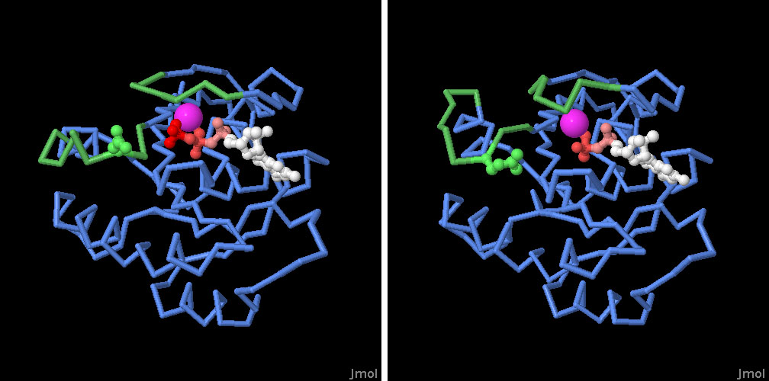
RELATIONSHIP TO THE CELL MEMBRANE
RAS G-PROTEIN

Slide 81
So what’s about ras????
RAS proteins are GTPases that function as molecular switches regulating pathways responsible for proliferation and cell survival. Ras proteins are normally tightly regulated by guanine nucleotide exchange factors (GEFs) promoting GDP dissociation and GTP binding and GTPase-activating proteins (GAPs) that stimulate the intrinsic GTPase activity of Ras to switch off signaling.

Slide 82
WHERE IS THE FAULT?
Oncogenes are genes that are closely linked to cancer, and the gene that encodes Ras was among the first to be discovered. Mutation of an oncogene changes the function of the encoded protein, creating the malignant properties that are needed for cancer to grow and spread..

Slide 83
For instance, some oncogenes encode proteins involved in programmed cell death, such as p53 tumor suppressor, and the oncogenic mutation allows the cancer cell to evade our powerful protections against abnormal growth

Slide 84
Ras is involved in the signals passed between cells that control the amount of growth that is allowed at any time. Cancer-causing mutation of Ras creates a form of the protein that is always on. This is a disaster, because the mutated Ras continually tells the cancer cells that it is okay to multiply, without the normal limits that control cell growth.

Slide 85
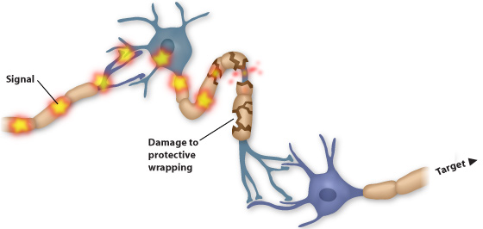
4. NEURAL DEGENERATION
Lets talk about multiple sclerosis as an example.

Slide 86
What is Neural Degeneration?
Neuro-degeneration is the progressive loss of structure or function of neurons, including death of neurons.
Neurodegenerative diseases are incurable, resulting in progressive degeneration and/or death of neuron cells.

Slide 87
What is it?
Multiple sclerosis is a disease in which the protective wrappings around nerve cells in the brain and spinal cord are destroyed. The affected nerve cells can no longer transmit signals from one area of the brain to another.

Slide 89
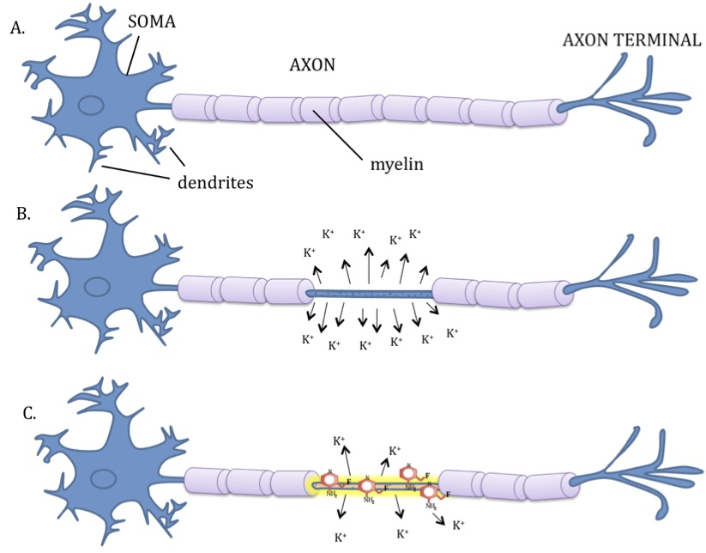
The nerve damage caused by multiple sclerosis leads to many problems, including muscle weakness, blurred or double vision, difficulty with balance, uncontrolled movements, and depression.

Slide 90
RELATIONSHIP TO THE CELL MEMBRANE
The cause of MS is not known, but it has all the hallmarks of an autoimmune disease that results in damage to the oligodendrocytes that are responsible for forming the myelin sheath, which enables neurons to conduct action potentials.

Slide 91
CONTINUED…
The levels of IGF-binding protein 2 (IGFBP-2) is increased in MS and this could reduce the neuro-protective and myelinogenetic actions of insulin-like growth factor I (IGF-I).

Slide 92
conclusion
Cellular processes that are coordinated by the cell membrane are crucial to the survival of the cell. However, any alteration in these cellular processes will result into disease that will have adverse effects on the entire organism.

Slide 93
References;
PDB – 101. (2017). Ras Protein. Retrived
from: https://pdb101.rcsb.org/motm/148.
Wikipedia. (2017). Ras Subfamily. Retrieved from:
https://en.wikipedia.org/wiki/Ras_subfamily.
Yasmin Zinni. (2017). List of Microaerophilic
Bacteria. Retrieved from: http://sciencing.com/list
microaerophilic-bacteria-7151185.html.

