Slide 1
CELL SIGNALLING
BIOC 142

Slide 2
LECTURER:
MR. W. KABISWA

Slide 3
PRESENTATION BY:
MUUNDA MUDENDA
15/BSB/BU/R/0004

Slide 4
TOPIC;
“DISCUSS G-PROTEIN RECEPTORS”

Slide 5
AIM:
To understand what g-proteins are, i.e. Their structure and mechanism of functioning in relation to cell signaling.

Slide 6
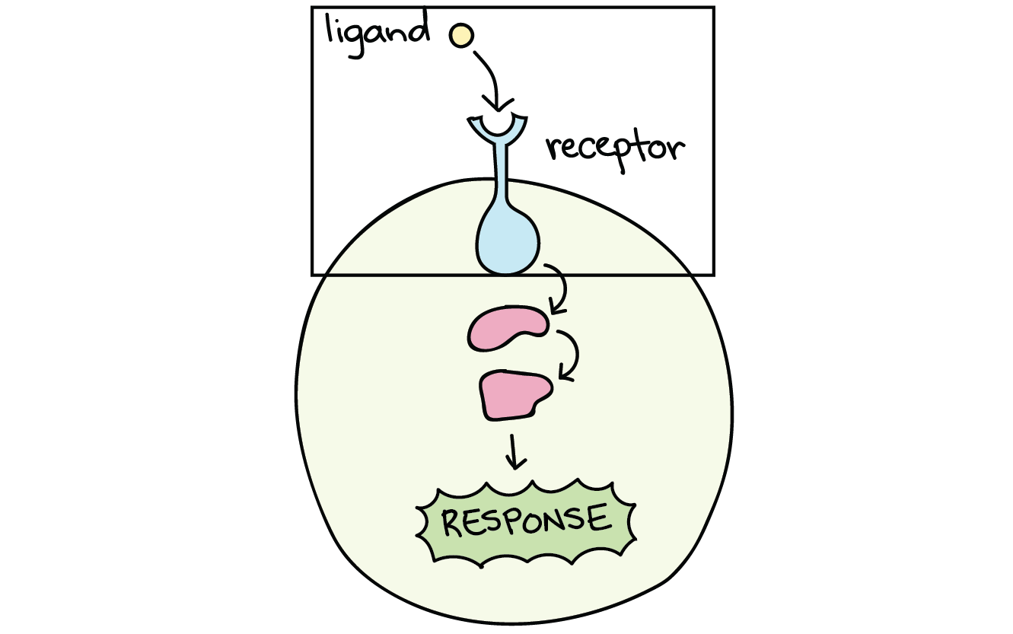
SIGNALING PATHWAYS
Signaling pathways are initiated when a signaling molecule (or ligand) binds to the receptor (s) of the cell membrane to form a ligand-receptor complex.

Slide 7
RECEPTORS
There are basically two classes of receptors.
Intracellular receptors, and
Cell surface receptors.

Slide 8
INTRACELLULAR RECEPTORS
These are found inside the cell, i.e. the cytoplasm or Nucleus.

Slide 9
Continued…
The ligands of intracellular receptors are usually;
Small
Hydrophobic

Slide 10
Examples of Ligands
Sex hormones such as;
Estradiol (an estrogen), and
Testosterone

Slide 12
MECHNISM OF ACTION
When, for example, a hormone enters the cell, and binds to the receptor, it causes the receptor to change shape. The change in shape allows the hormone-receptor complex to enter the nucleus and regulate gene activity.

Slide 13
CELL SURFACE RECEPTORS
These are membrane-anchored proteins that bind to ligands on the outside of surface of the cell.

Slide 14
Continued…
The ligands of these receptors can either be; small or hydrophilic (water-loving).

Slide 15
STRUCTURE
Typical cell-surface receptors have three domains, (or protein parts). These are;
Extracellular domain (outside the cell) – for ligand binding.

Slide 16
Hydrophobic domain – extends through the membrane.
Intracellular domain (inside of cell) – transmits a signal.

Slide 17
FOR EXAMPLE – STRUCTURE OF G-PROTEINS

Slide 18
EXAMPLES – CELL SURFACE RECEPTORS
LIGAND-GATED ION CHANNEL RECEPTORS
These are ion channels that can open in response to the binding ligand.
e.g.
Neurons or nerve cells have ligand-gated channels that are bound by neurotransmitters.

Slide 20
RECEPTOR TYROSINE KINASES OR PROTEIN KINASES
These are also called enzyme-linked receptors.
Definition: Receptor tyrosine kinases are a class of enzyme-linked receptors that transfer phosphate groups to the amino acid tyrosine.

Slide 21
Continued…
Examples of RTKs are GF (Growth Factors) such as;
PDGF (Platelet Derived Growth Factors.)
NGF (Nerve Growth Factors.)

Slide 22
Note: Growth factors are responsible for activities such as cell division and survival.

Slide 24
G-PROTEIN RECEPTORS

Slide 25
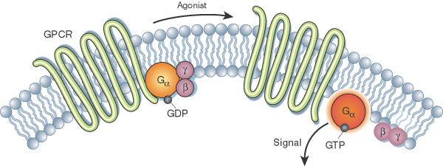
G-Protein receptors are the largest family of cell-surface receptors that are coupled with a G-protein. These receptors are called G-Protein Coupled Receptors (GPCRs).

Slide 26
OTHER NAMES FOR THE G-PROTEIN RECEPTORS
Seven (7) Trans-membrane domain proteins – 7TM
Serpentine Receptors
G Protein-Linked Receptors (GPLR)
Heptahelical Receptors

Slide 27
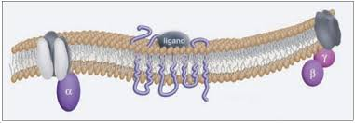
INTERESTING FACTS ABOUT GPCRs

Slide 28
They are the largest family of cell surface receptors.
They are the target for most of the available drugs on the market.

Slide 29
They have various types of ligands – odorants, hormones, pheromones, electromagnetic signals, ect.
They are found in eukaryotic cells.

Slide 30
Continued…
There are numerous different types of GPCRs—some 1,000 types are encoded by the human genome alone—and as a group they respond to a diverse range of substances, including light, hormones, amines, neurotransmitters, and lipids.

Slide 31
Some examples of GPCRs include;
beta-adrenergic receptors, which bind epinephrine;

Slide 33
prostaglandin E₂ receptors, which bind inflammatory substances called prostaglandins; and

Slide 34
rhodopsin, which contains a photoreactive chemical called retinal that responds to light signals received by rod cells in the eye.

Slide 35
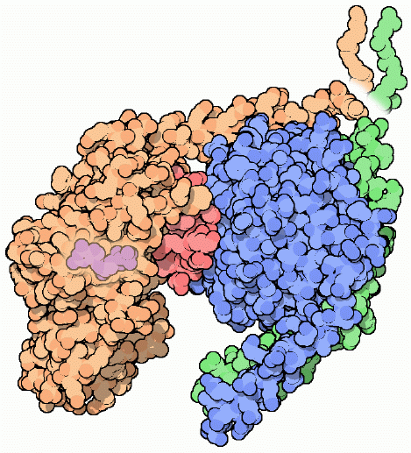
What do the GPCRs do?
They are linked with a 7TM protein called the G-Protein which is a type of intracellular signal receptor in cell signaling.

Slide 36
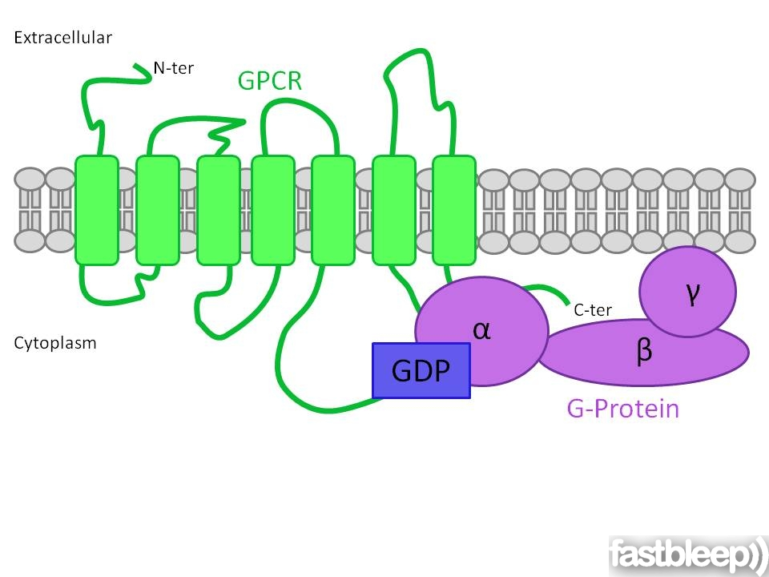
In-short, GPCRs are called thus because of the presence of the G-protein.

Slide 37
SO WHAT ARE G-PROTEINS?
G proteins are specialized proteins with the ability to bind the nucleotides guanosine triphosphate (GTP) and guanosine diphosphate (GDP).

Slide 38
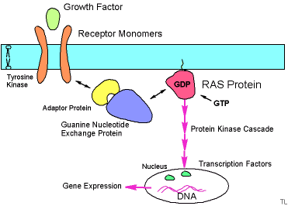
Some G proteins, such as the signaling protein Ras, are small proteins with a single subunit.

Slide 39
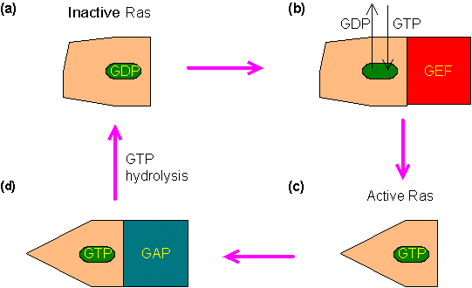
What does RAS G-protein DO?
Ras is a family of related proteins which is expressed in all animal cell lineages and organs.

Slide 40
All Ras protein family members belong to a class of protein called small GTPase, and are involved in transmitting signals within cells (cellular signal transduction).

Slide 41
When Ras is 'switched on' by incoming signals, it subsequently switches on other proteins, which ultimately turn on genes involved in cell;
Growth,
Differentiation and
Survival.

Slide 42
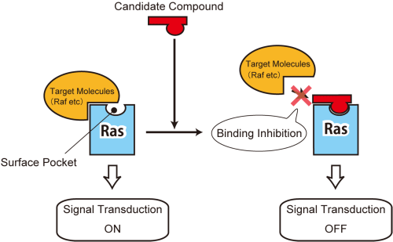
Mutations in ras genes can lead to the production of permanently activated Ras proteins.

Slide 43
As a result, this can cause unintended and overactive signaling inside the cell, even in the absence of incoming signals.

Slide 44
However, the G proteins that associate with GPCRs are heterotrimeric, meaning they have three different subunits: an alpha subunit, a beta subunit, and a gamma subunit.

Slide 46
Continued…
A diverse set of ligands bind to this type of receptor, including;
peptide hormones,
neurotransmitters, and
odor molecules.

Slide 48
HOW GPCRs WORK

Slide 50
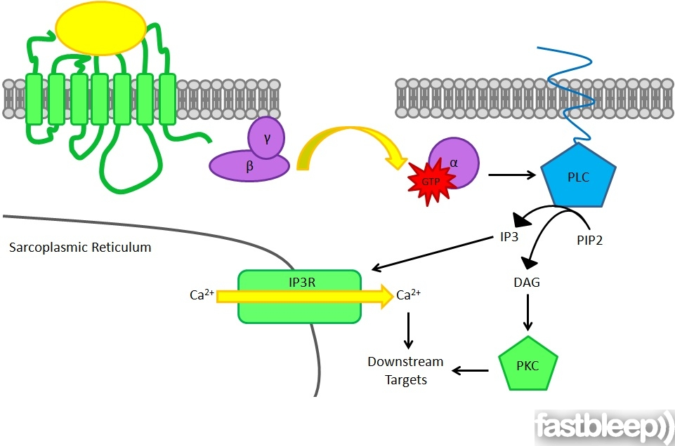

Slide 52
NOTE:
The G protein system plays a central role in many signaling tasks, making it a sensitive target for drugs and toxins.

Slide 53
Many of the drugs that are currently on the market, such as Claritin and Prozac, as well as a number of drugs of abuse, such as heroin, cocaine and marijuana, act at G-protein-coupled receptors in these signaling chains.

Slide 54
“ON” and “OFF”????

Slide 55
HOW DOES THE GDP to GTP exchange occur?

Slide 56
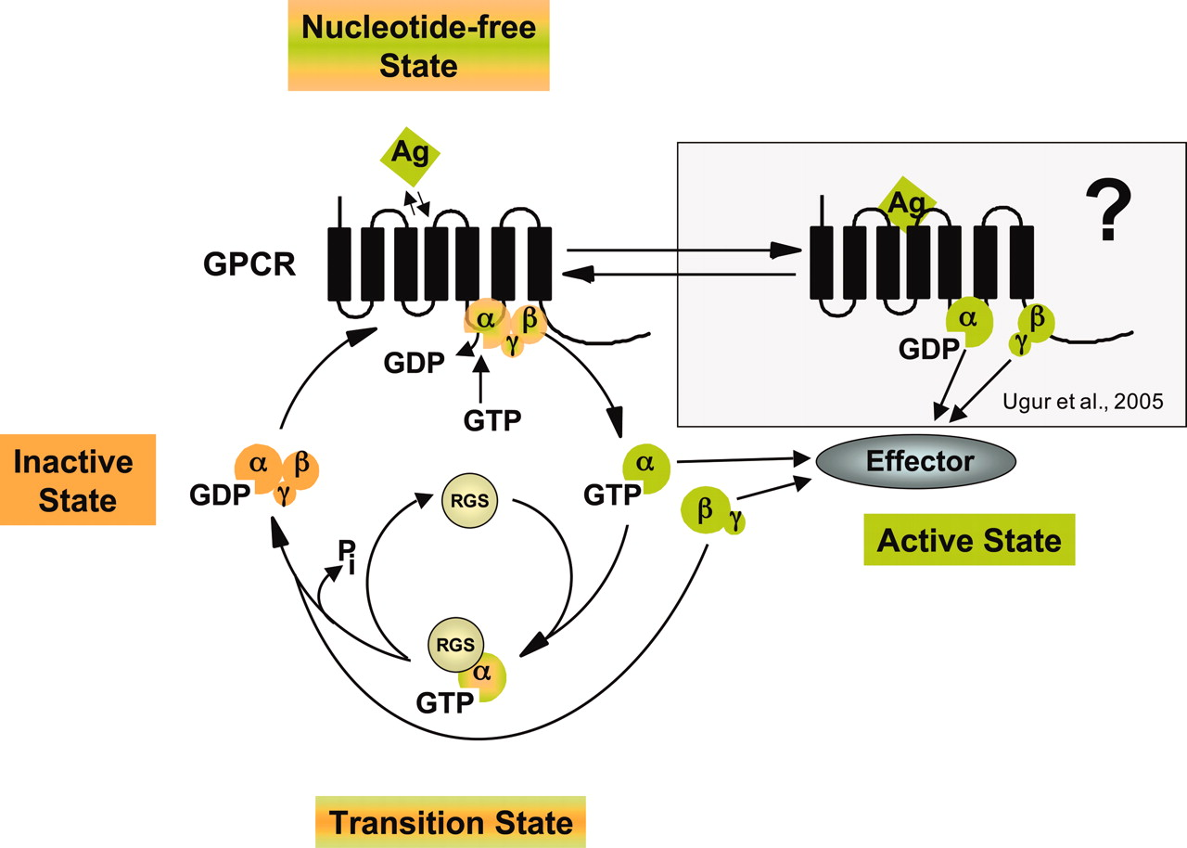
The alpha subunit exchanges GDP for GTP and dissociates from the beta-gamma complex

Slide 57
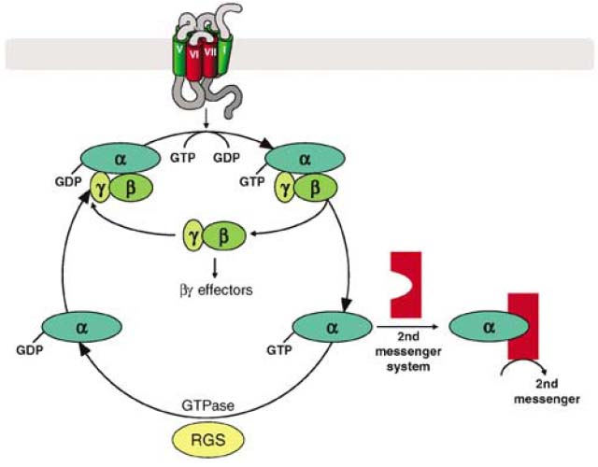
-Now the alpha subunit is ACTIVE and free to diffuse along the membrane

Slide 58
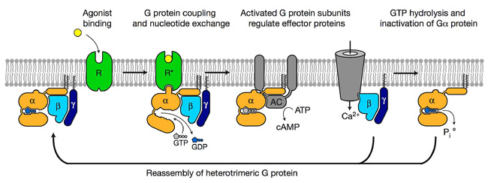
The GTPase activity of the alpha subunit causes the loss of GTP from the binding site in the alpha subunit, and another GDP binds, resetting the system

Slide 59
PATHWYAYS OF G-PROTEINS
There are two principal signal transduction pathways involving the G protein–coupled receptors:
the cAMP signal pathway and
the phosphatidylinositol signal pathway.

Slide 60
cAMP signal pathway

Slide 61
Continued…

Slide 63
The cAMP pathways has an advantage in that it amplifies signals through the enzyme adenylyl cyclase. This means even weak signals from outside the cell can be detected by the cell.

Slide 64
EXAMPLES OF SECOND MESSENGERS
Ca2+
cyclic AMP [cAMP],
diacylglycerol [DAG], and
inositol 1, 4, 5-triphosphate [IP3]

Slide 65
phosphatidylinositol signal pathway.
Phospholipase C is another common target of activated G proteins. This membrane-associated enzyme catalyzes the synthesis of not one, but two second messengers — DAG and IP3 — from the membrane lipid phosphatidyl inositol.

Slide 67
Continued…
This particular pathway is critical to a wide variety of human bodily processes. For instance, thrombin receptors in platelets use this pathway to promote blood clotting.

Slide 69
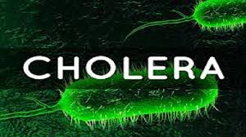
FAULTS IN THE GPCRs
An example is Cholera.

Slide 70
How does Cholera cause trouble?????

Slide 71
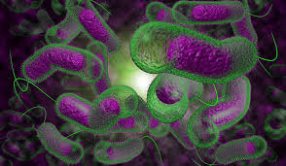
Cholera bacteria make a toxin that attacks G proteins directly, by attaching a nucleoside group in a strategic place.
This modification causes the G protein to be continually active.

Slide 72
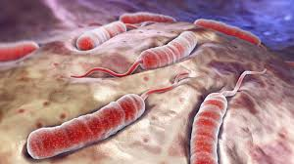
…this disrupts the normal controls on fluid balance in intestinal cells, and the infected person rapidly becomes dehydrated as water, sodium and chloride are lost.

Slide 73
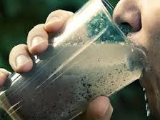

Slide 74
MORE EXAMPLES OF FAULTS IN GPCR
Whooping Cough
Night Blindness
Cholera
Alzheimer’s Disease
Hypertension
Cancers
Etc…

Slide 75
REFERNCES
Khanacedemy (2017). Ligand and Receptors. Retrieved from:
https://www.khanacademy.org/science/biology/cell-signaling/mechanisms-of-cell
Kara Rogers (2017). G protein-coupled receptor. Encyclopedia Britannica. Retrieved from:
https://www.britannica.com/science/G-protein-coupled-receptor
Wikipedia (2017). G protein-coupled receptor. Retrieved from:
https://en.wikipedia.org/wiki/G_protein%E2%80%93coupled_receptor
Interpro (2017). G protein. Retrieved from: https://www.ebi.ac.uk/interpro/potm/2004_10/Page2.htm
Nature (2017). GPCR. Retrieved from: http://www.nature.com/scitable/topicpage/gpcr-14047471
S. R. Sprang (1997) G protein mechanisms: insights from structural analysis. Annual Review of Biochemistry 66, 639-678.
H. R. Bourne (1997) How receptors talk to trimeric G proteins. Current Opinion in Cell Biology 9, 134-142.

