Slide 1
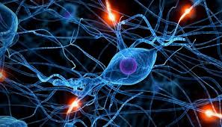
CELL SIGNALING
BIOC 142

Slide 2
Lecturer:
MR. W. KABISWA,

Slide 3
PRESENTATION BY
MUUNDA MUDENDA
15/BSB/BU/R/0004

Slide 4
TOPIC:
DISCUSS ENDOCRINE SIGNALLING.

Slide 5
GOALS…!!!
Discuss Briefly About Cell Signaling.
Define Endocrine Signaling.
Discuss The Mechanisms In Endocrine Signaling.
Give Examples Of Endocrine Signaling And How They Work.
Give Importance Of Endocrine Signaling.

Slide 6
Introduction
1. Proper body functioning requires that the body should be able to; respond to communications from both the internal and external environment.

Slide 7
This communication within cells, among cells or between cells is what is called “cell signaling.”

Slide 8
An overview of cell signaling

Slide 9
Cells can respond to different types of signals; chemical, mechanical, electromagnetic, etc.
In order to communicate one cell sends the message and the other cell (s) receives the message.

Slide 10
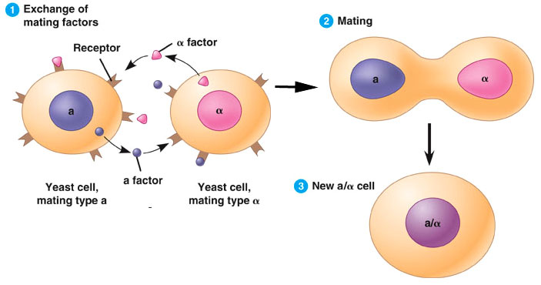
In a typical communication between cells, the signaling cell produces a particular type of signal molecule that is detected by the target cell.

Slide 15
SO WHAT CAN WE CONCLUDE?
Cell signaling is simply a phrase to mean cell communication.
It requires;
A sending Cell
A Receiving cell (target cell), and
A signal molecule (s), also called ligands.
Cell signaling involves three major steps;
Reception
Transduction (interpretation)
Response

Slide 16
Note:
Communication is defined as the process of sending (encoding) and receiving (decoding) messages. In proper communication there is feedback (response).

Slide 17
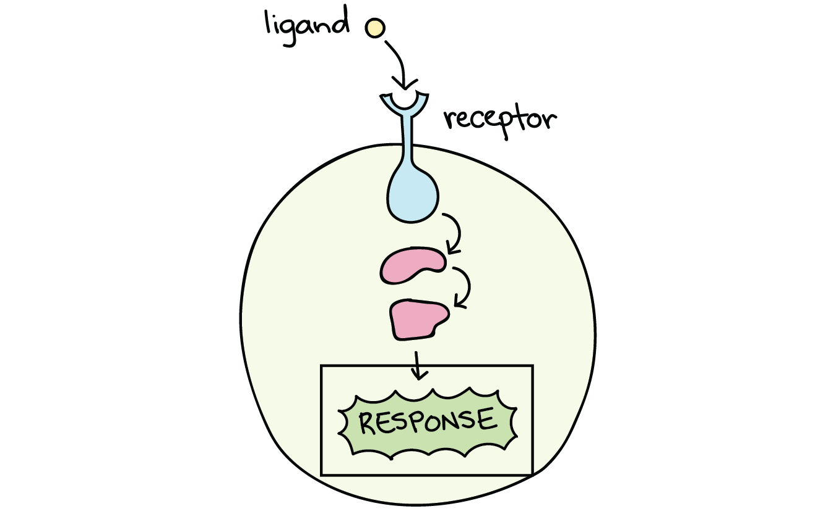
Continuation…
A message received but without feedback causes communication breakdown.

Slide 18
Examples of cell signaling responses include;
Increase in transcription of particular genes – proteins.
Cell growth – division.
Cell death – apoptosis.
Menstrual cycle triggered.
Production of more energy.
Ect….

Slide 19
Further more;
From the external environment we receive a variety of signals by means of our senses: eyes, light; ears, sound; nose, odors; tongue, taste; and skin, touch.

Slide 20
In our internal environment, however, there are but two ways of signaling — chemical and electrical.

Slide 21
HOMEOSTASIS
Homeostasis happens to be the core of cell signaling.

Slide 22
…the term homeostasis…defined…as “The body’s collective communication and control effort to maintain constant, healthy internal conditions.”

Slide 23
Homeostasis is the core goal of all physiological activity and depends on the ability of every cell to send and receive communications.

Slide 24
All cells participate in many homeostatic signal loops; that is, they both transmit and receive signals that help maintain the body in good health.

Slide 25
Note:
Cells can communicate using different methods;
Paracrine
Juxtacrine
Endocrine
Autocrine
Intracrice
Exocrine, etc…
The method of communication depends on the proximity (the distance the message is to travel to cause an effect).

Slide 26
FOR EXAMPLE

Slide 27
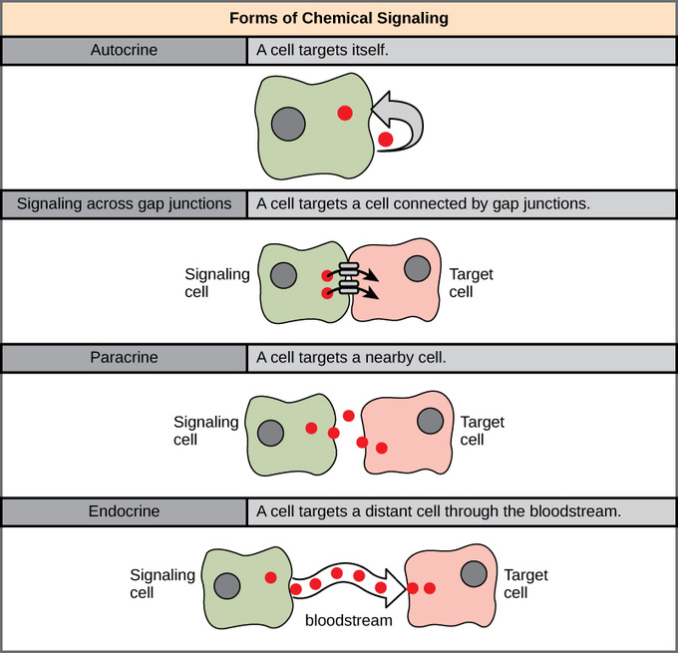

Slide 28
ENDOCRINE SIGNALLING

Slide 29
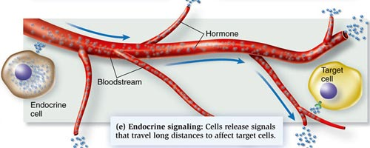

Slide 30
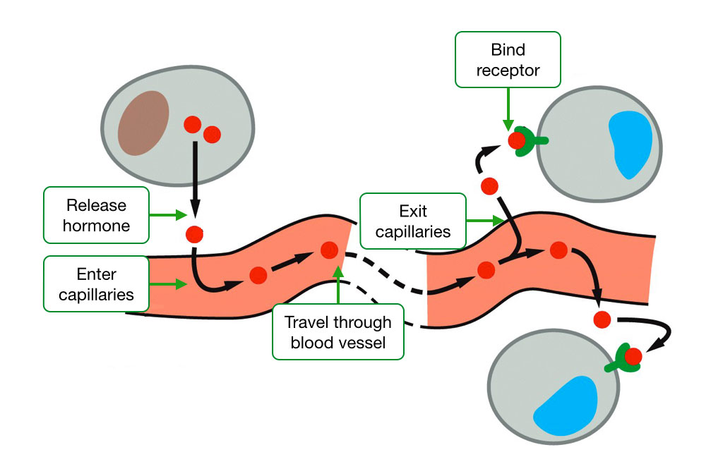

Slide 31
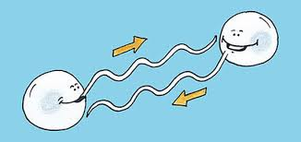
What is endocrine signaling?
This is a type of cell communication occurring between distant cells and is mediated by hormones.

Slide 32
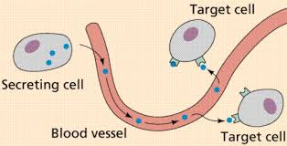
The hormones are released by specific cells of the body to particular target cells and they cause slow but long-lasting responses.

Slide 33
THE ENDOCRINE SYSTEM
The key organs in endocrine signalling are glands. Glands are the target for signals, often coming from the brain. In response to these signals they will release the appropriate hormone.

Slide 34
A gland involved in endocrine signalling specifically releases hormones into the bloodstream. Examples of glands include the islets of Langerhans in the pancreas, and the thyroid gland.

Slide 36
The endocrine system mostly starts in the area of the brain known as the hypothalamus. When a particular response is required, the hypothalamus releases a signal.

Slide 37
This signal will usually be targeted to another area of the brain, the pituitary gland.

Slide 38
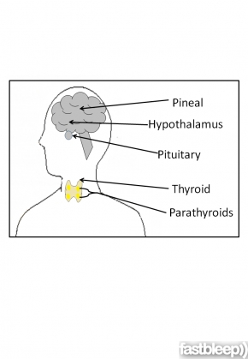
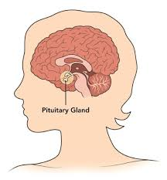
The pituitary gland interprets the signal and then itself releases the appropriate chemical signal, usually a hormone.

Slide 39
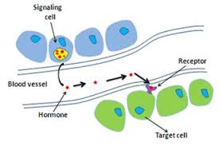
This signal will then travel through the body via the bloodstream to reach its required destination, which will be a gland.

Slide 40
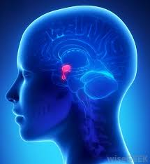
The gland then responds to the signal from the pituitary to secrete a particular hormone into the bloodstream. This will produce a response in the body.

Slide 41
HORMONES
The ligands of endocrine signaling are the Hormones.

Slide 43
RAVEN HAS THIS TO SAY…
A hormone is a regulatory chemical that is secreted into the blood by an endocrine gland or an organ of the body exhibiting an endocrine function.

Slide 44
CONTINUED…
The blood carries the hormone to every cell in the body, but only the target cells for a given hormone can respond to it.

Slide 45
Hormones secreted by endocrine glands belong to four
different chemical categories:

Slide 46
1. Polypeptides.
These hormones are composed of chains of amino acids that are shorter than about100 amino acids. Some important examples include insulin and antidiuretic hormone (ADH).

Slide 47
2.Glycoproteins.
These are composed of a polypep-tide significantly longer than 100 amino acids to which is attached a carbohydrate.

Slide 48
Examples include;
follicle-stimulating hormone (FSH) and
luteinizing hormone (LH).

Slide 49
3. Amines.
Derived from the amino acids tyrosine and tryptophan, they include hormones secreted by the adrenal medulla, thyroid, and pineal glands.

Slide 50
4. Steroids.
These hormones are lipids derived from cholesterol, and include the hormones testosterone, estradiol, progesterone, and cortisol.

Slide 52
MORE ABOUT STEROIDS AND PEPTIDE HORMONES
Steroid hormones:
these are lipids formed from cholesterol. They travel around the body bound to carrier proteins as they are water-insoluble. Once they have entered the target cell, they bind directly to nuclear receptors, which then travel into the nucleus.

Slide 53
These hormones directly regulate gene expression of target genes. Examples include cortisol and oestrogen.

Slide 54
Peptide hormones:
these are made from strings of amino acids. They are often made in the cell in advance and packaged into secretory vesicles until the signal is received for them to be released via exocytosis.

Slide 55
Peptide hormones are often made in a longer form (called pre-hormone or pre-pro-hormone) which are then cleaved to create the mature form. When released, they will bind to cell-surface receptors and trigger a response inside the target cell.

Slide 56
Peptide hormones usually bind to G-protein coupled receptors (GPCR) or tyrosine kinase receptors. Examples of peptide hormones include insulin, ACTH and thyroid stimulating hormone (TSH).

Slide 57
HOW THEN DOES ENDOCRINE SIGNALING HAPPEN?

Slide 58
ILLUSTRATION…

Slide 59
ENDOCRINE PATHWAYS

Slide 60
Endocrine pathways?
These are the various routes, or paths, that hormones take from the glands to the target cells in the body. Different hormones take different routes and cause different effects.

Slide 61
Examples of endocrine pathways include;

Slide 62
THYROID SIGNALING
Function:
metabolic control (conversion of food to energy). The thyroid hormones T4 and T3 require iodine to function. A lack of iodine can lead to thyroid-related diseases.

Slide 63
Hormone released from the hypothalamus: thyrotropin releasing hormone (TRH).
Hormone released from the pituitary gland: thyroid stimulating hormone (TSH).

Slide 64
Key gland and hormones:
thyroid gland. Releases thyroxine (T4) which is converted to its active form triiodothyronine (T3) in the target tissue.

Slide 65
Target tissues: many, including;
liver
kidney
heart
CNS
skeletal muscle, and
pituitary.

Slide 66
Signaling mechanism:
T3 and T4 function much like steroid hormones, in that they require binding proteins for transport around the bloodstream.

Slide 67
Continued…
The hormones usually travel around the body as T4 bound to a carrier protein such as thyroxine binding globulin or albumin.

Slide 68
When they reach the target tissue, T4 is released from the binding protein and travels into the cell. It is then converted to T3 by iodothyronine deiodinase.

Slide 69
T3 binds to the nuclear steroid receptor and this travels as a complex into the nucleus where the hormone directly regulates gene transcription.

Slide 71
Pancreatic hormones: insulin
The endocrine cells in the pancreas are called the islets of Langerhans. Specific endocrine cells include;
1.the alpha-cells which release glucagon,

Slide 72
2.beta-cells, which are responsible for the release of insulin, and
3.C-cells, which release somastatin.

Slide 73
Insulin happens to be the most famous pancreatic hormone whose role is to regulate glucose levels in the blood.

Slide 74
HOW DOES INSULIN HORMONE WORK?
What is important to note is that….
Glucose, binds to the GLUT2 receptor displayed on the surface of the beta cells.

Slide 75
1. Upon receiving the signal that glucose is present the beta-cells mobilize their pre-existing stocks of insulin, which are found packaged into secretory vesicles.

Slide 76
2. This mobilization happens due to the closing of potassium channels by the downstream response to the GLUT2 receptor, which includes the release of ATP.

Slide 77
3. The closing of the potassium channels causes depolarization of the cell and triggers calcium channels to open. The influx of calcium into the cell moves the insulin granules to the cell surface. Insulin will then be released from the cell.

Slide 78
4. Insulin acts on the liver, where it triggers the conversion of glucose to its storage form glycogen. It also acts on adipose (fat) tissue where it converts glucose to fat, and in muscles where glucose is converted to amino acids.

Slide 79
Note:
Glucagon, released from the alpha-cells, has the opposite effect to insulin and is released when glucose levels are low. Glucagon therefore triggers the production of glucose from stores such as glycogen.

Slide 80
Other glands and hormones
Pineal:
found buried deep in the brain. Reponsible for the production of melatonin, an important hormone for circadian (time-dependent) rhythms. It is responsive to changes in light.

Slide 82
2. Ovaries/testes:
responsible for the release of the sex steroids (also called gonadotrophins), oestrogen and testosterone (small amounts of these are also secreted from the zona reticularis of the adrenal cortex).

Slide 83
CONTINUED…
These are steroid hormones and are responsible for sexual development as well as secondary sexual characteristics such as facial and body hair.

Slide 84
They are released in response to gonadotrophin releasing hormone (GnRH) from the hypothalamus and follicle stimulating hormone (FSH) and luteinising hormone (LH) from the pituitary.

Slide 85
4. Parathyroid:
found adjacent to the thyroid gland. Responsible for the release of parathormone, whcih helps to maintain calcium homeostasis throughout the body.

Slide 86
5. Thymus:
found in the chest. Responsible for the release of the hormone thymosin, which is important for development of the immune T cells. The thymus is only functional as an endocrine gland until puberty.

Slide 87
6. Growth hormone:
released from the pituitary in response to growth-hormone releasing hormone (GHRH) from the hypothalamus.

Slide 88
It is a peptide hormone which signals through the janus-kinase-signal transducer and activation of transcription (JAK-STAT) pathway (tyrosine kinase receptors).

Slide 89
Targets the liver to release insulin-like growth factor-1 (IGF-1). Responsible for growth in adolescence as well as bone mass, protein and carbohydrate metabolism.

Slide 90
DISORDERS IN ENDOCRINE SIGNALING
Pituitary tumors: overgrowth of cells or over-secretion of hormones from this gland can lead to several disorders, including;
Cushing's syndrome: ACTH over-secretion (see below).

Slide 91
CONTINUED…
Gigantism: growth hormone over-secretion. Dwarfism can be caused by a lack of growth hormone.

Slide 92
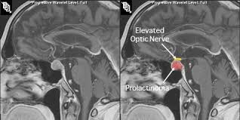
Prolactinoma: causes lactation and amenorrhoea (menstruation stops) - prolactin over-secretion. This is the most common type of pituitary tumor.

Slide 93
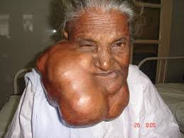
2. Thyroid disorders
Goitre: enlarged thyroid, causing swelling of the neck. Caused by lack of iodine (endemic goitre) or mutations in the thyroid signaling system, such as the TSH-receptor (toxic goitre)

Slide 94
Grave's disease: an overactive thyroid caused by antibodies binding to or stimulating the TSH receptor leading to stimulation of thyroid hormones without the signal. Symptoms include protruding eyes, muscle wasting, tremor and heat intolerance.

Slide 95
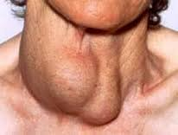
Hashimoto's thyroiditis: underactive thyroid due to destruction of the follicular cells of the thyroid. Symptoms include weight gain, depression and memory loss.

Slide 96
3. Adrenal disorders
Cushing's syndrome: caused by a pituitary tumour oversecreting ACTH, which in turn leads to an overproduction of cortisol from the adrenal glands. Symptoms vary but can include "moon face", "buffalo hump", diabetes, truncal obesity, osteoporosis, easy bruising, poor wound healing.

Slide 97
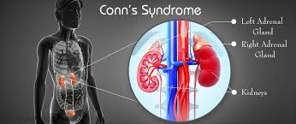
Conn's syndrome: overproduction of aldosterone, sometimes due to an adrenal tumor. Symptoms include hyperkalaemia (high levels of potassium in the blood), muscle weakness and hypertension (high blood pressure).

Slide 98
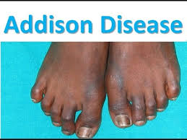
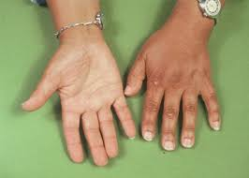
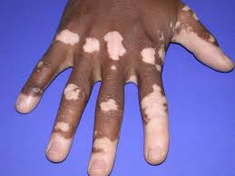
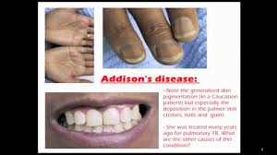
Addison's disease: underproduction of aldosterone due to damage to the adrenal tissue (either through infarction (tissue death) or removal of adrenal glands in surgery). Symptoms include faintness and and hypotension (low blood pressure).

Slide 99
3. Pancreatic disorders
Diabetes mellitus Type 1 (a.k.a. juvenile-onset diabetes): this is caused by a destruction of the beta-cells of the pancreas, either by a virus or an autoimmune attack (by the body's own immune cells).

Slide 100
This results in a total lack of insulin, which could be very dangerous. It is treated by injections of insulin, usually a recombinant human form of the protein.

Slide 101
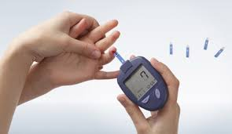
Diabetes mellitus Type 2: This occurs when the cells which are normally responsive to insulin stop recognising it due to a problem with the insulin receptors.

Slide 102
In Type 2 diabetes, the insulin is produced and released as normal, but it has less of an effect. It often occurs in patients who are obese. It can be controlled by diet and exercise.

Slide 103
IN SUMMARY
Endocrine signaling is very important for normal body functioning. Any imbalance in hormonal levels in the body could lead to very serious disorders – disease.

Slide 104
REFERENCES;
Fastbleep. (2017). Endocrine signaling. Retrieved from: https://www.fastbleep.com/biology-notes/31/997
Alberts et al, (2002) "Molecular Biology of the Cell" (4th Edition) Garland Science
Lodish et al, (2003) "Molecular Cell Biology" (5th Edition) W.H. Freeman
Mayer et al (2007) "Insulin Structure and Function" Peptide Science 88 (5) 687-713
Lisurek and Bernhardt (2004) "Modulation of aldosterone and cortisol synthesis on the molecular level" Molecular and Cellular Endocrinolgy 215 (1-2) 149-159

