Slide 1
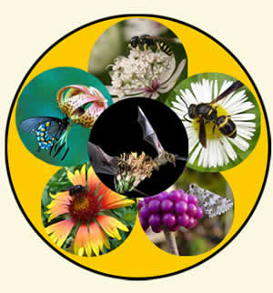
Making Pollinator Habitat
Your
Personal
Pollinator
Paradise

Slide 2
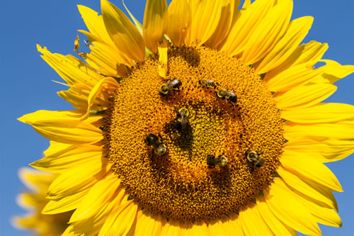
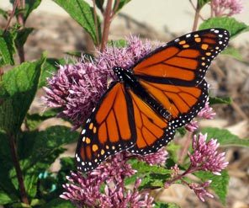
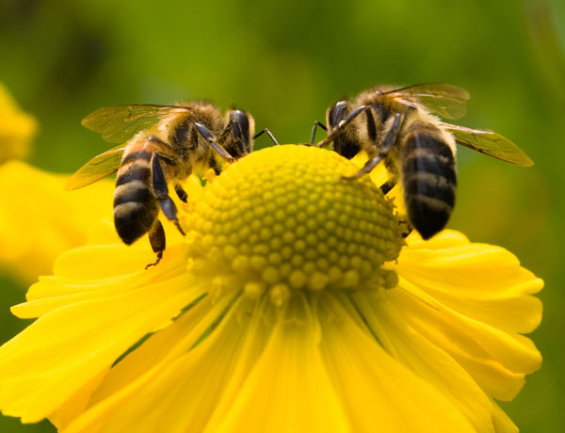
Defining your goal
What kind of pollinators are you trying to create habitat for?
What are the needs of each pollinator?
Which plants will provide food & habitat?
Will the plants thrive in your yard?
What else can you do to support pollinators in your yard?

Slide 3
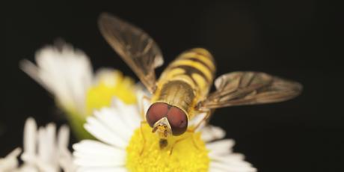
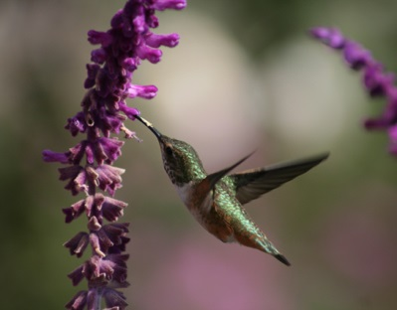
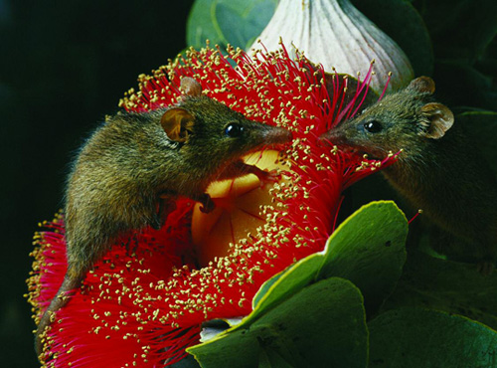
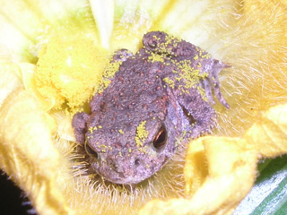
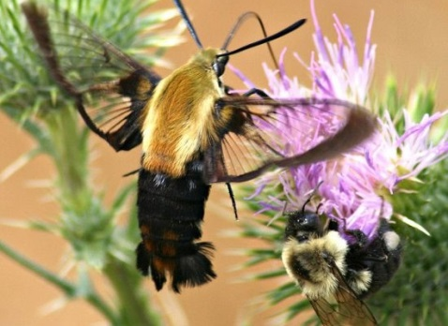
Which Pollinator
Pollinators can be found in nearly every class of animal from birds and insects to mammals and amphibians, all with different nutrition and habitat needs
946 documented native bee species in Colorado
More than 250 species of native butterflies
Many moths, flies, beetles and birds are all native pollinators

Slide 4
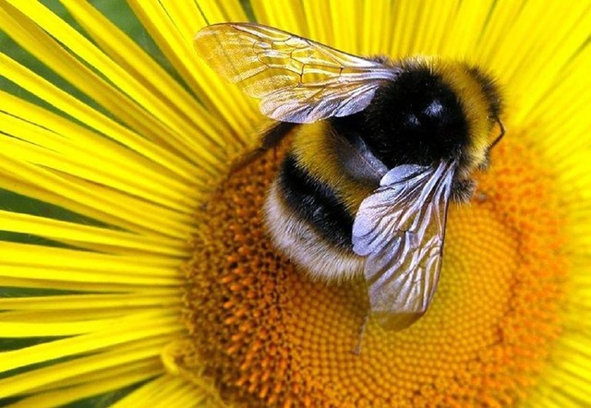
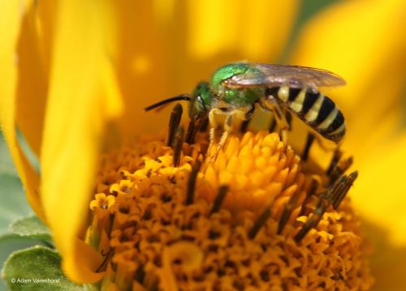
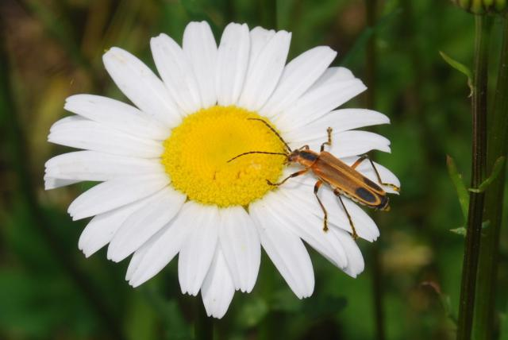
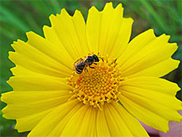
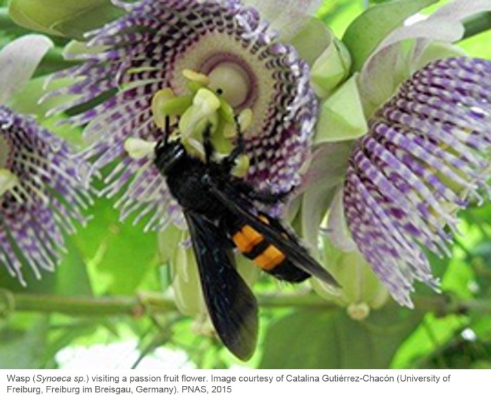
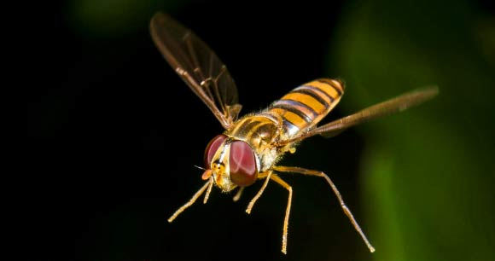
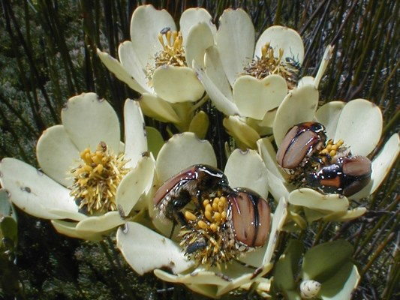

Slide 5
Pollinator needs
Shelter
Where do they live/nest?
Food
What do the adults and their young eat?
Water
Too much or too little, think Goldie Locks
Security
Is your yard harboring something that will eat them or compete for resources?

Slide 6
Which Plants to Plant
Determine when the pollinators need food and which kind
Some will only collect food during a very brief window during the year
Some need a food source for their young and will only pollinate once they are adults
Some are great natural predators of pests during one phase of life and pollinators during another
Some are actually pests when young and pollinate later

Slide 7
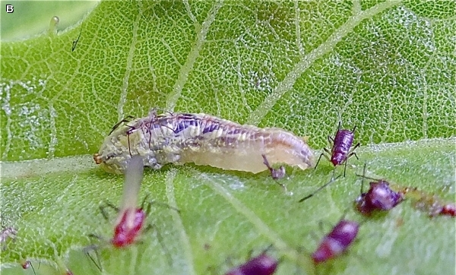
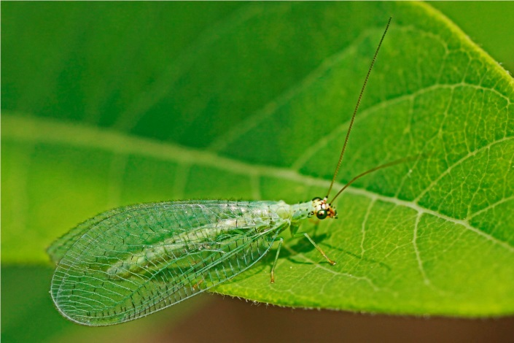
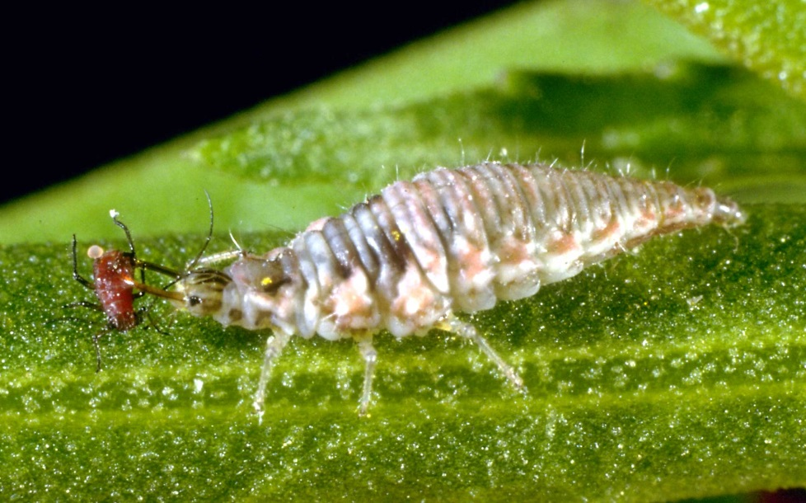
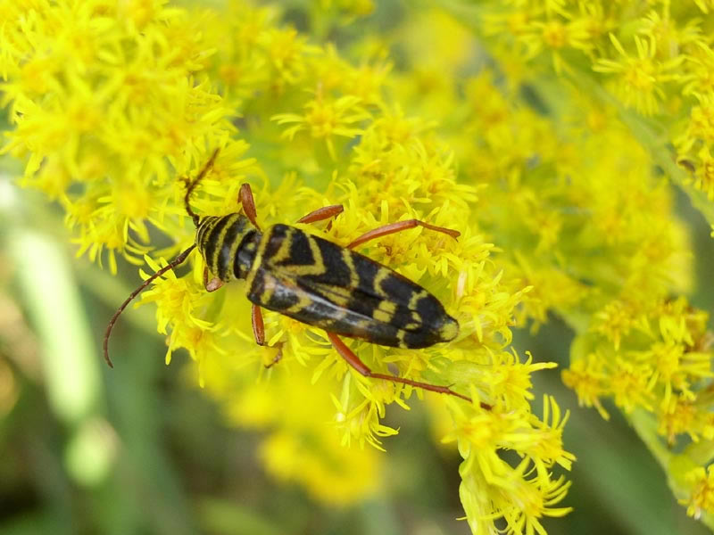
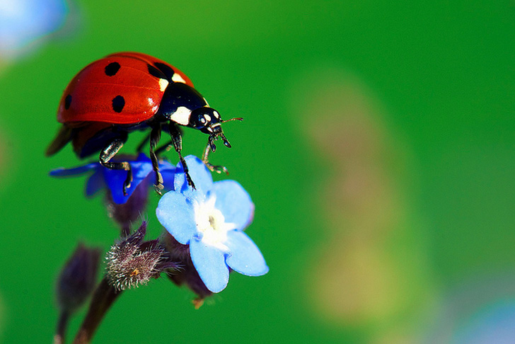
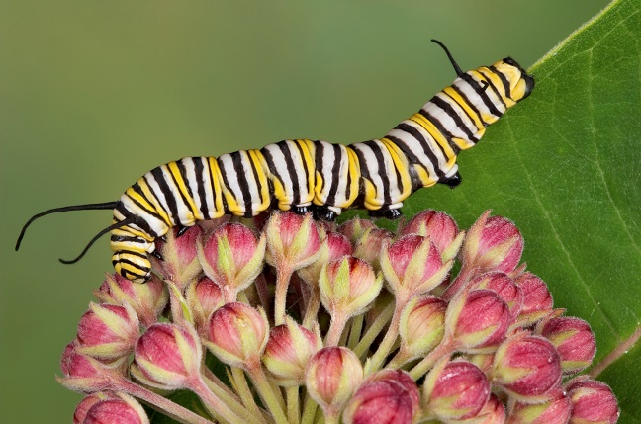
Which Plants to Plant

Slide 8
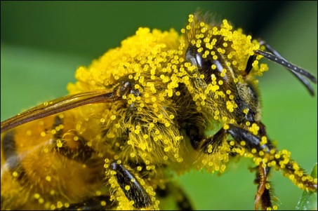
Plants for Honeybees
Honeybees forage for nectar and pollen from early Spring to Fall
Plant a variety of plants that bloom during different seasons
Plants with open flowers give a landing space for bees and easy access to the nectar and pollen
Planting “drifts” of the same plant will encourage bees to forage in them
Plants with high pollen levels but low nectar are not optimal forage for bees but better than none

Slide 9
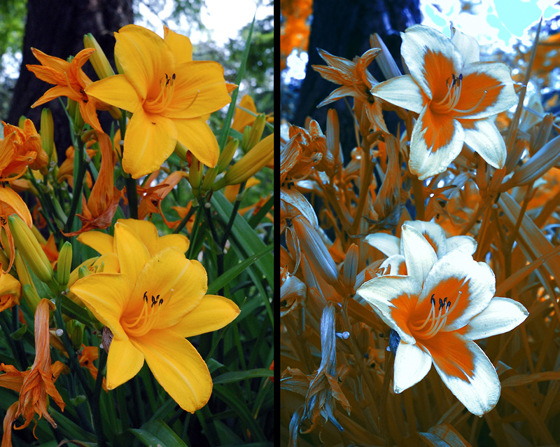
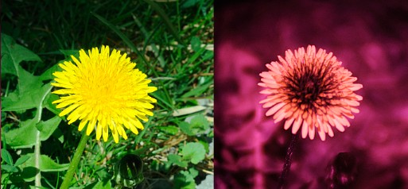
Plants for Honeybees
Bees do not see the same spectrum of light that we do, they see toward the ultra violet spectrum
Plants with white, blue and yellow flowers catch their attention because of the way they reflect UV light
Many flowers that appear to be one color to us are quite different to a bee

Slide 10
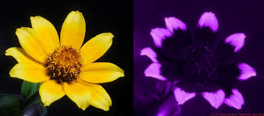
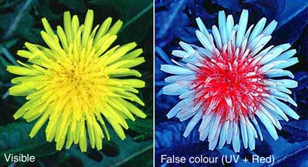
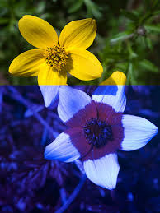
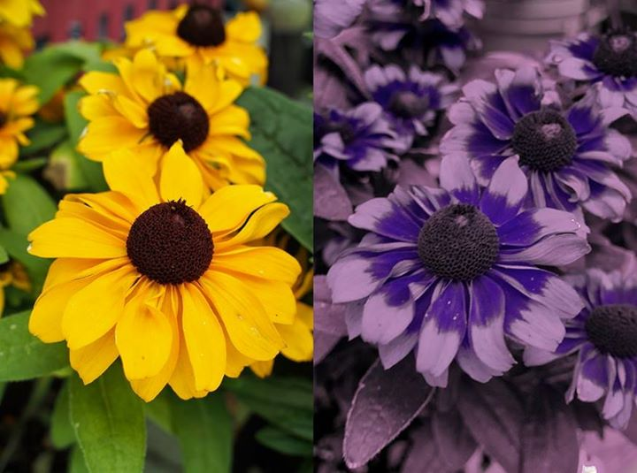
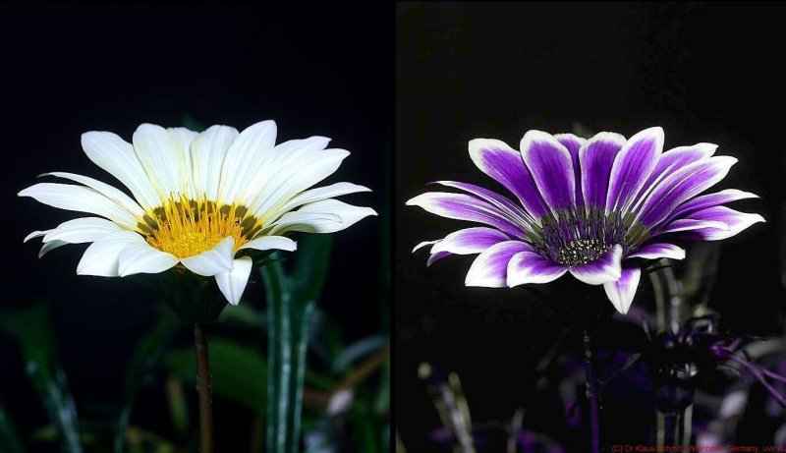
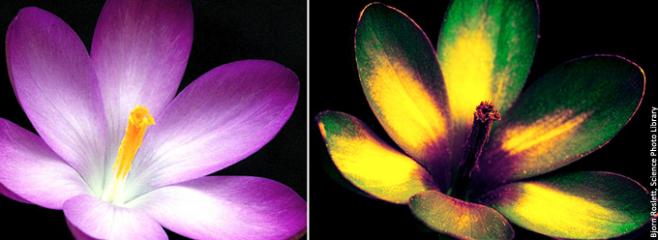
Plants for Honeybees

Slide 11
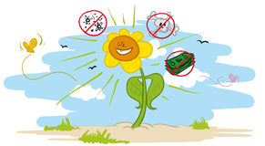
Selecting Plants to Thrive
Stressed out plants tend to be sick plants
They will have more pests
They require treatments to keep them going
They will not produce the same quantity or quality of food for the pollinators
They will need to be replaced which means they will rarely reach their full potential and cost you more money
Happy plants just look better and everyone wants to look better, right?

Slide 12
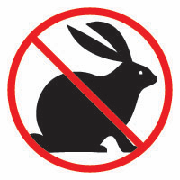
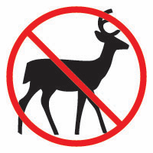
Selecting Plants to Thrive
Know the conditions of your garden spaces (they are not all the same)
When selecting plants be sure to match the sun and moisture exposure of the space to the plant
Pay attention to how large the plant will be
There’s no use in planting a shrub or tree that you will have to prune to make it fit a space
Keep an eye on your plants
Often small changes in how they are cared for can make all the difference
Young plants that are not happy can usually be moved to a better spot

Slide 13
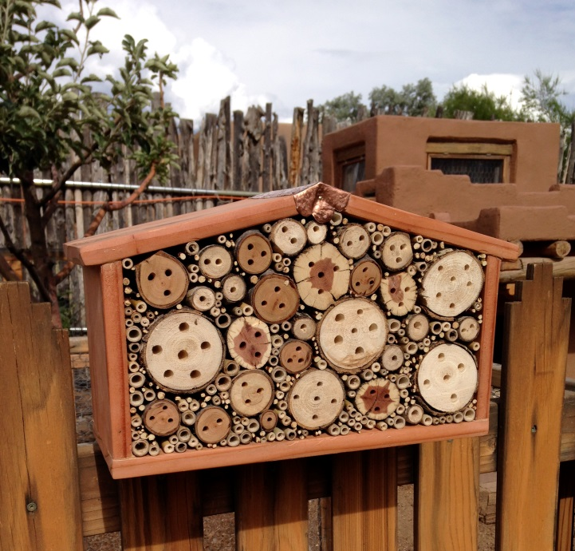
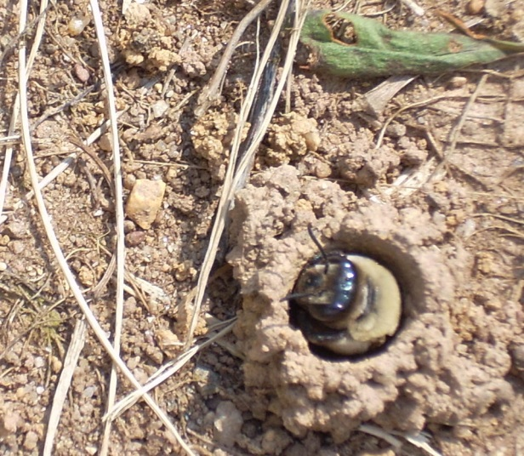
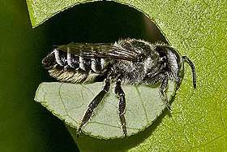
Other Support for Pollinators
Give them the home they want
Hive boxes, empty tubes, bare ground, correct host plants and plenty of food can all help

Slide 14
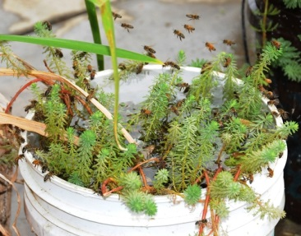
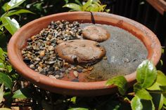
Other Support for Pollinators
Give them water
Many pollinators need a source of clean water and if you don’t have it they will leave to find it

Slide 15
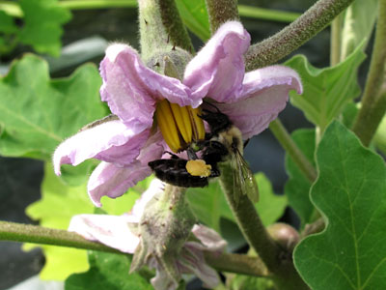
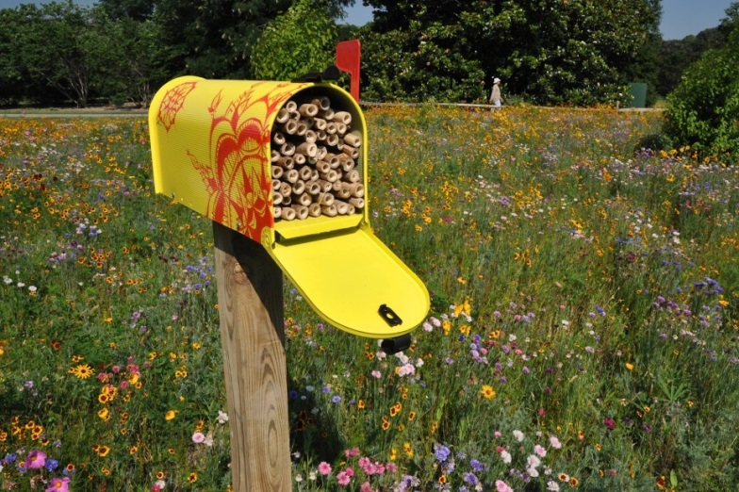
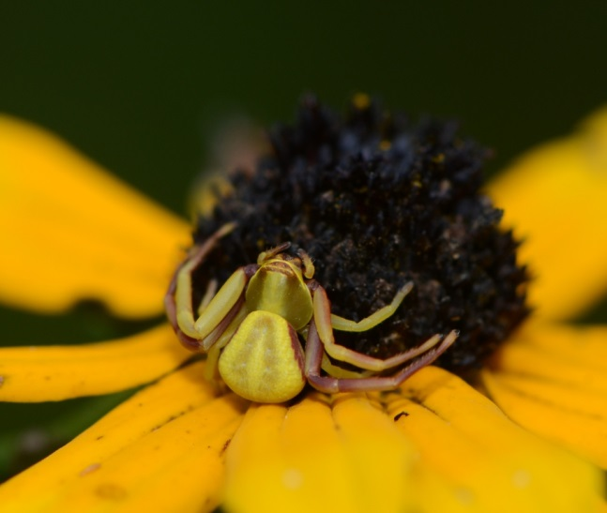
Other Support for Pollinators
Give them security
Reduce the number of predators they have to contend with, but remember some are good
Reduce competition by providing multiple food sources and keeping the plants healthy

Slide 16
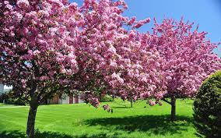
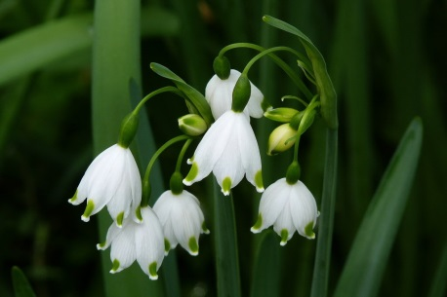
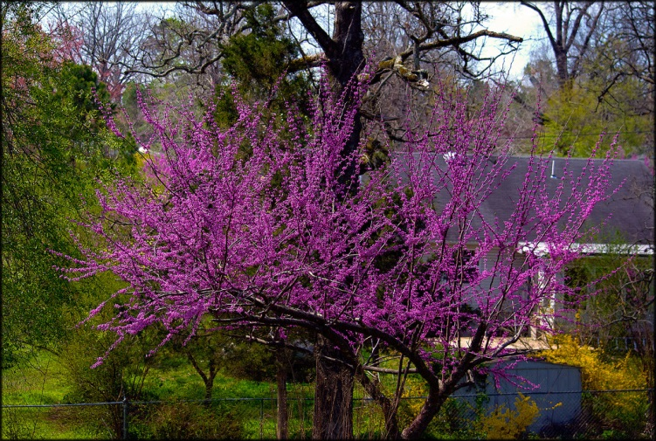
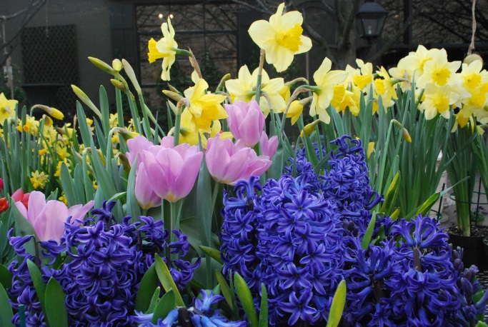
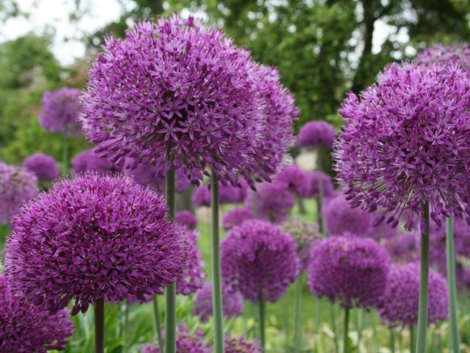
Pollinator Plants- Spring
Spring flowering trees are some of the very first flowers to appear and usually in large numbers
Maple, Apple, Plum, Pear, Cherry, Redbud, Hawthorn, Honey Locust
Spring bulbs are the next flowers you can provide for pollinators, they are cheap and easy to care for
Crocus, Hyacinth, Tulip, Daffodil, Allium, lily of the Valley, Squilia

Slide 17
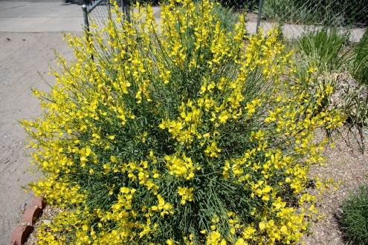
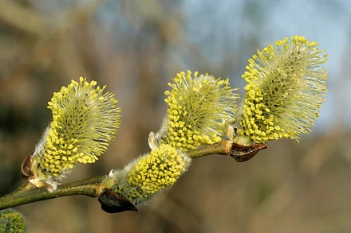
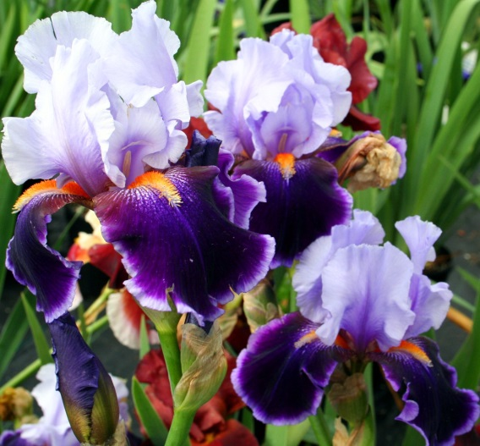
Pollinator Plants- Spring
Spring perennials offer a great source of forage
Broom, Penstemon, Salvia, Foxglove, Primrose, Peony, Scabiosa, Iris, Dianthus
Spring flowering shrubs carry the bloom along
Nine bark, Forsythia, Lilac, Daphne, Viburnum, Pussy Willow, Cistene Plum, Nanking Cherry, Blueberry, Cotoneaster, Pyracantha, Magnolia, Privet, Barberry, Flowering Quince

Slide 18
Pollinator Plants- Summer
Summer perennials offer a wide variety
Thyme, Sedum, Ice Plant, Butterfly Weed, Dahlia, Blanket Flower, Daylily, Delphinium, Clematis, Wisteria, Mint, Coneflower, Bee Balm, Hyssop, Lavender, Coreopsis, Russian Sage, Astilbe, Yarrow, Water lily
Summer flowering shrubs
Rose, Butterfly Bush, Mock Orange, Spirea, Potentilla, Rose of Sharon, Hydrangea, Honeysuckle
Summer trees
Linden, Golden Raintree, Pagoda Tree, Buckeye, Catalpa, Horse Chestnut

Slide 19
Pollinator Plants- Summer
Summer annuals
Squash, Tomato, Pepper, Basil, Borage, Sunflower, Zinnia, Eggplant, Melons, Bean, Cucumber, Dill, Tomatillo, Cosmos, Coleus, Salvia, Rudbeckia, Moss Rose, Poppies,

Slide 20
Pollinator Plants- Fall
Fall Blooming Perennials
Aster, Goldenrod, Mums, Crocus, Toad Lily, Anemone
Many of the Spring and Summer blooming plants will bloom again, or still be blooming, in the Fall
Be sure to remove spent flowers from your perennials and annuals, this will encourage them to bloom continuously throughout the year

